Slide 1

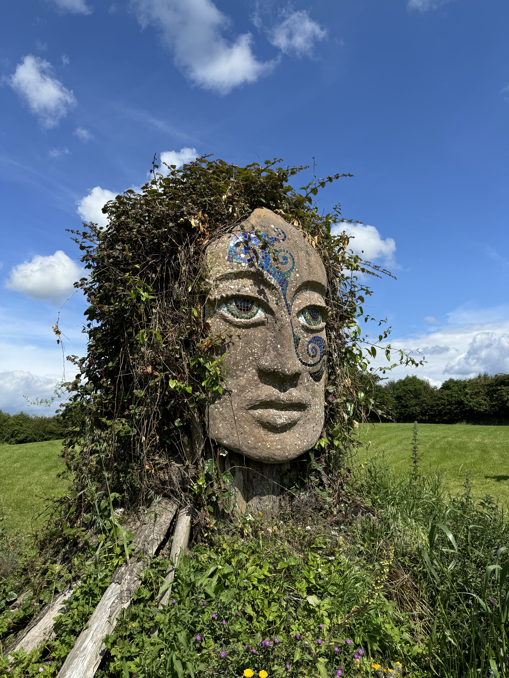
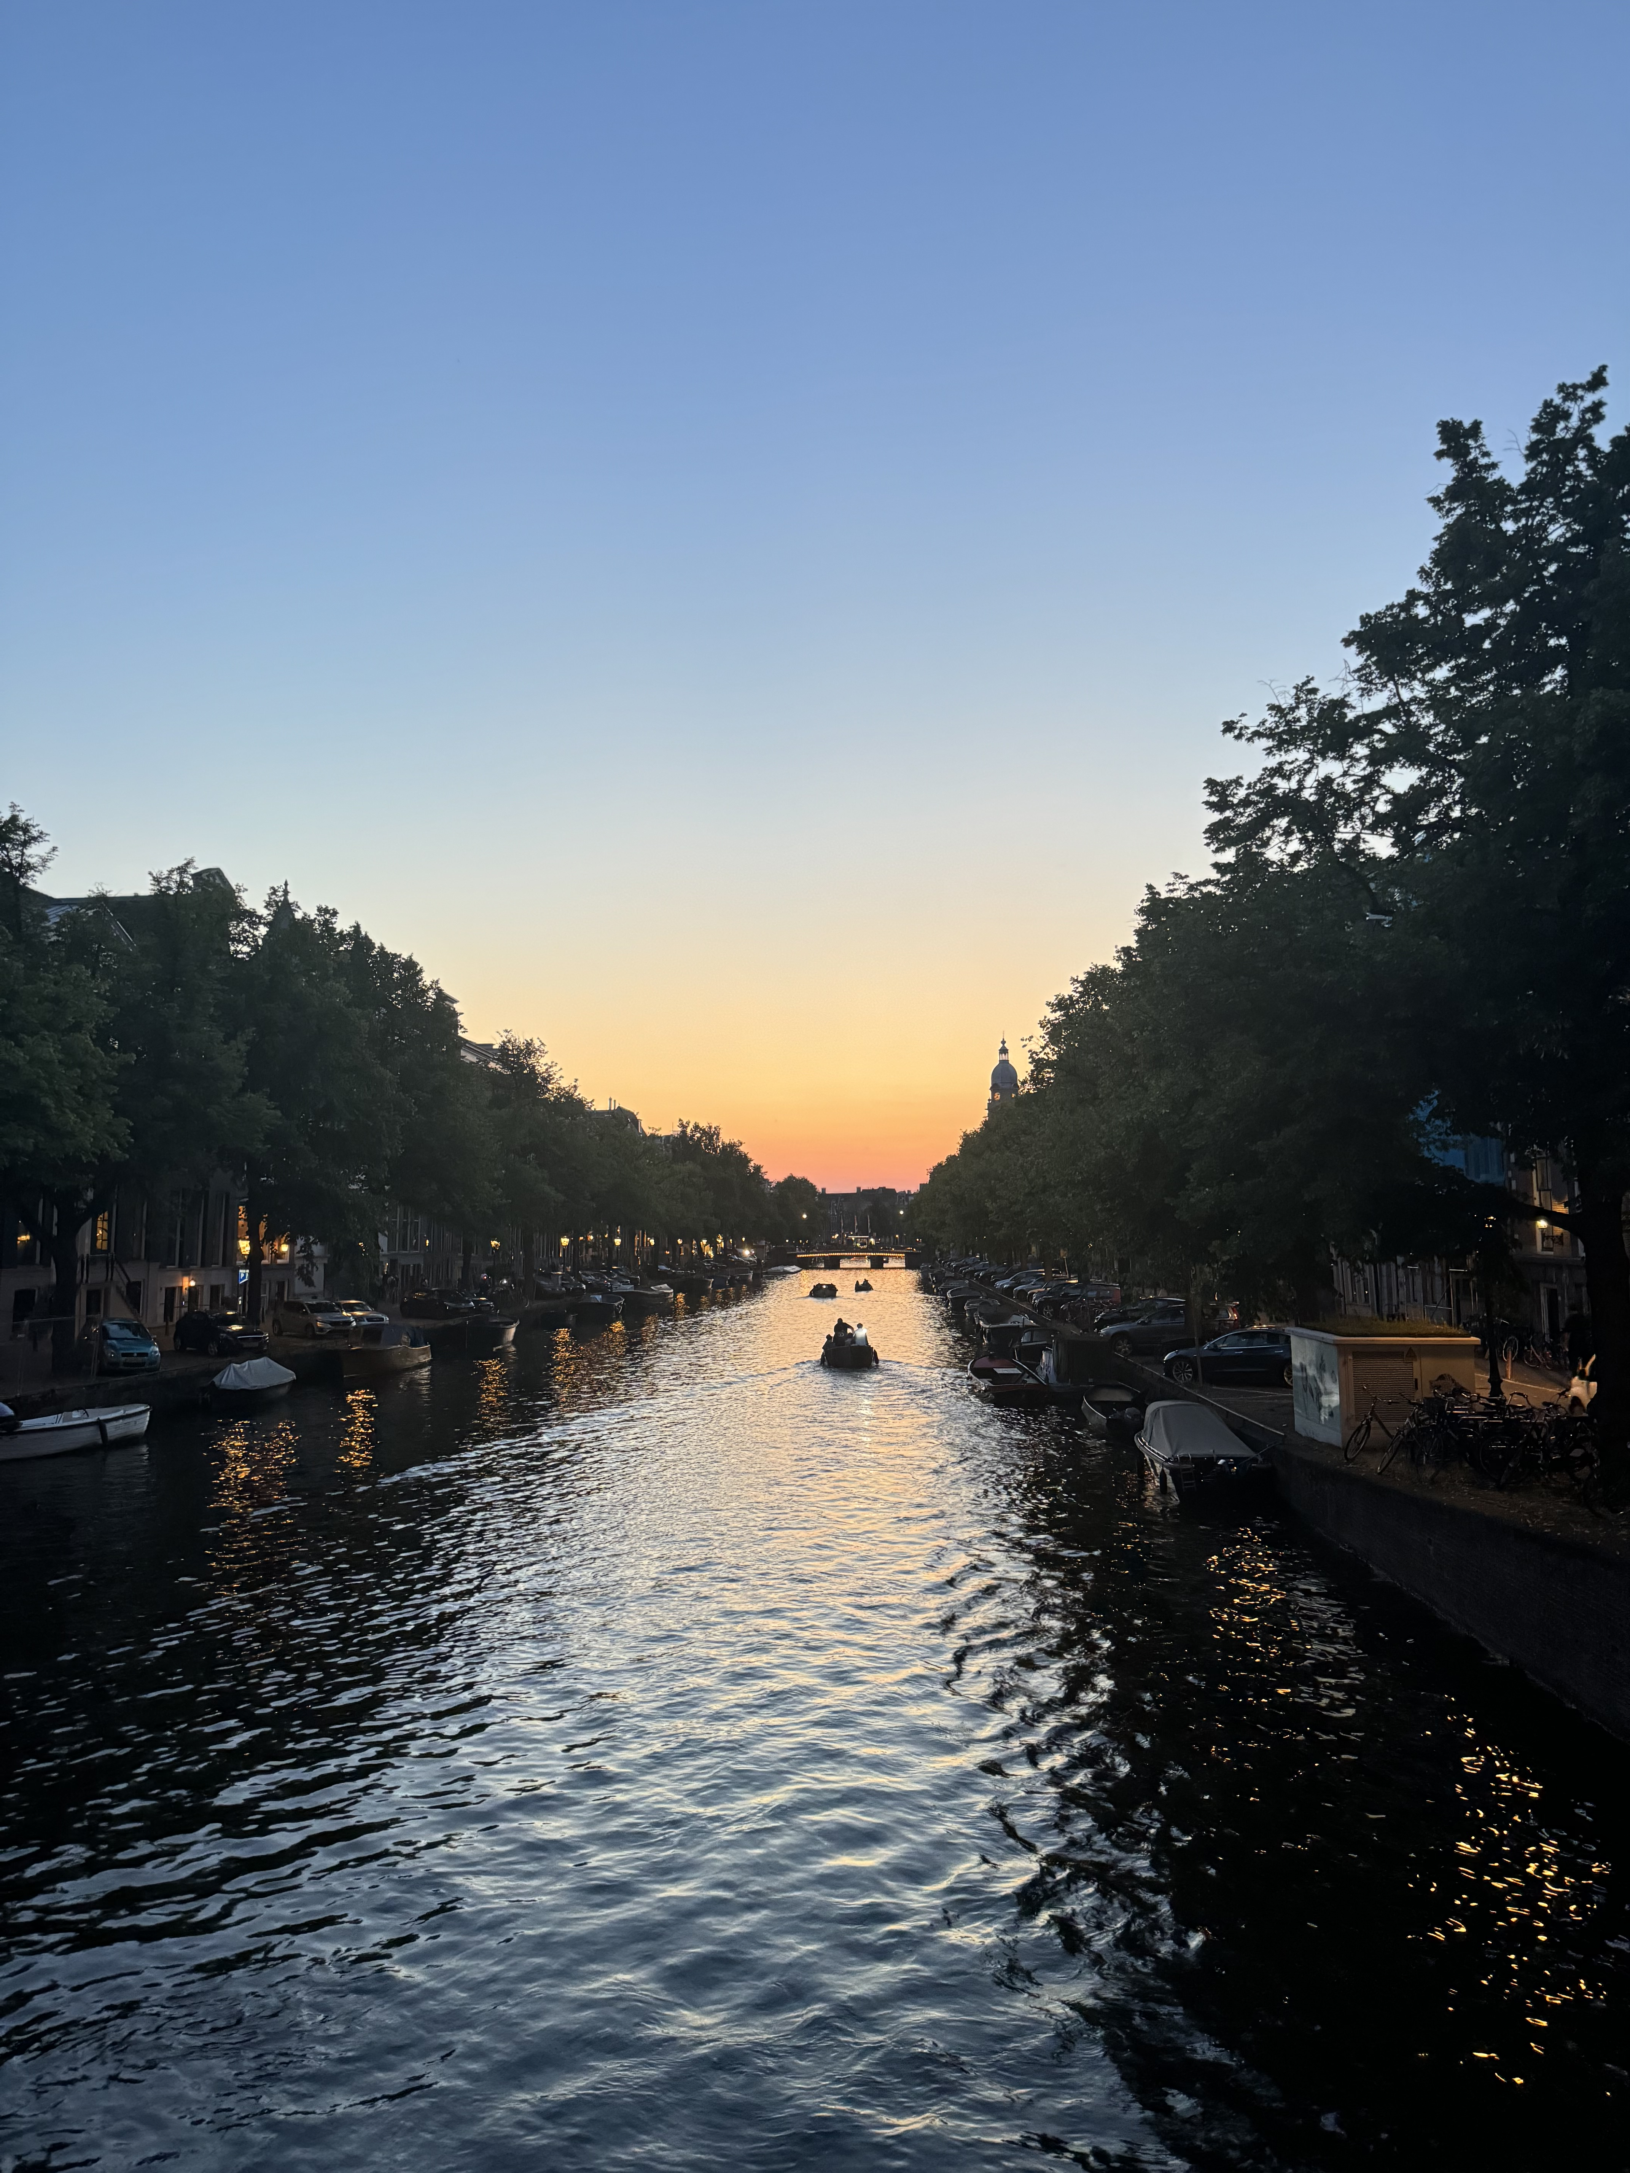
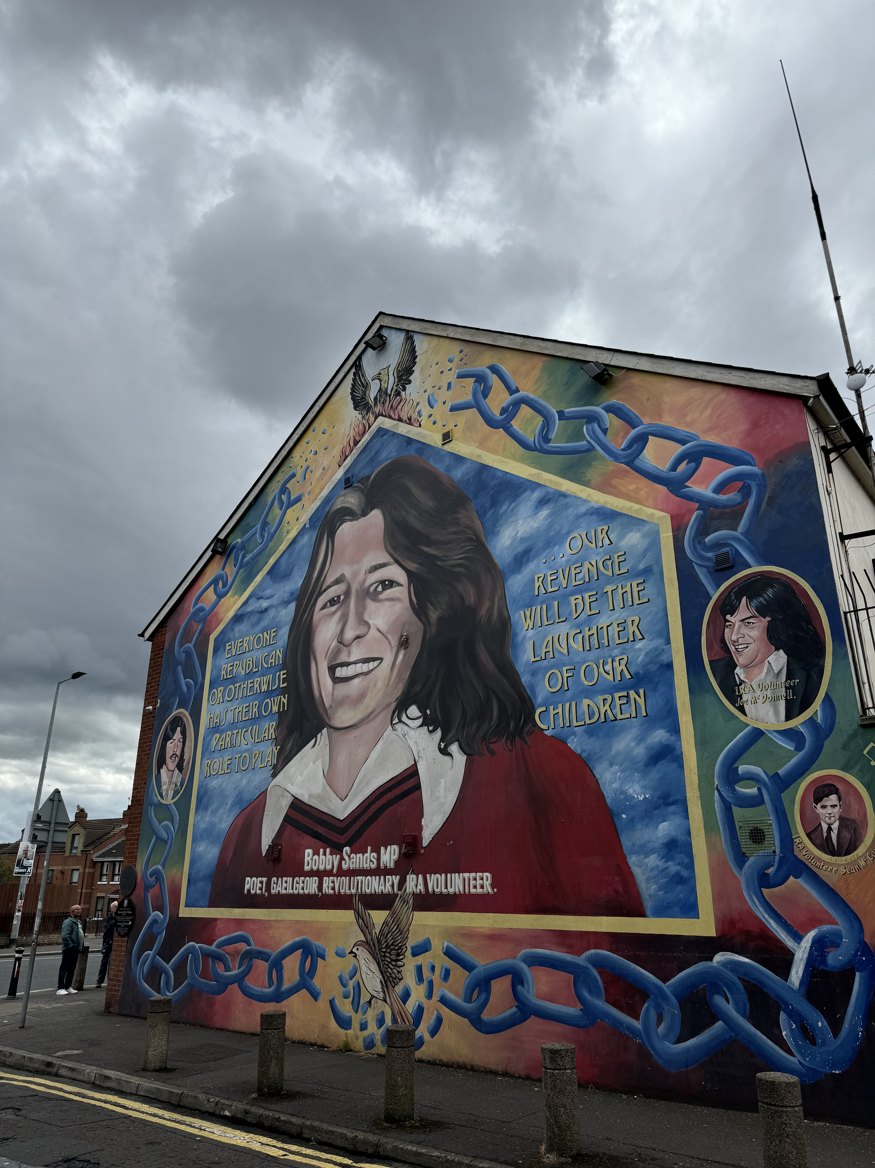
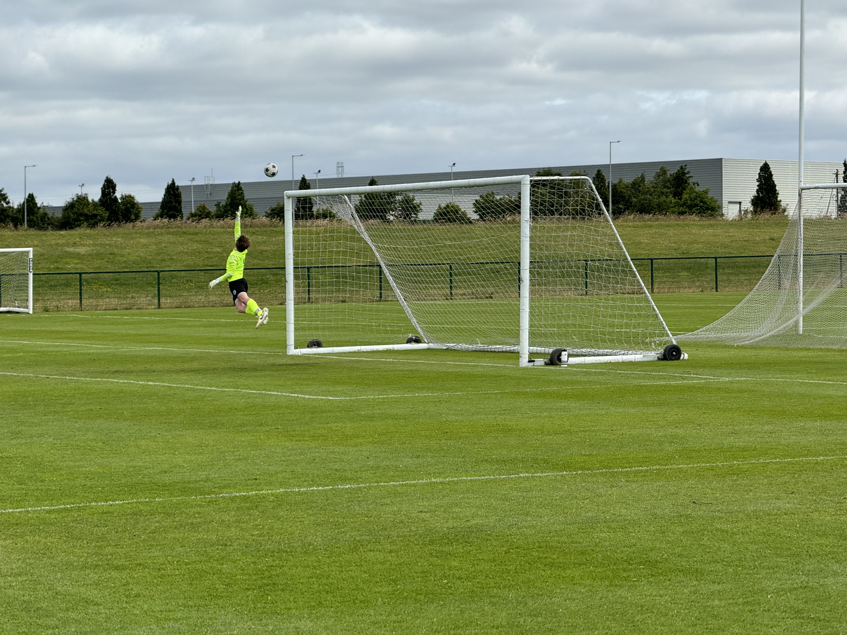
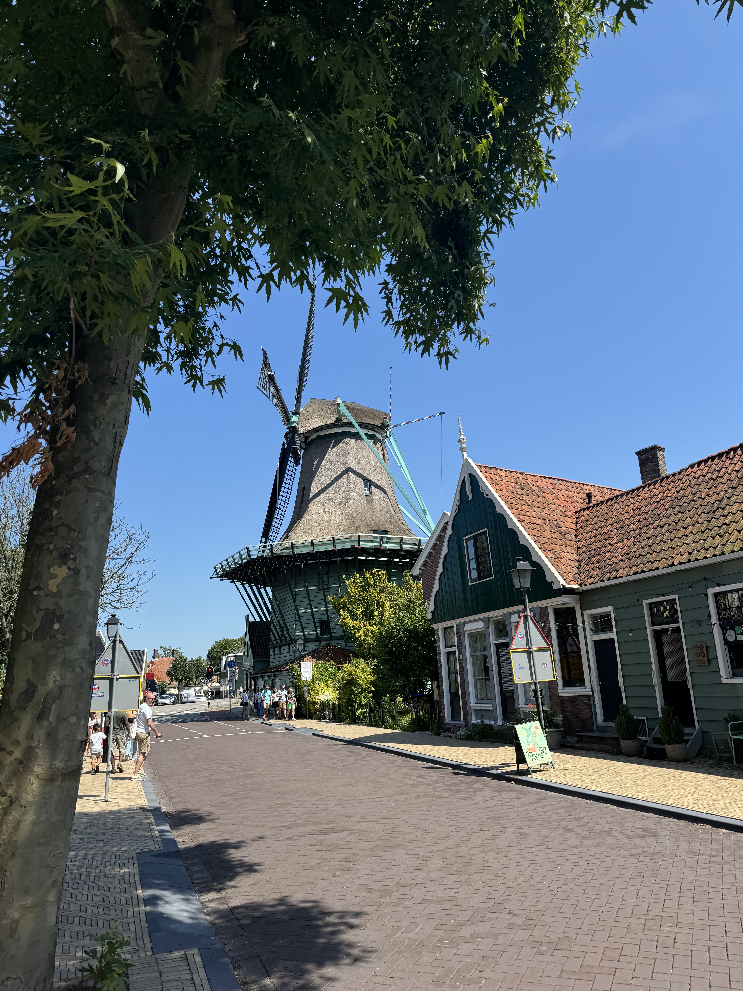
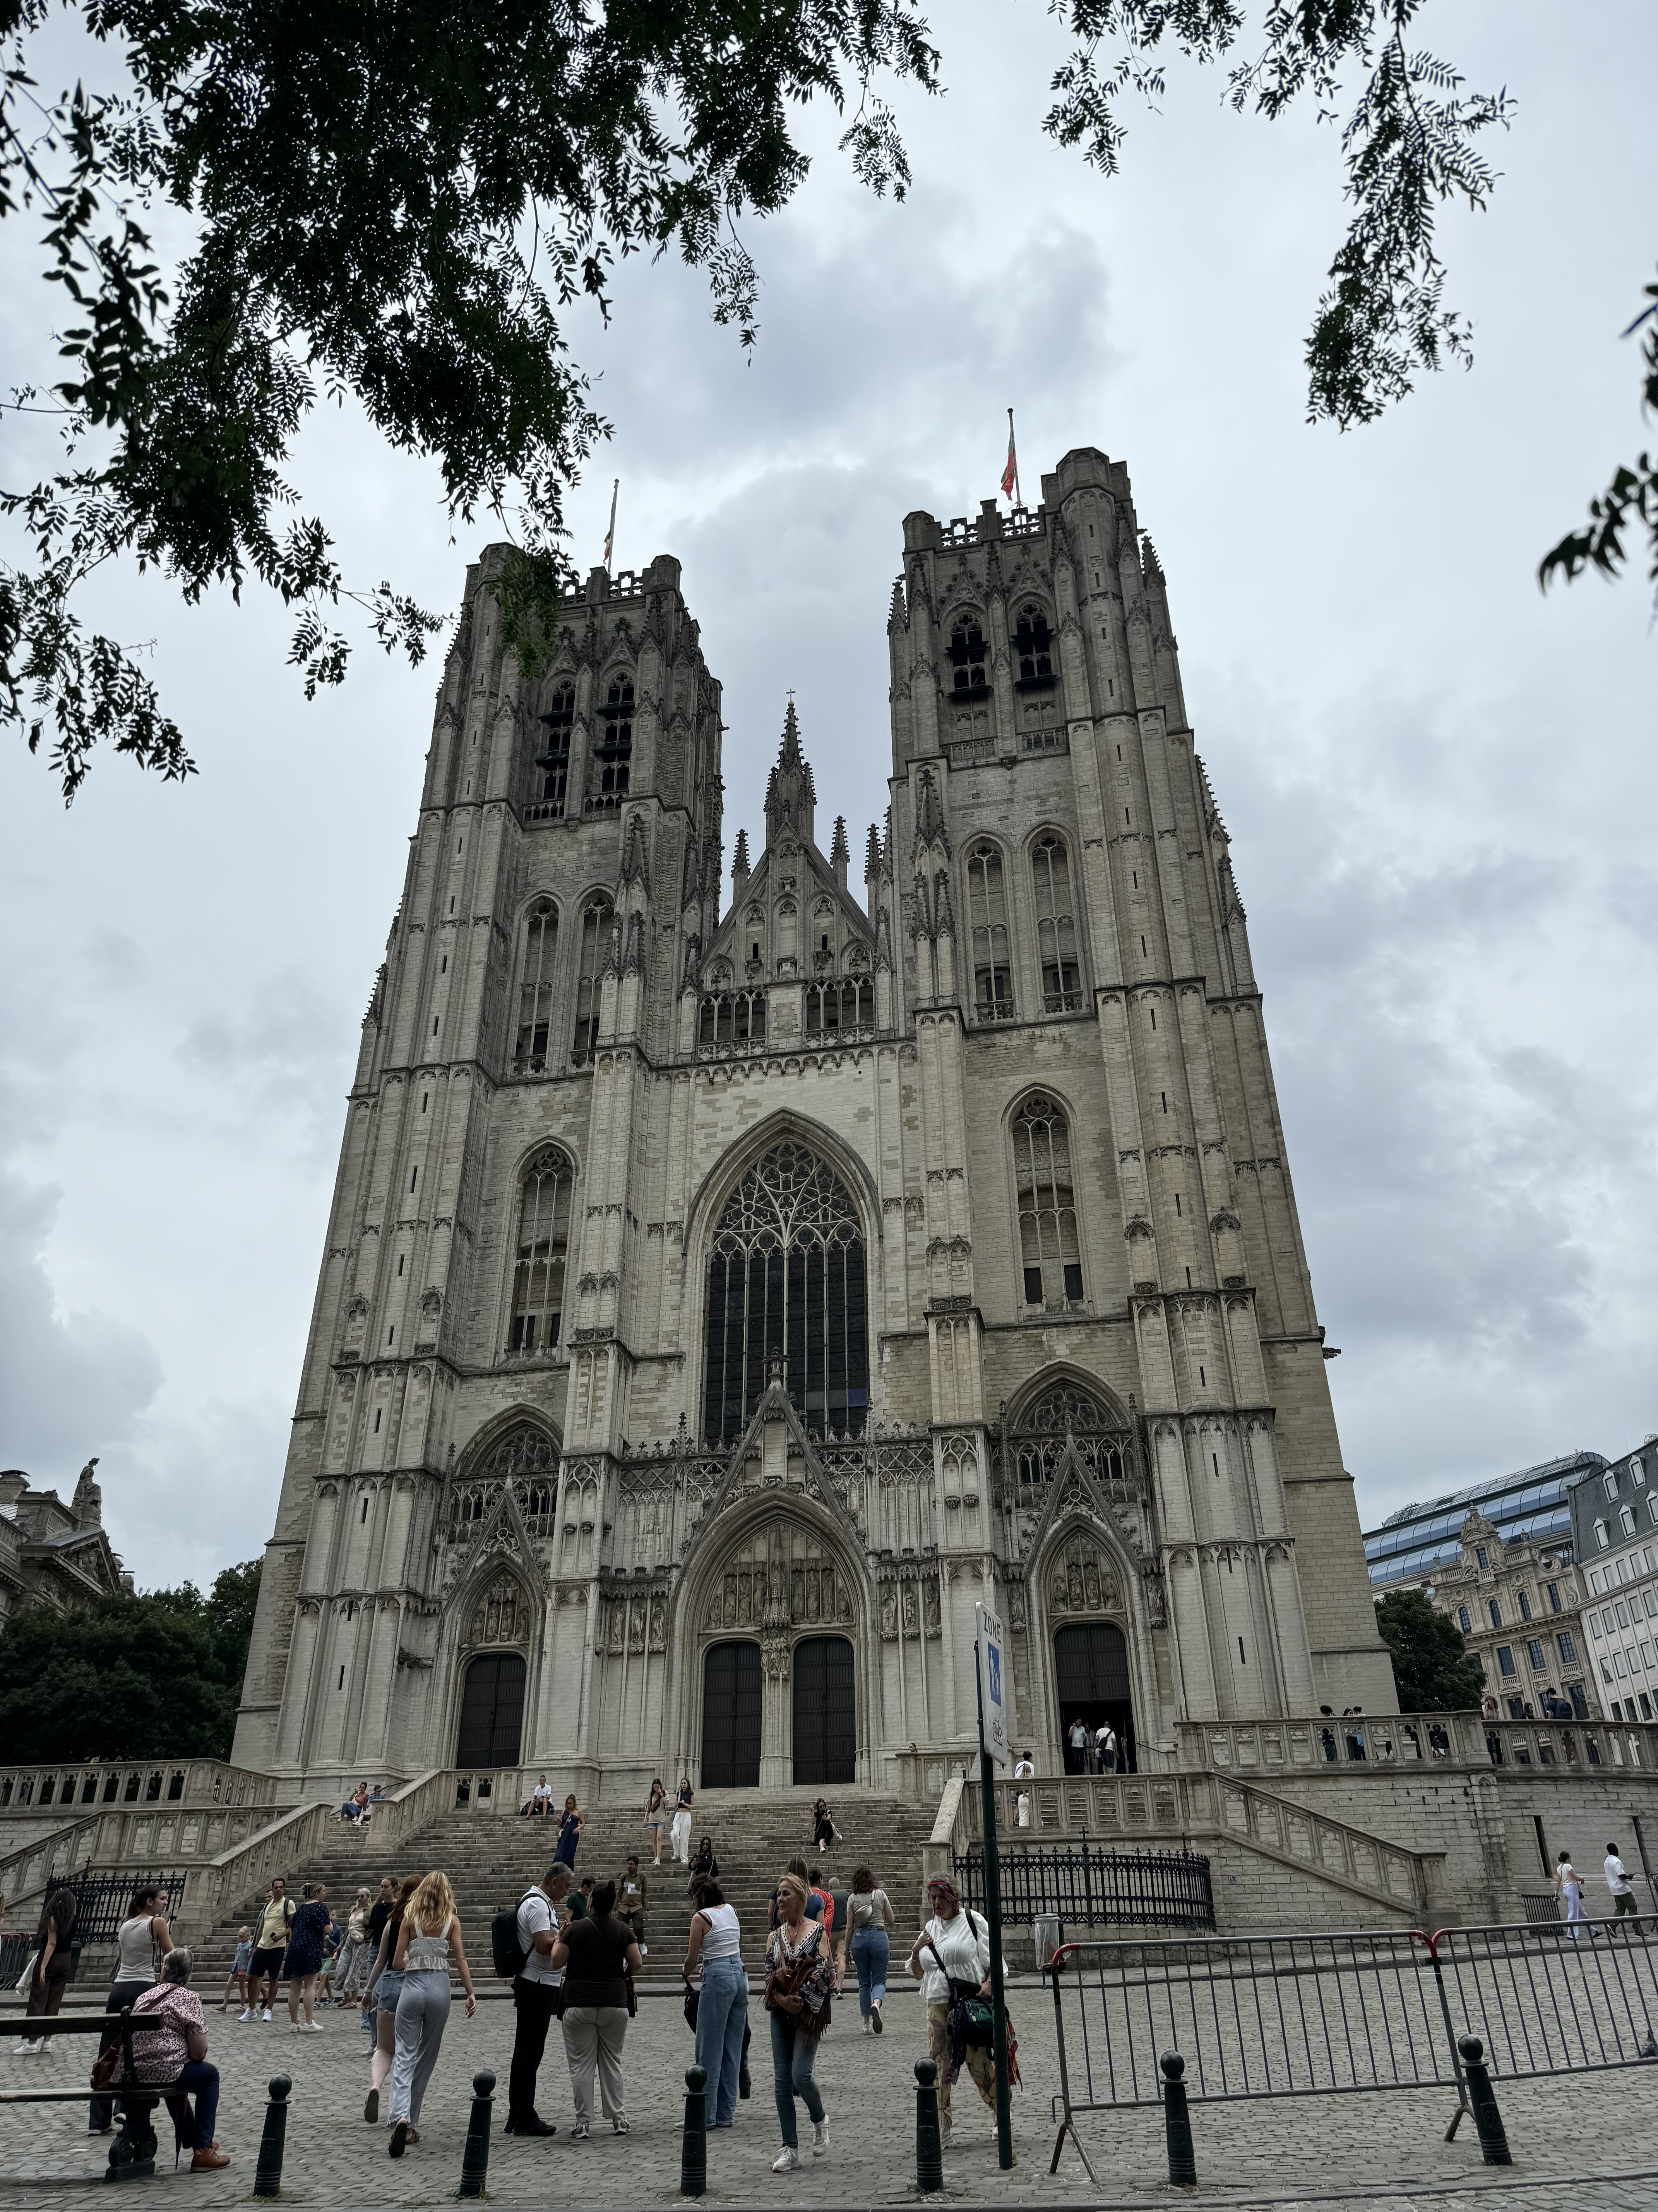
Bucknell In Dublin
Bennett McKeon
Bucknell University, Lewisburg, Pa.
Overview
For a total of eight weeks I studied, lived and fully emersed my self in Ireland. Being abroad in country for that long allows a person to experience what the culture is like and make connections with people who you otherwise may never have met. All of that being combined with the opportunity to learn in a familiar environment by professors you may have had or will have in the future is rewarding. As a computer science major these classes were in an area I had very little information about and yet I feel as though I was able to understand and learn both inside and outside of the classroom. Overall this experience was extremely rewarding and one I would recommend people take.
Coursework
Cultural Events
During the study abroad students have the opportunity to take two classes MGMT 290 and ANOP 315 both of which are classes in the Freeman College of Management.
ANOP 315:
This course dives into Ireland's historical and modern strategies for managing operations and services. You'll explore a variety of key topics, including operations and supply chain management in agriculture, manufacturing (especially textiles), and logistics (with a focus on ports and port operations). Through a mix of lectures, discussions, and field trips, you'll get a hands-on understanding of the political, geographical, and economic challenges these industries have faced over time. It's a great chance to learn about the evolution and current state of Ireland's operations and supply chains in a dynamic and engaging way.
MGMT 290:
This course dives into how management works in Ireland by looking at its culture food, arts, language, religion along with its history, politics, and geography. Plus, you get real world experience through an internship. It's perfect for anyone interested in global business practices. This course has something for anyone, if your want work experience, independence or just want to experience another cultures this program is perfect. It’s also great for anyone curious about global management and leadership. There are no prerequisites, so students from all backgrounds are welcome. One cool part of the course is the weekly blog writing assignment, where you can reflect on and share your experiences and insights as you go.
During the course we traveled all over Ireland, to Galway, Kilkenny, Belfast and so many more great places. While in Dublin we learned about the famine and the mass amount of people who fled Ireland for a better life. We learned about the troubles or trouble times, a turbulent time in Irish history. This time period was marked by a fight for independence and great loss for many including my family. When learning about this time period it felt like the conflict was from the medieval era but in reality it was just from around 50 years ago. This trip gave me great incite into my families history as many of my ancestors and relatives have called and still call Ireland home today. We learned about so much more including sacred sights like the Giants Causeway and Guinness, the most popular drink in Ireland.
Internship
Travels
DB Sports
My internship this summer was with DB Sports, a soccer academy and tour company. Having grown up deeply connected to sports, I thoroughly enjoyed my time there. Although soccer (or football, if you prefer) was a new area for me, I gained substantial knowledge about the sport through this experience. More importantly, I also learned a great deal about running a business. DB Sports was incredibly supportive, involving me in various business-related calls and taking the time to explain key details about their operations. Initially, I was focused on bug fixing their new website, but once that was completed, I had the opportunity to work in accounting, finance, and marketing. DB Sports provided me with a comprehensive range of experiences and valuable insights into the workings of their company.
AMSTERDAM:
My long free weekend I went to Amsterdam with almost everyone on the trip. After experience 7 weeks in Ireland and getting used to that culture, Amsterdam was a complete shock. Everyday was filled with activities as I only had 3 days there. I don’t feel like I get a chance to fully experiencing everything about Dutch culture but I feel like I got to experience almost everything Amsterdam had to offer. My favorite part of that trip was going to Zaanse Schans Windmill Village which was beautiful.
BRUSSELS:
I took a day with a group of friends while in Amsterdam to train over to Brussels to see the difference in culture and city life. It just so happens we ended up going on their independence day. Lots of ceremonies were happening, and the city was alive with people celebrating. My favorite part of that trip was seeing the parliament building which was having an open house.

