Slide 1

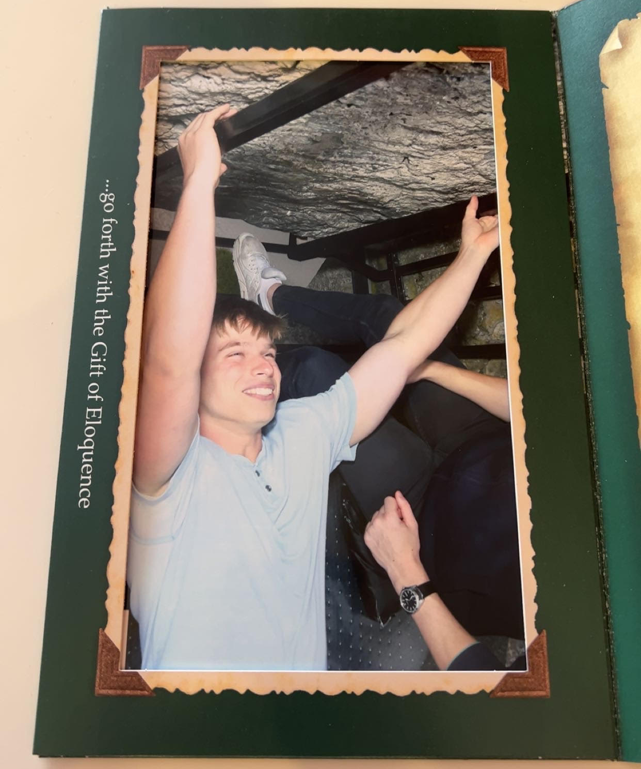
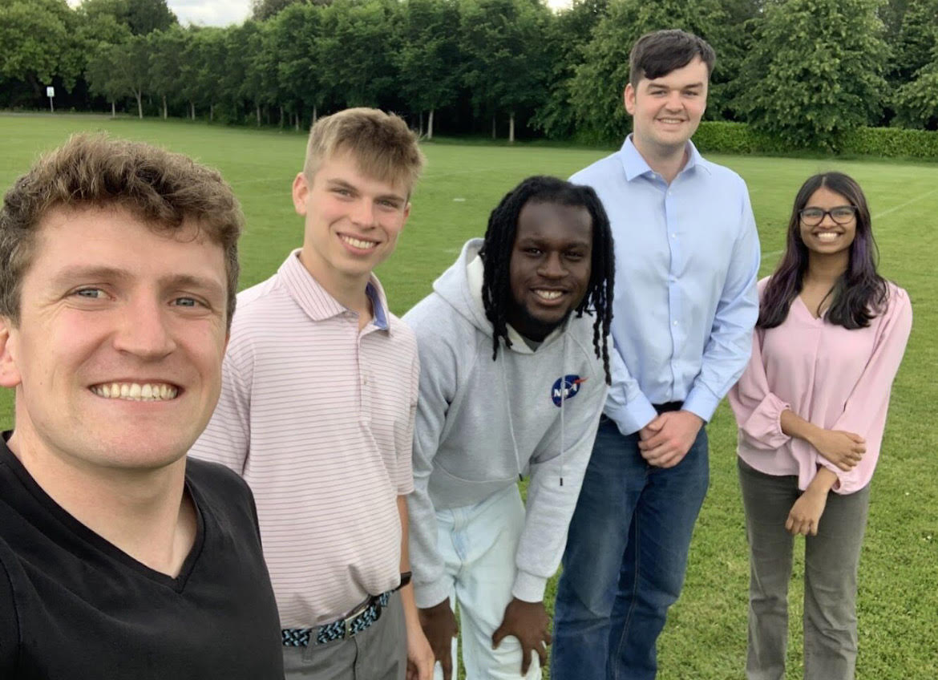
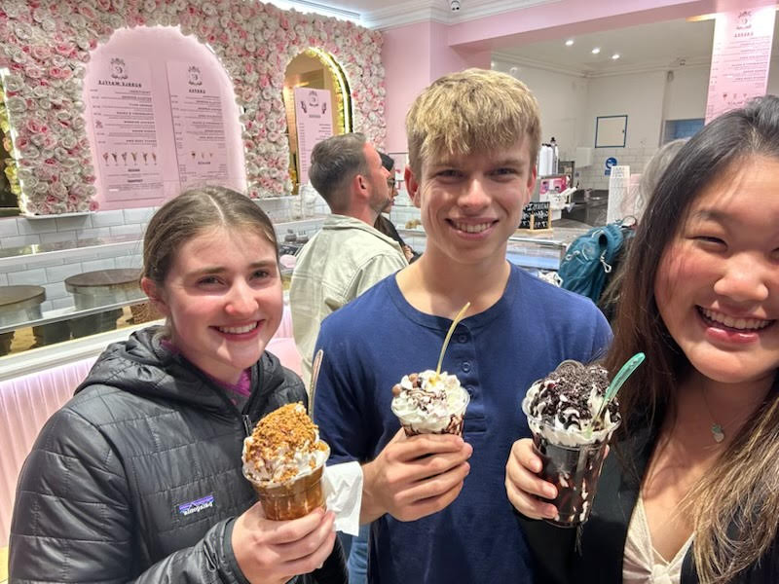
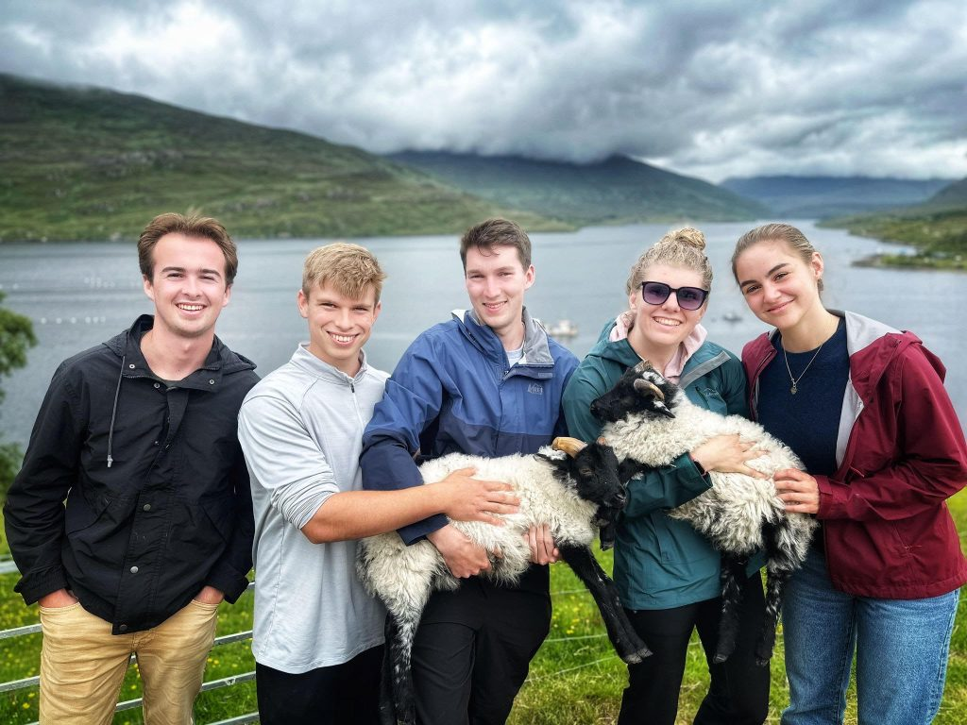
Tyler Thrutchley – Bucknell in Dublin
Summer 2024
Abstract
I don’t know if there was a better way to spend my summer than in Ireland for the Bucknell in Dublin program. Whether it was interning at Sports Impact Technologies as an analytics intern and getting to put my business analytics major to use, getting to take two informative classes from Dean Kepner and Professor Wilck, or traveling around Ireland and Amsterdam, this trip truly was one of the highlights of my life. I have made friendships with people that will last a lifetime and was immersed in a culture that taught me a multitude of things about living abroad and respecting other cultures. Looking back on my time in Dublin, the variety of informative trips around the country and visits to various museums leave me with a broadened knowledge of Ireland’s rich history.
Course Work
Internship
Cultural Events
Ice Cream Tier List
While in Ireland I had the opportunity to take two Bucknell classes – MGMT 290 (Global/Society/Culture) and ANOP 315 (Guinness to Globalization). The classes were comprised of the following activities:
Weekly Blogs:
Each student was tasked with posting a weekly blog that talked about the adventures of the week as well as 4 pictures that described these adventures. Family and friends could also add comments to these blogs.
LinkedIn Learning Certification
Throughout the two month program, students were tasked with becoming certified in three different fields via LinkedIn Learnings. For each certification, students must watch a series of videos and answer questions at the end in order to obtain the certification.
Weekly Writing Assignments
For our weekly writing assignment, we wrote 1 page about the history of Ireland. And incorporated our internship experiences as well as some things that we learned during our trips.
Case Studies:
Lastly, in groups of 5 we completed a weekly case study, which was a real-world case study, that incorporated what we learned during our weekly ANOP 315 class.
During the two-month program, I had the opportunity to intern for Sports Impact Technologies as an analytics intern. Sports Impact Technologies is an early-stage stage up founded by Eoin Tuohy to promote head impact safety in contact sports.
The product is a tiny circular sensor that athletes wear behind their ear. The sensor sends information to an app that reports the magnitude of a hit to the athlete’s head in g’s.
Some of my tasks included putting together a competitor analysis of all of the companies that make up our competition, an investor analysis, market research of a variety of sports industries, and research on distribution centers.
I was the only business intern working with 4 other engineers. Though I didn’t understand much of their work, I still was present during their presentations, as they were present for mine. We made sure to share the work that we were working on at the end of every week. By the end of the internship, we were a well-oiled machine and we had accomplished so much in a short period of time!
We went on so many trips that exposed us to Ireland’s rich culture, so it would take too long to talk about all of them. However, I want to highlight some of my favorite cultural events.
The Blarney Stone: Kissing the Blarney Stone was one of the highlights of the entire trip. Though the two hour line to get to the top of the castle was awful, nothing beat the thrill of leaning back and kissing the stone, and looking down at the 100 foot drop. I received the gift of the gab for kissing the stone, receiving the ability to speak eloquently.
The Titanic Museum: I’m not going to lie, I never realized that the Titanic was built in Belfast. The museum was amazing, with countless visuals displaying all of the details that went into building the Titanic, as well as a “roller coaster” ride inside the museum that walked us through a day in a life of a worker on the Titanic.
The Jeanie Johnston: This was my favorite “museum” that I saw in Ireland, although it is not much of a museum. It is a boat. However, the history of the boat is amazing. At a time when coffin ships brought people from Ireland to other countries during the great famine with a 50% survival rate, the Jeanie Johnston never had a fatality.
While in Ireland. I tasted countless different ice cream, whether it was from an ice cream store, a grocery store, or out of a carton. There was some ice cream that I absolutely loved, and there was some ice cream that I wanted to spit out. Thus, I decided to make an ice cream tier list highlighting all of the different ice cream I consumed during the trip.
Scrumdiddly’s – My favorite ice cream by far. The sundaes were magnificent, with a variety of different flavors for cheap and great portions.
Cloud Nine – Tasted almost as good as Scrumdiddly’s, with massive portions, but a little more expensive.
Sophie’s Ice Cream – This was the dessert at our dinner at Sophie’s on he last night. Delicious with brownie in it.
Aran Islands Ice Cream – Very scenic drive to get to the ice cream.
Scoops
Irish House Party Ice Cream
Little Kitchen Ice Cream
Gino’s
Murphy’s
Teddy’s
Howth Gelato
Ben and Jerry’s
Teddy’s
Cliffs of Moher Ice Cream
Eddie Rocket’s
Amsterdam Ice Cream

