Slide 1

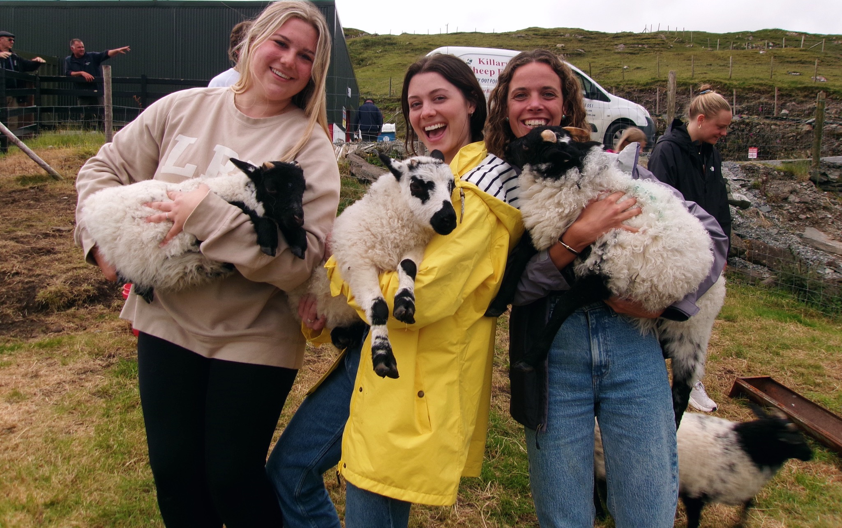

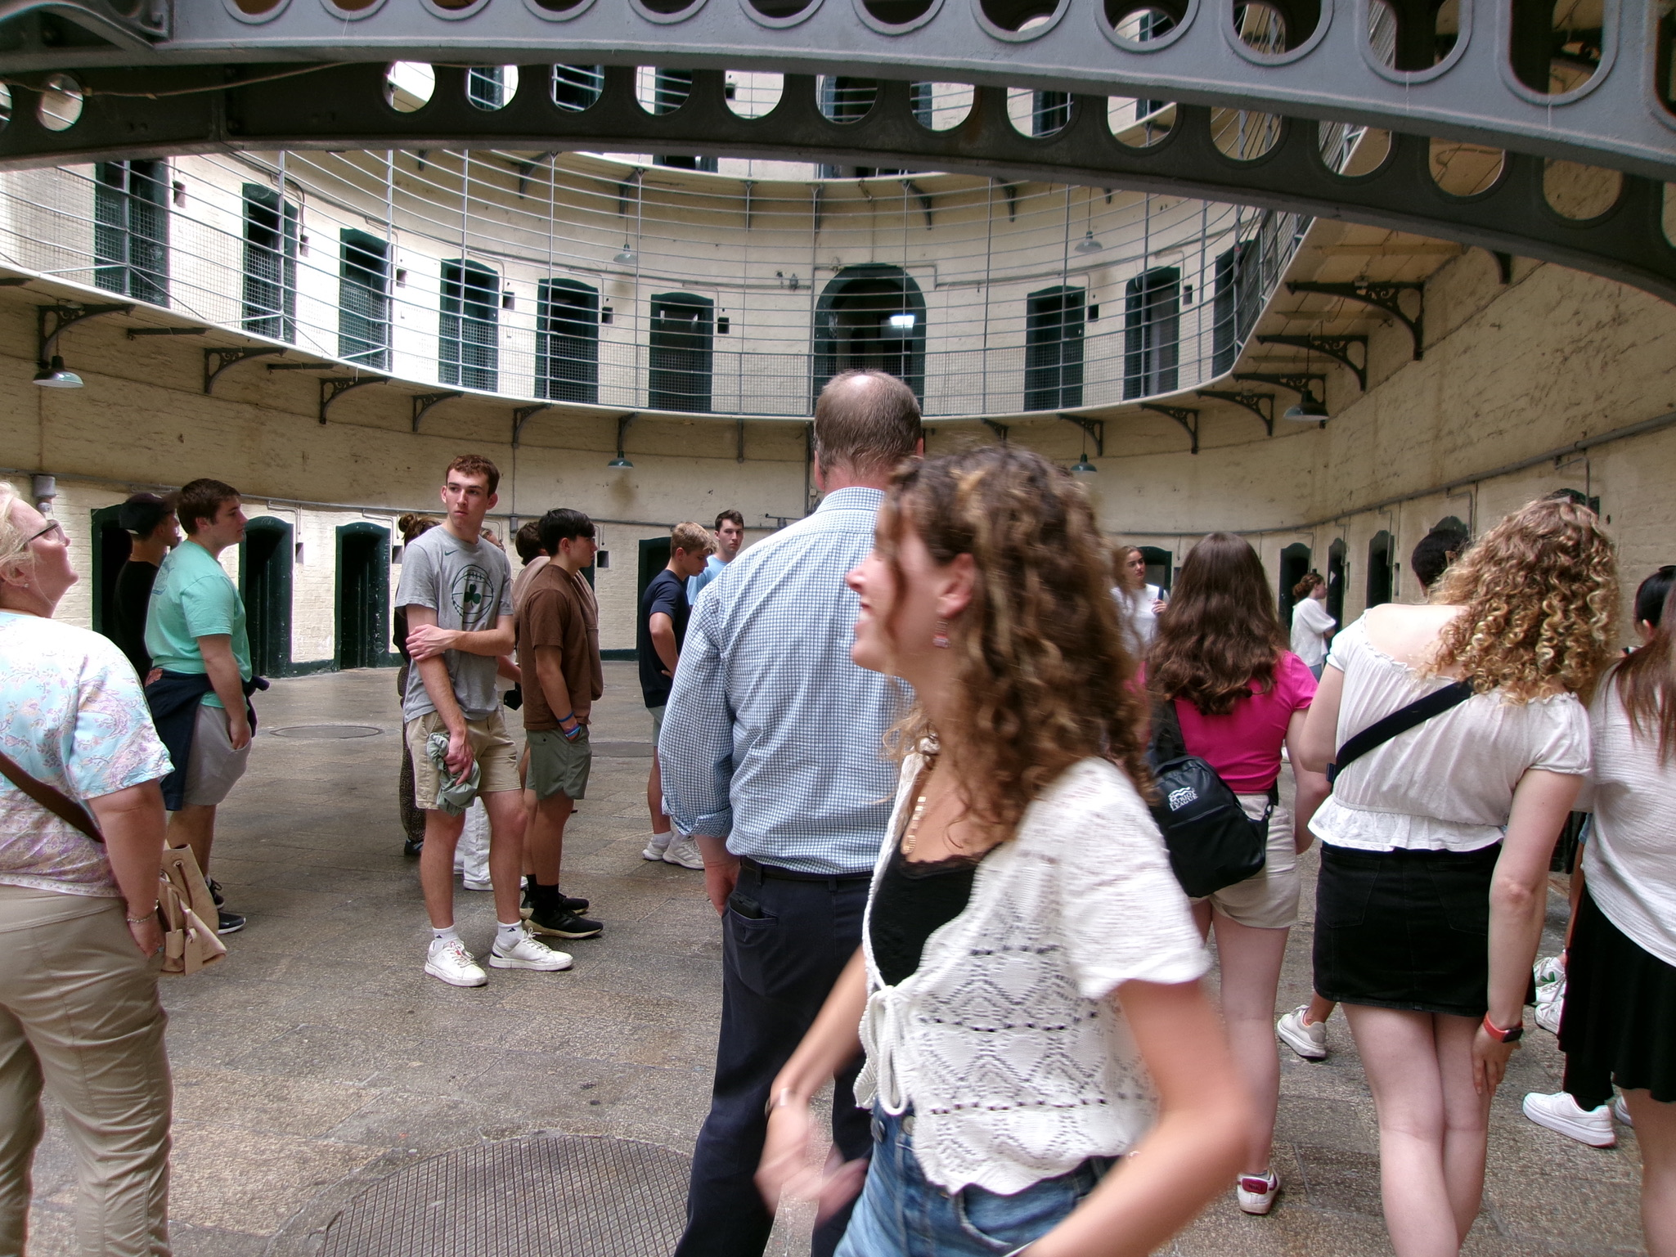
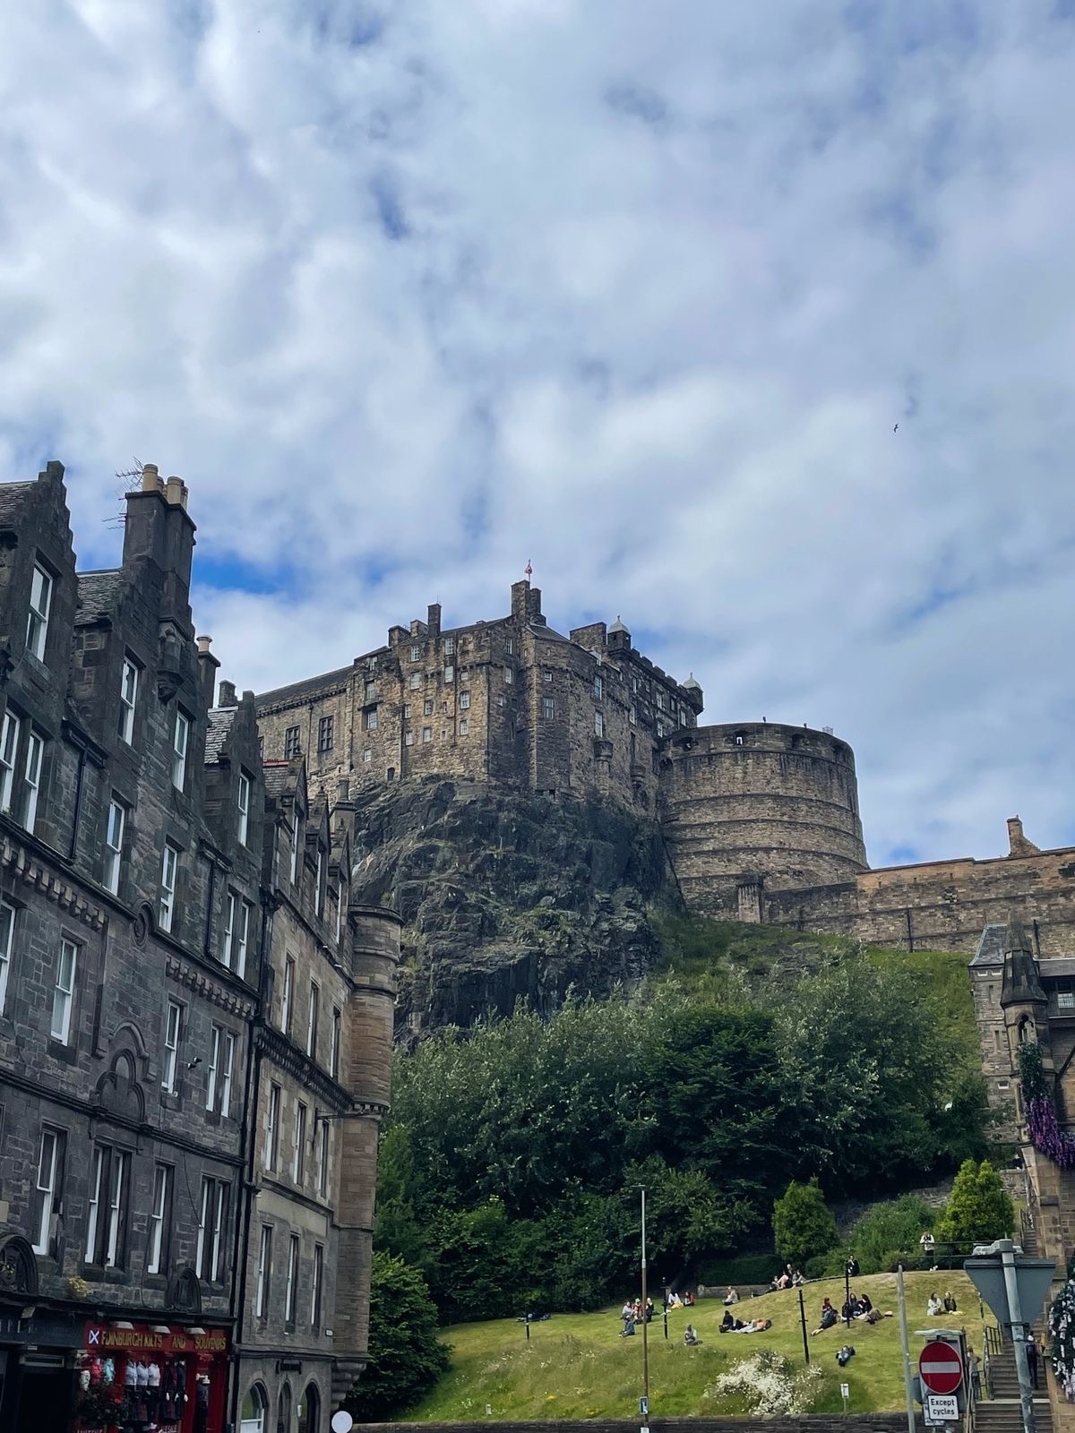
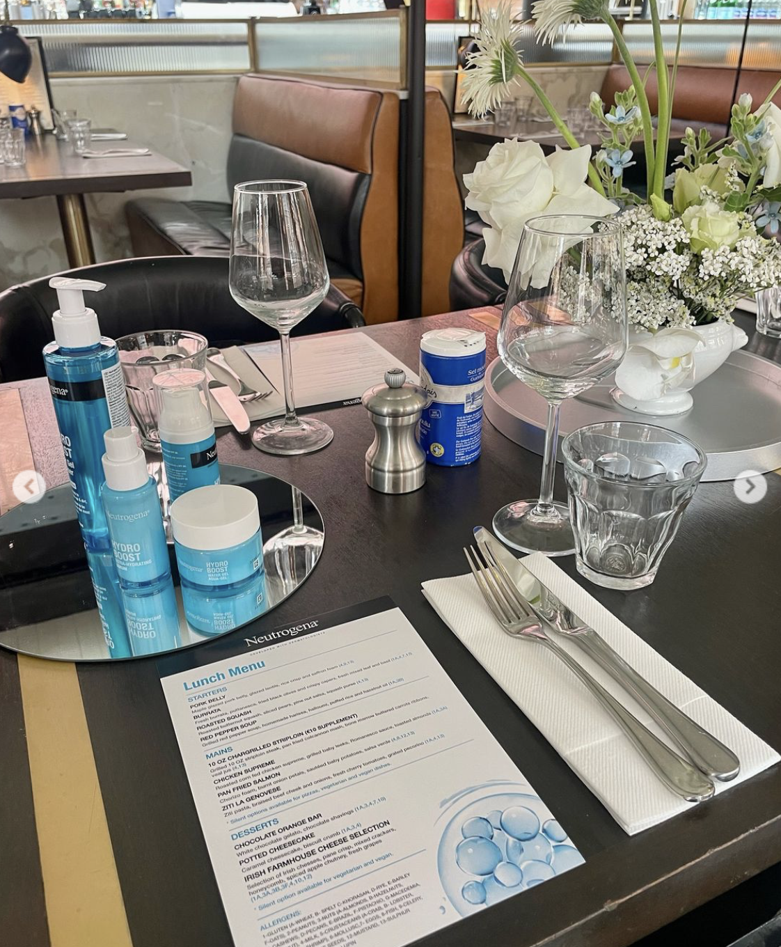
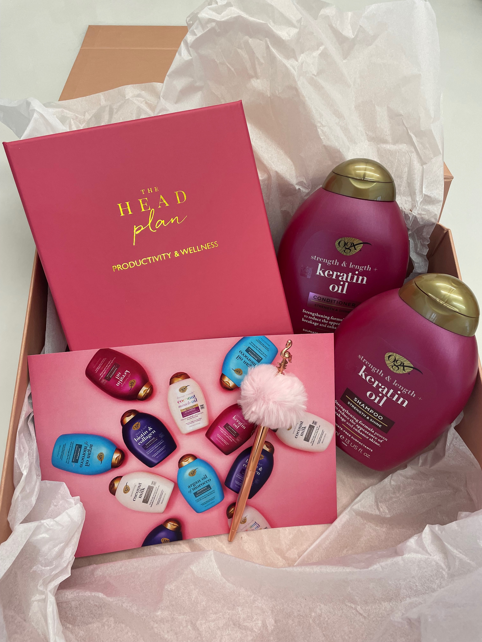
Bucknell in Dublin
Lauren Joyce.
Summer Internship Program 2024
Abstract
Over the last eight weeks, Bucknell students have lived in Dublin, specifically at the UCD campus, having classes on Monday and an internship the rest of the weekdays. After class on Mondays we continued our studies, going to a wide range of tours, walking through museums or visiting other spots in and around Dublin with a focus on learning about Irish history and culture. Then, on the weekends we explored what feels like a majority of the country, traveling to Kilkenny, Belfast and Galway to name a few major spots. We’ve lived with 5 other students in an apartment, though a significant amount of my time was spent in the city where my internship at Burrell Marketing and Publicity was located. I chose this internship specifically as the summer is the only time I could study abroad being a 3-season athlete, and I wanted to explore a new country while getting some credits and meeting new people. I leave this program with lifelong friendships, an expanded worldview and professional experience that gives me a lot of confidence for my future. I can’t understate how grateful I am for signing up and going out of my comfort zone, to soon experience an extremely fun and rewarding summer!
Course Work
Internship
Cultural Events
Favorites
Our class: Guinness to Globalization : ANOP 315
This Analytics and Operations class is a management course, focused on Ireland’s supply chain, operations and services. At the same time, it does so through a historical perspective and the class could be segmented through different time periods. Distinct centuries were looked at, along with specific events including partition, Irish independence, the Troubles and the Celtic Tiger Era.
Applications:
As we progressed through the material, we had class trips to relevant locations where we could apply concepts and learn more about the historical background regarding them. Through these field trips such as to the Guinness Storehouse or the Titanic Museum, it helped solidify what we had been learning.
How?
The class took place on Mondays on the UCD campus walking distance from our dorms. The class was three hours long and each week we were assigned a one-page write up to relate our internship, class content and the field trip we went on. This would center around the time periods laid out previously, to make up our final paper due at the conclusion of the program.
Burrell Marketing and Publicity:
At Burrell I was a marketing and communications intern, a company located in south Dublin in the city at 5 Pembroke Lane. Here, I worked 9-5 in person Tuesday to Friday with another intern, 4 coworkers and a supervisor.
Overview:
Burrell is a PR agency that works with several consumer and lifestyle brands, such as Aveeno, Neutrogena, Boohoo and Pretty Little Thing to name a few. With different media and influencer contacts they work with, they help with product launches, facilitate press releases and giftings, events and other experiences.
My experience:
I helped with different brand events, going to venues or helping to set up. I also created different press packs to be sent out, labeling and packaging as needed. I found different influencers/ media contacts to work with and later on created coverage reports. Lastly, I wrote press releases for different products and on some hotels Burrell works with.
I learned a lot when it comes to working in a professional environment and got to relate course concepts from my marketing and business classes to real life which has been instrumental. It was such a relaxed, collaborative environment that was so fun to work in, I’ll miss it a ton!
Culture:
A majority of the cultural experiences we had were outside of the work environment, though at my internship I was able to learn about local life, especially considering most of my coworkers were girls my age.
In the summer especially, we were able to spend time outside while the weather was into the 60s and 70s, and people stayed out later as the days were longer.
Events:
We went to many different castles, a storytelling event, and towns throughout the country. These really helped to grasp the history and a cultural identity as we spoke to locals and tour guides elaborated on their experiences
  Going to Blarney Stone and the Cliffs of Moher stood out especially as must-see experiences I’m so glad we got to go to!
I felt I was able to understand the culture especially in the city, whether it be spending time in St Stephen’s Green or in a multitude of pubs, ranging from those in Temple Bar or going to local spots.
  Here the friendliness and lively atmosphere of locals was obvious and equally as felt at the workplace with my welcoming and genuine coworkers
Food:
During the course of the program my friends and I became enwrapped in what the city had to offer. The Ramen Bar and Murphy’s were frequently visited spots, as was Beanhive. Later in Galway I had the best pizza I’ve ever had at the Dough Bros.
Travel:
On our free weekends in which we could more flexibility I went to two of my favorite cities!
Amsterdam
The city was clean, full of canals and greenery and the people were consistently lovely. The social life was lively, I found there was plenty to and the food was incredible
Edinburgh
In Scotland this city had more of an English influence that was very interesting to see. Although it felt more touristy, off the beaten path people were friendly and the countryside was beautiful similarly to the architecture.
During these weekends I was able to spend time with classmates who once were strangers, and soon became great friends. I couldn’t recommend this program more to anyone who wants to have a similar experience, to gain internship experience and to make long-lasting memories.
Kilmainham Gaol Museum where we
learned about Irish independence and political prisoners, relating to course work.

