Slide 1

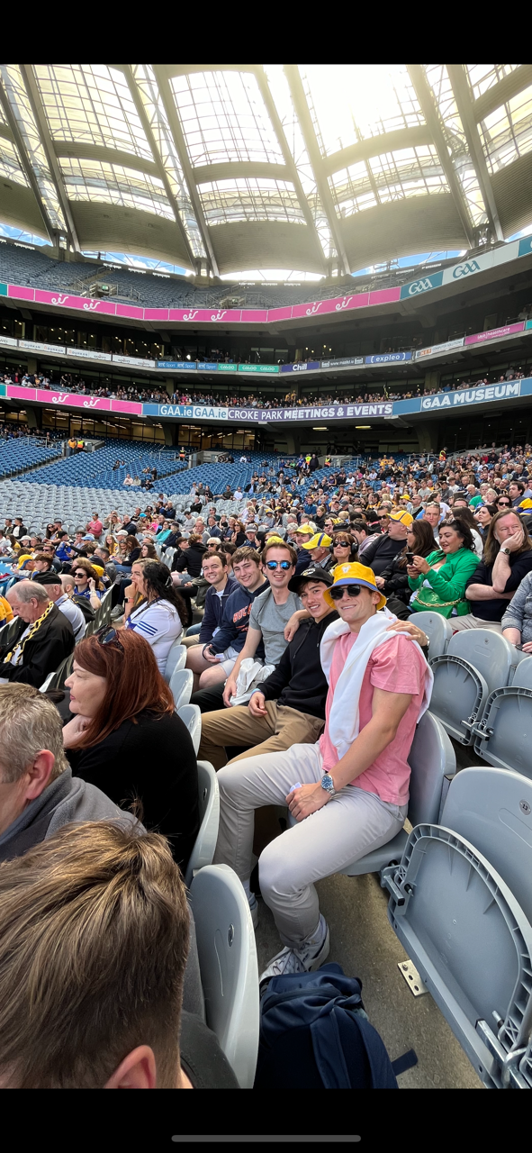
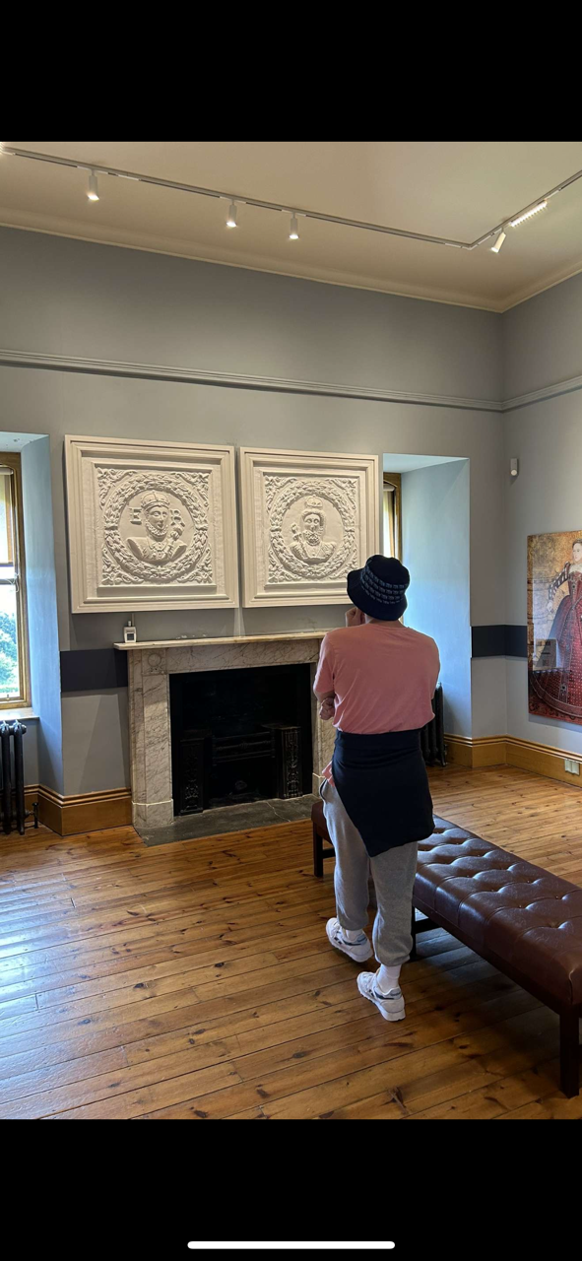
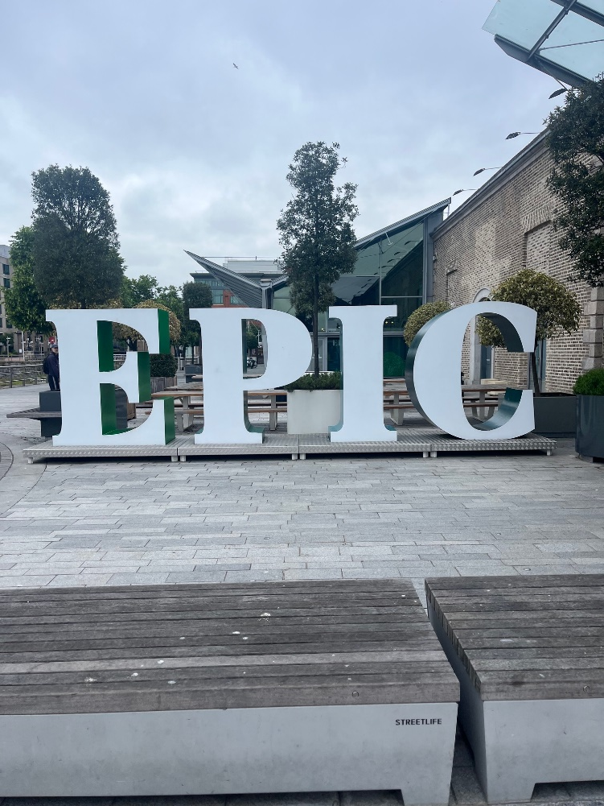
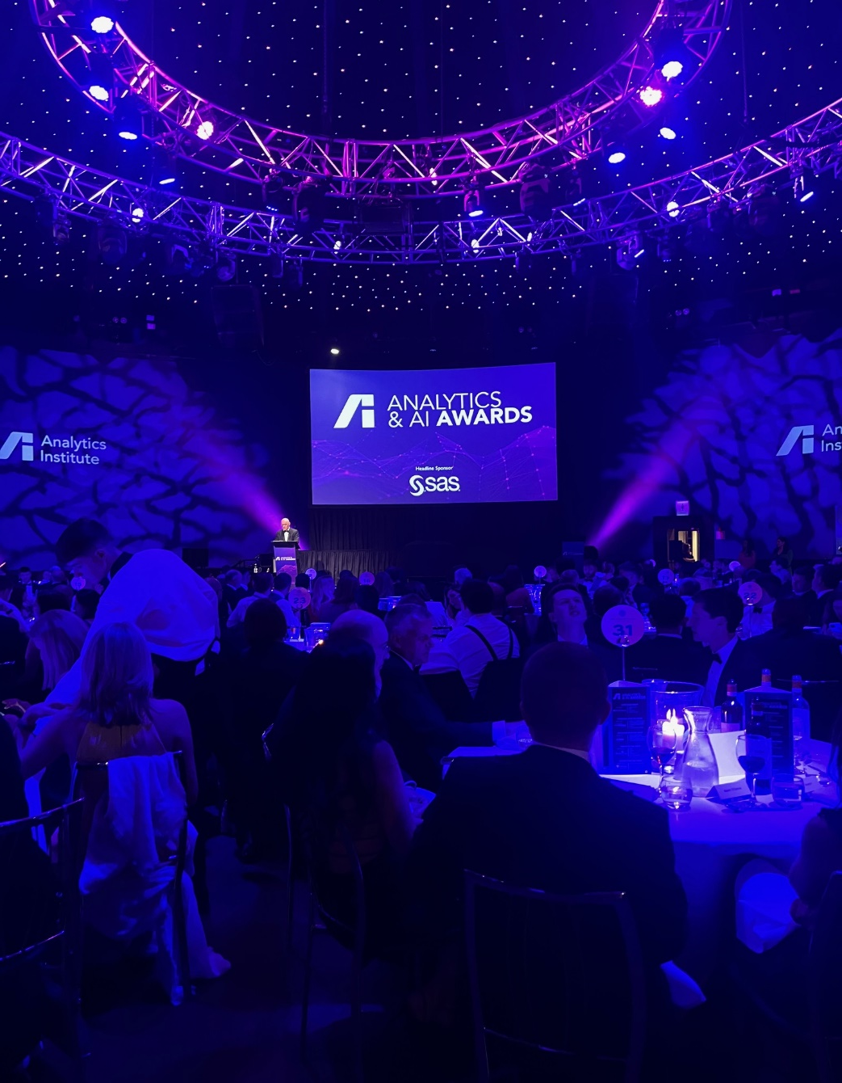
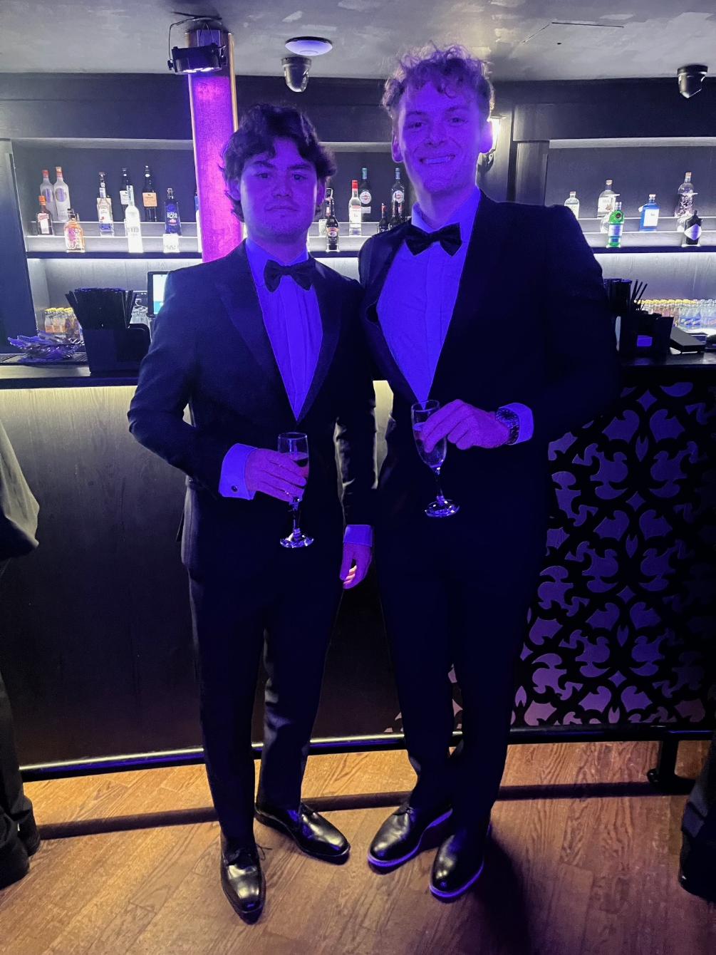
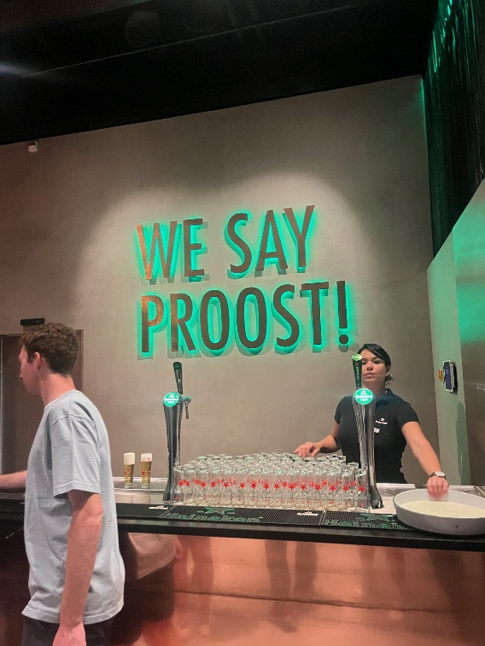
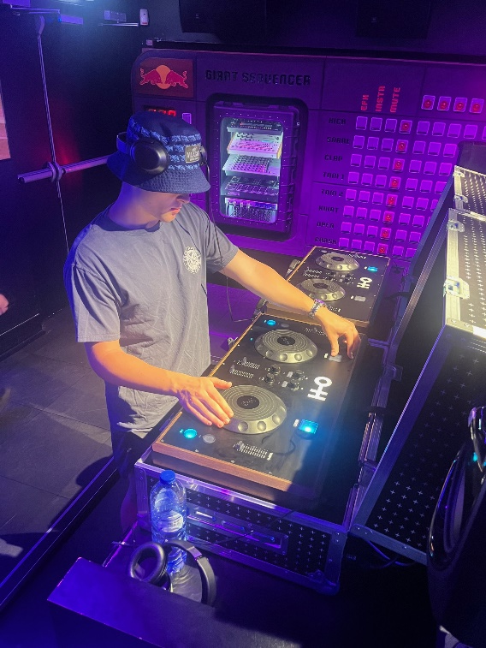
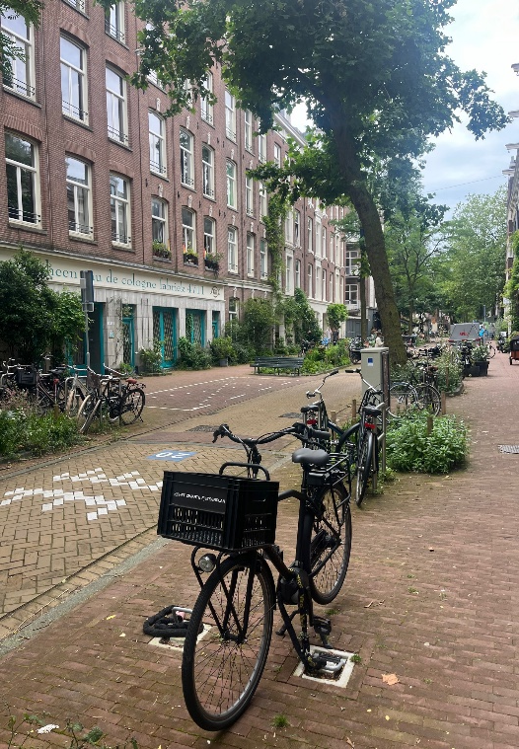
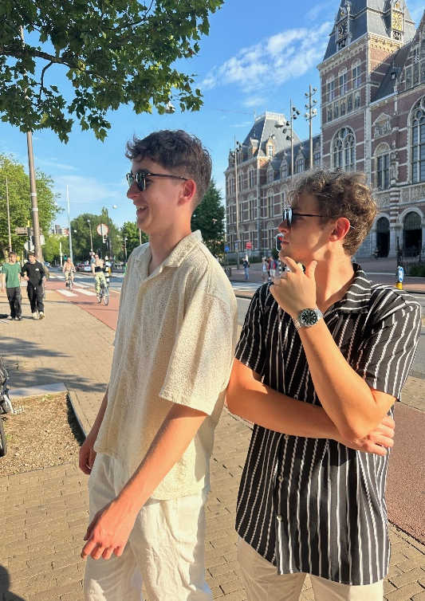
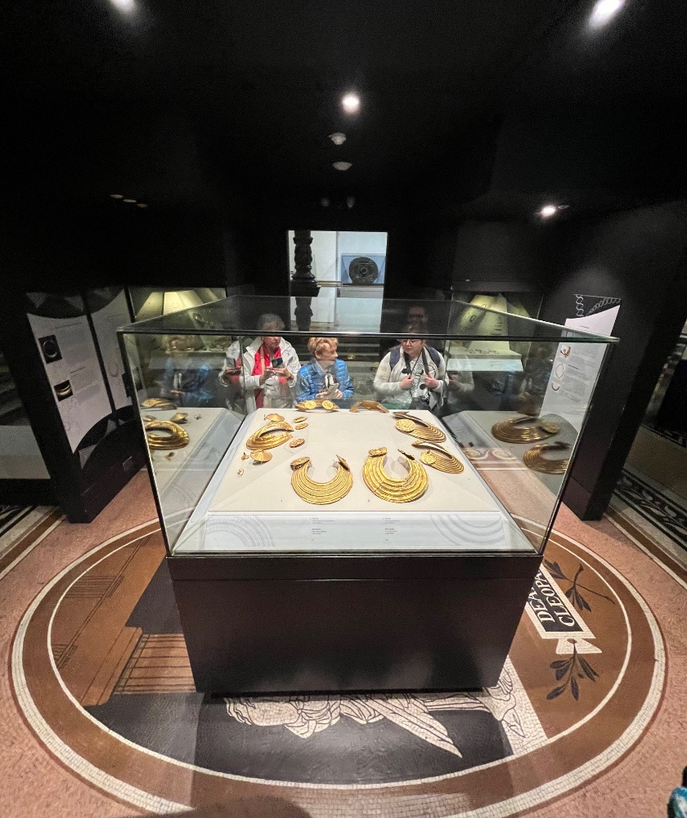
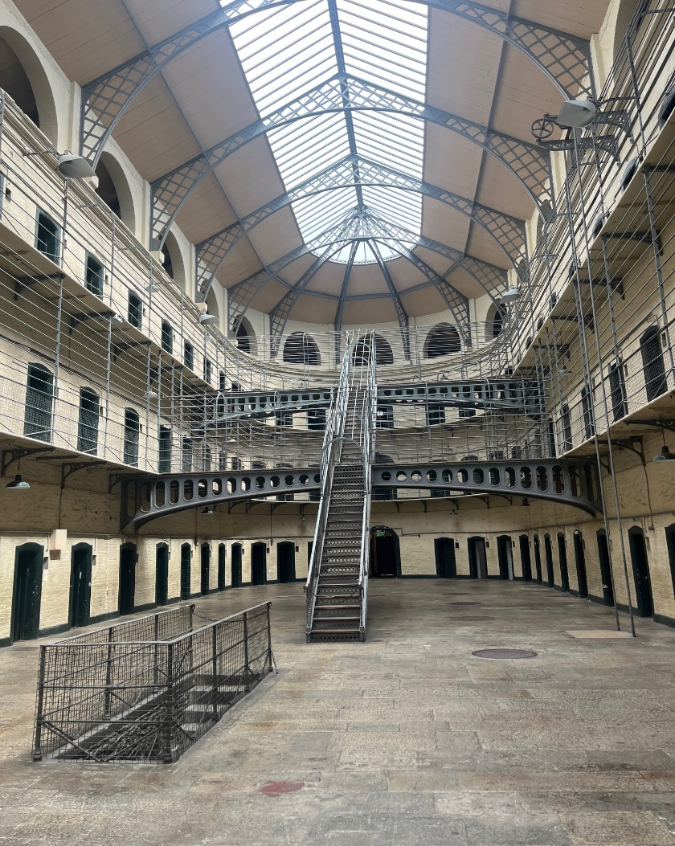
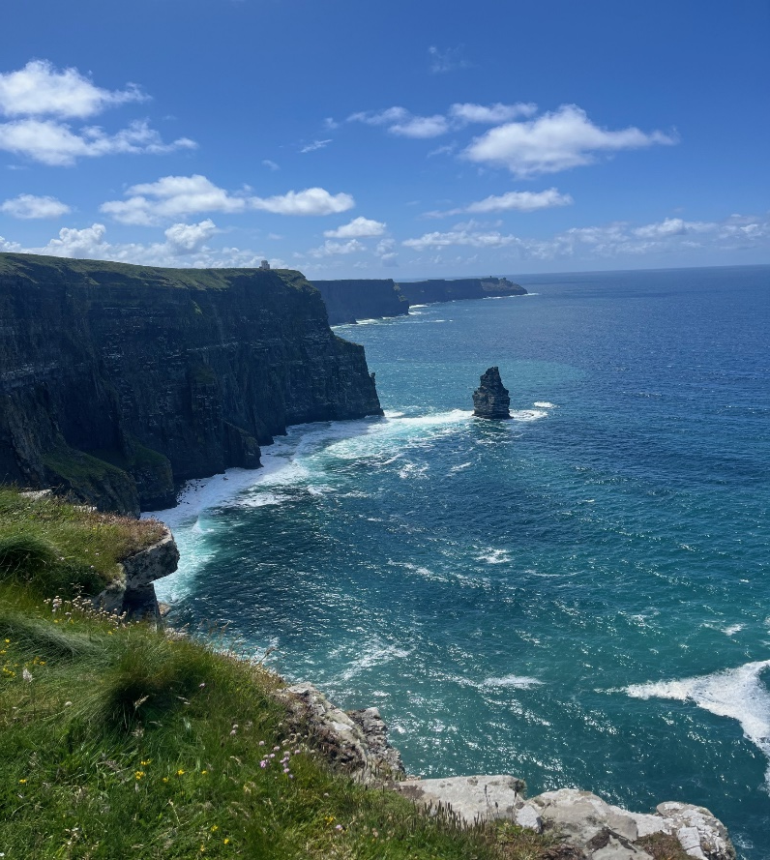

Bucknell In Dublin
By Evan Miserendino
Department of Mechanical Engineering and Management, Bucknell University, Lewisburg, Pa.
Abstract
This past summer I participated in Bucknell in Dublin. Bucknell in Dublin offered a dynamic intersection of personal, academic, and professional growth within a vibrant culture and society. I embarked on this journey with Associate Professor of Practice in Analytics & Operations Management, Joe Wilck, Dean for the Freeman College of Management, Ivy Kepner, and twenty-eight other Bucknellians. The 8-week summer program completely changed my identity and world view. Taking classes, working, and living abroad opened my eyes to a different way of life. I was forced to immerse myself and become familiar with a completely different culture. I am forever grateful for Bucknell and this program. During Summer 2024, I made amazing memories with students that will last an eternity. It has truly been the best summer of my life.
Course Work
Internship
Cultural Events
The Free Weekend
Course Descriptions:
MGMT 290 and ANOP 315: Guinness to Globalization
MGMT 290 is an interdisciplinary exploration of the management in Ireland through the lens of culture and an internship experience
ANOP 315 showcases the historical management of operations and services strategies of Ireland
ANOP 315 covers basic topics in operations and supply chain management related to agriculture, manufacturing, and logistics
Course Logistics ANOP 315:
Three hour lectures once a week
Case Studies and in class discussions
Field trips to emphasize the political, geographical, and economic challenges faced throughout history
Weekly writing assignments
Final paper highlighting the time periods of Ireland from Pre-Industrial Period to Present Day
Course Logistics MGMT 290
Working an internship four days a week
Weekly blog posts
Company/Role:
Sunstone AI
24-26 Bridge Street, Ringsend, Ireland
Assisted Sunstone, using computer programming techniques, to analyze sales and other data, to develop optimal marketing strategies
Outside of Office Experience:
Invited by my boss, Roger Courtney, to attend Analytics and AI Awards Ceremony
This was black-tie dinner held at the Round Room at the Mansion House in downtown Dublin
The common theme amongst the companies attending was the incorporation of generative AI to help provide more efficient solutions for the world’s problems
Lessons Learned From Internship:
Sunstone was not just a company, it was a family
Working for a small startup data analytics company has taught me the importance of connectivity
Despite being just an intern, I felt valued and respected in the office
Hurling Match:
I attended the All-Ireland Hurling Semi Finals at one of the largest and most iconic sports stadiums in Europe, Croke Park
Having the opportunity to see Kilkenny square off against Clare live was thrilling
While cheering on Clare during the match, I noticed how passionate both county’s fanbases were
It was truly a battle until the final minute which made the game that much more riveting
These gentlemen, who receive no pay for playing, sacrificed everything on the pitch
The heart and pride these players had for their county and the sport was incredible
Visiting Cliffs of Moher:
Seeing the Cliffs of Moher at first was emotional
The last time I was here, my family and I spread my grandparents’ ashes over the cliffs
I had to hold back some tears at first
However, sitting alone allowed me to reconcile with my past experience
I understood the validity in my family’s actions
My grandparents wanted so badly to travel to Ireland and reconnect with their heritage but never had the opportunity
We did the next best thing by letting them finally rest peacefully in their ancestral homeland.
Traveling to Amsterdam, Netherlands (A Remarkable City):
Amsterdam Day 1:
Walked around the Jordaan - quite a charming neighborhood.
Many narrow streets, picturesque canals, and historic buildings, such as the Anne Frank House
Bikes, the tram, and two seat electric vehicles called a Canta, are the main modes of transportation in the city
Without any gas powered vehicles, there is little noise pollution
Amsterdam Day 2:
I am an avid house music and EDM fan
Toured Our House: The EDM Museum in Amsterdam
This museum is dedicated to the history and culture of electronic dance music
Amsterdam Day 3:
Toured the Heineken Factory in Amsterdam
I learned about the brewery’s rich history, beer-making process, and global brand evolution
In Ireland they say Sláinte! In the Netherlands, it is Proost!
Amsterdam Day 4:
Wandered around near Vondelpark
Vondelpark is Amsterdam’s most famous and largest urban park in the heart of the city
Acknowledgements
I can not thank my family enough for allowing me to participate in this program abroad. They sacrificed so much for my sister and I in order to provide us with the best life opportunities. I am so unequivocally grateful for that.

