Slide 1

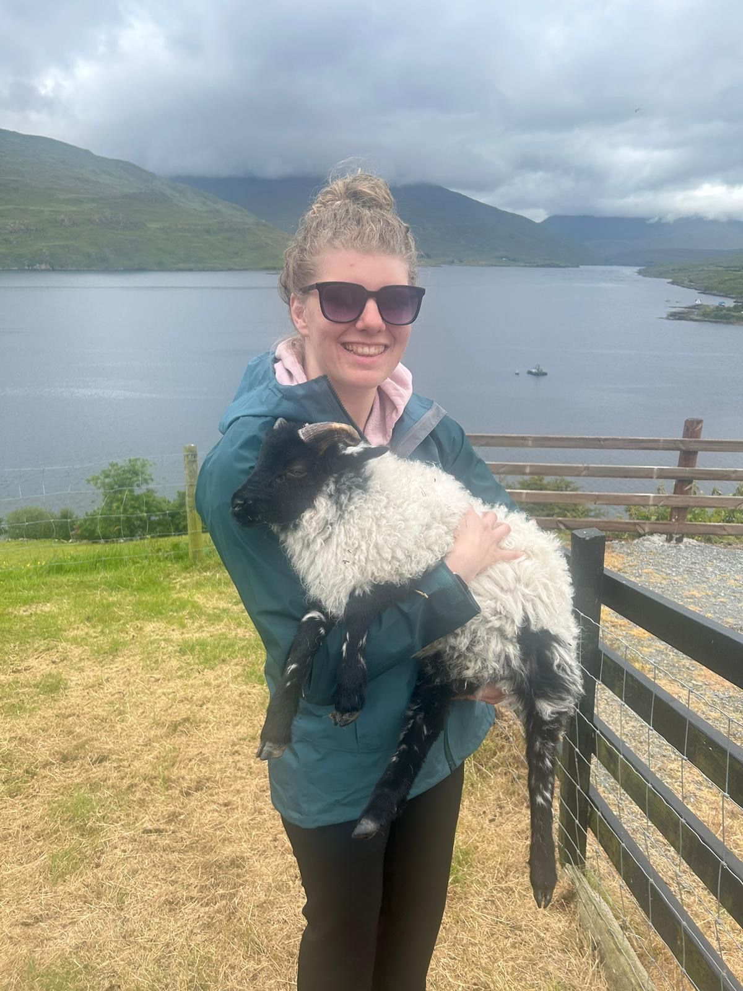
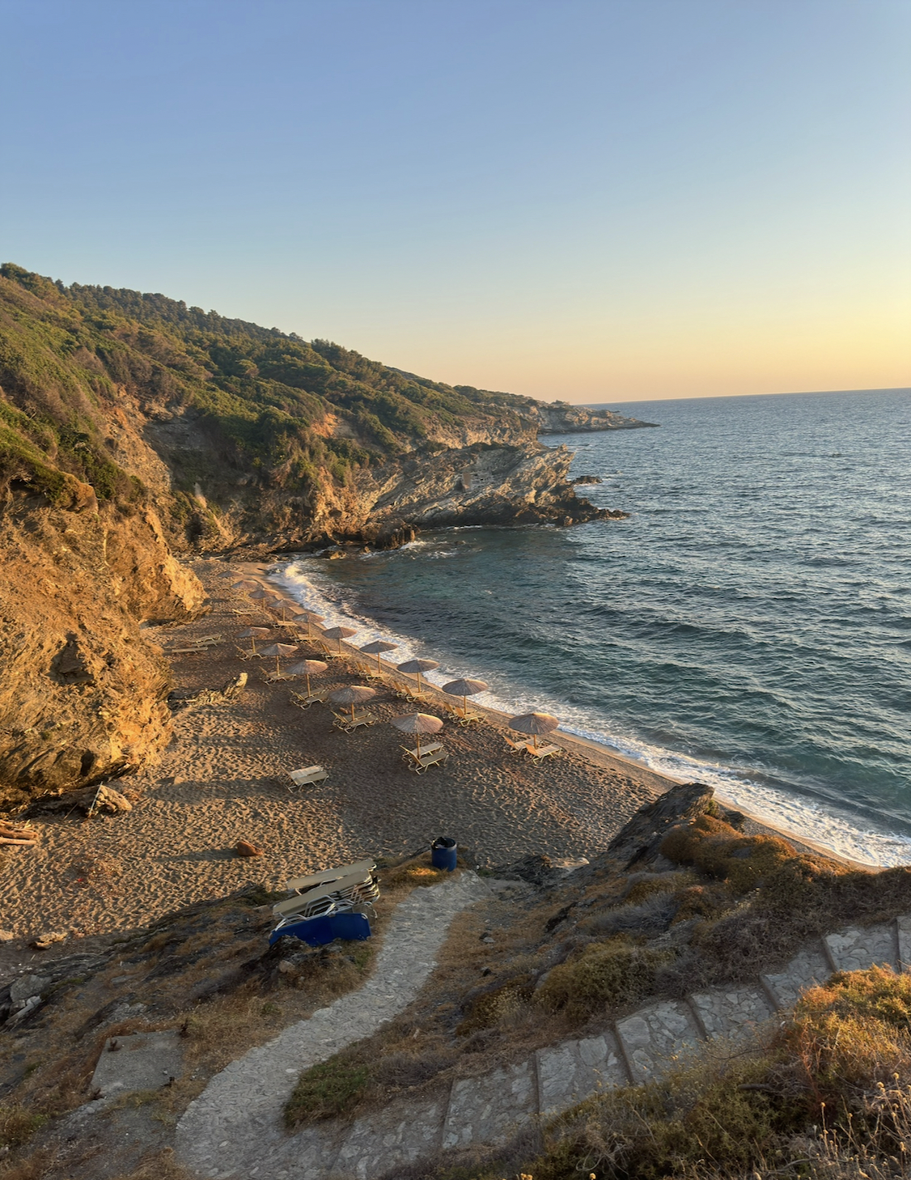
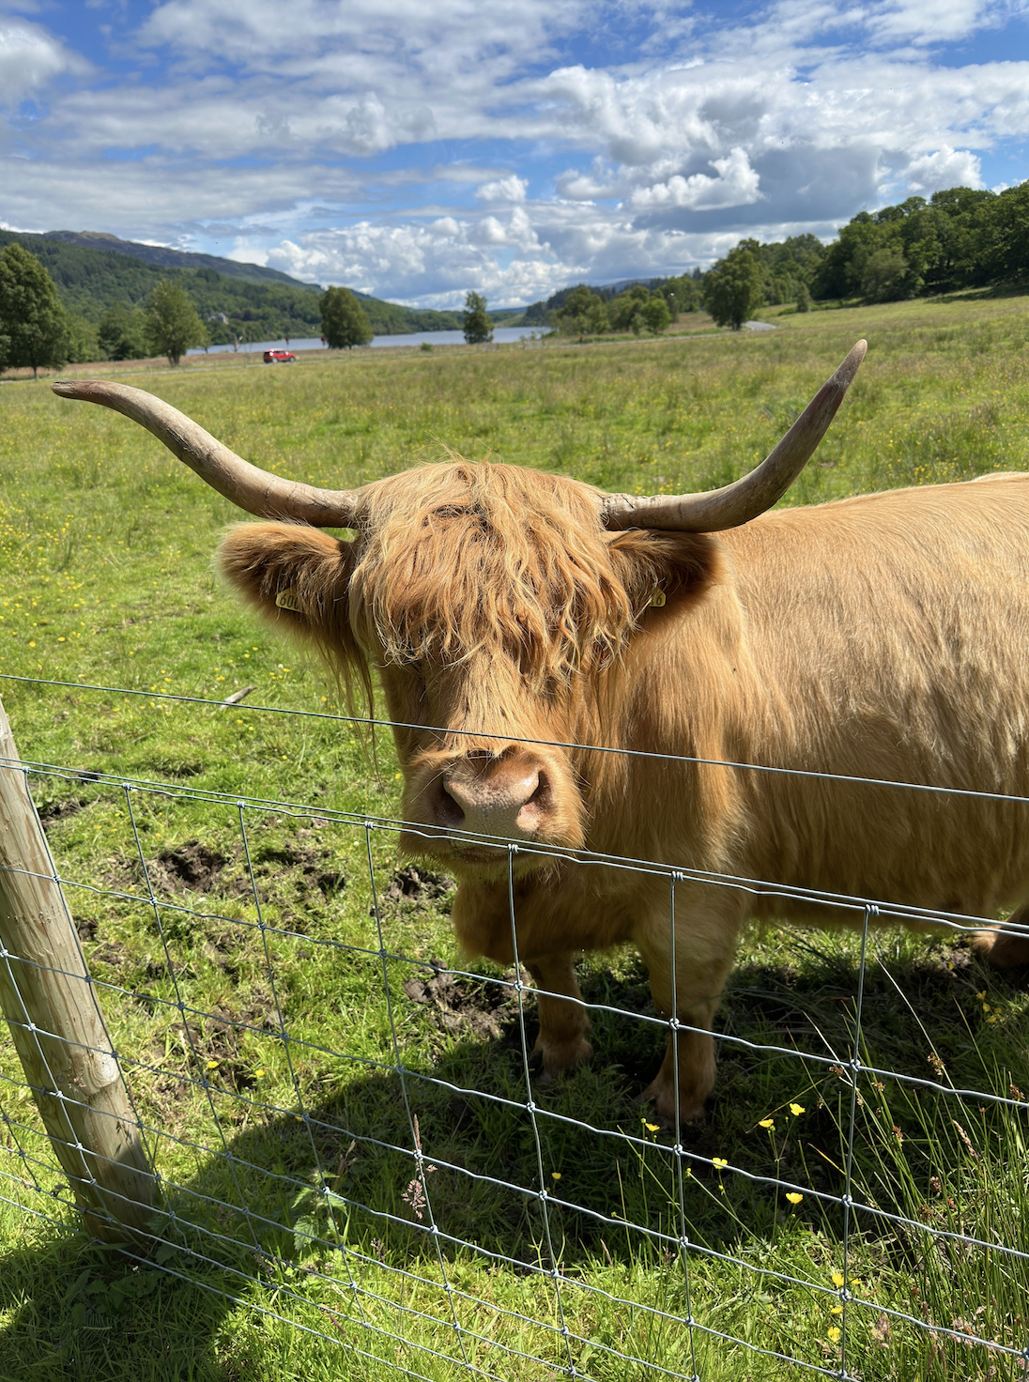

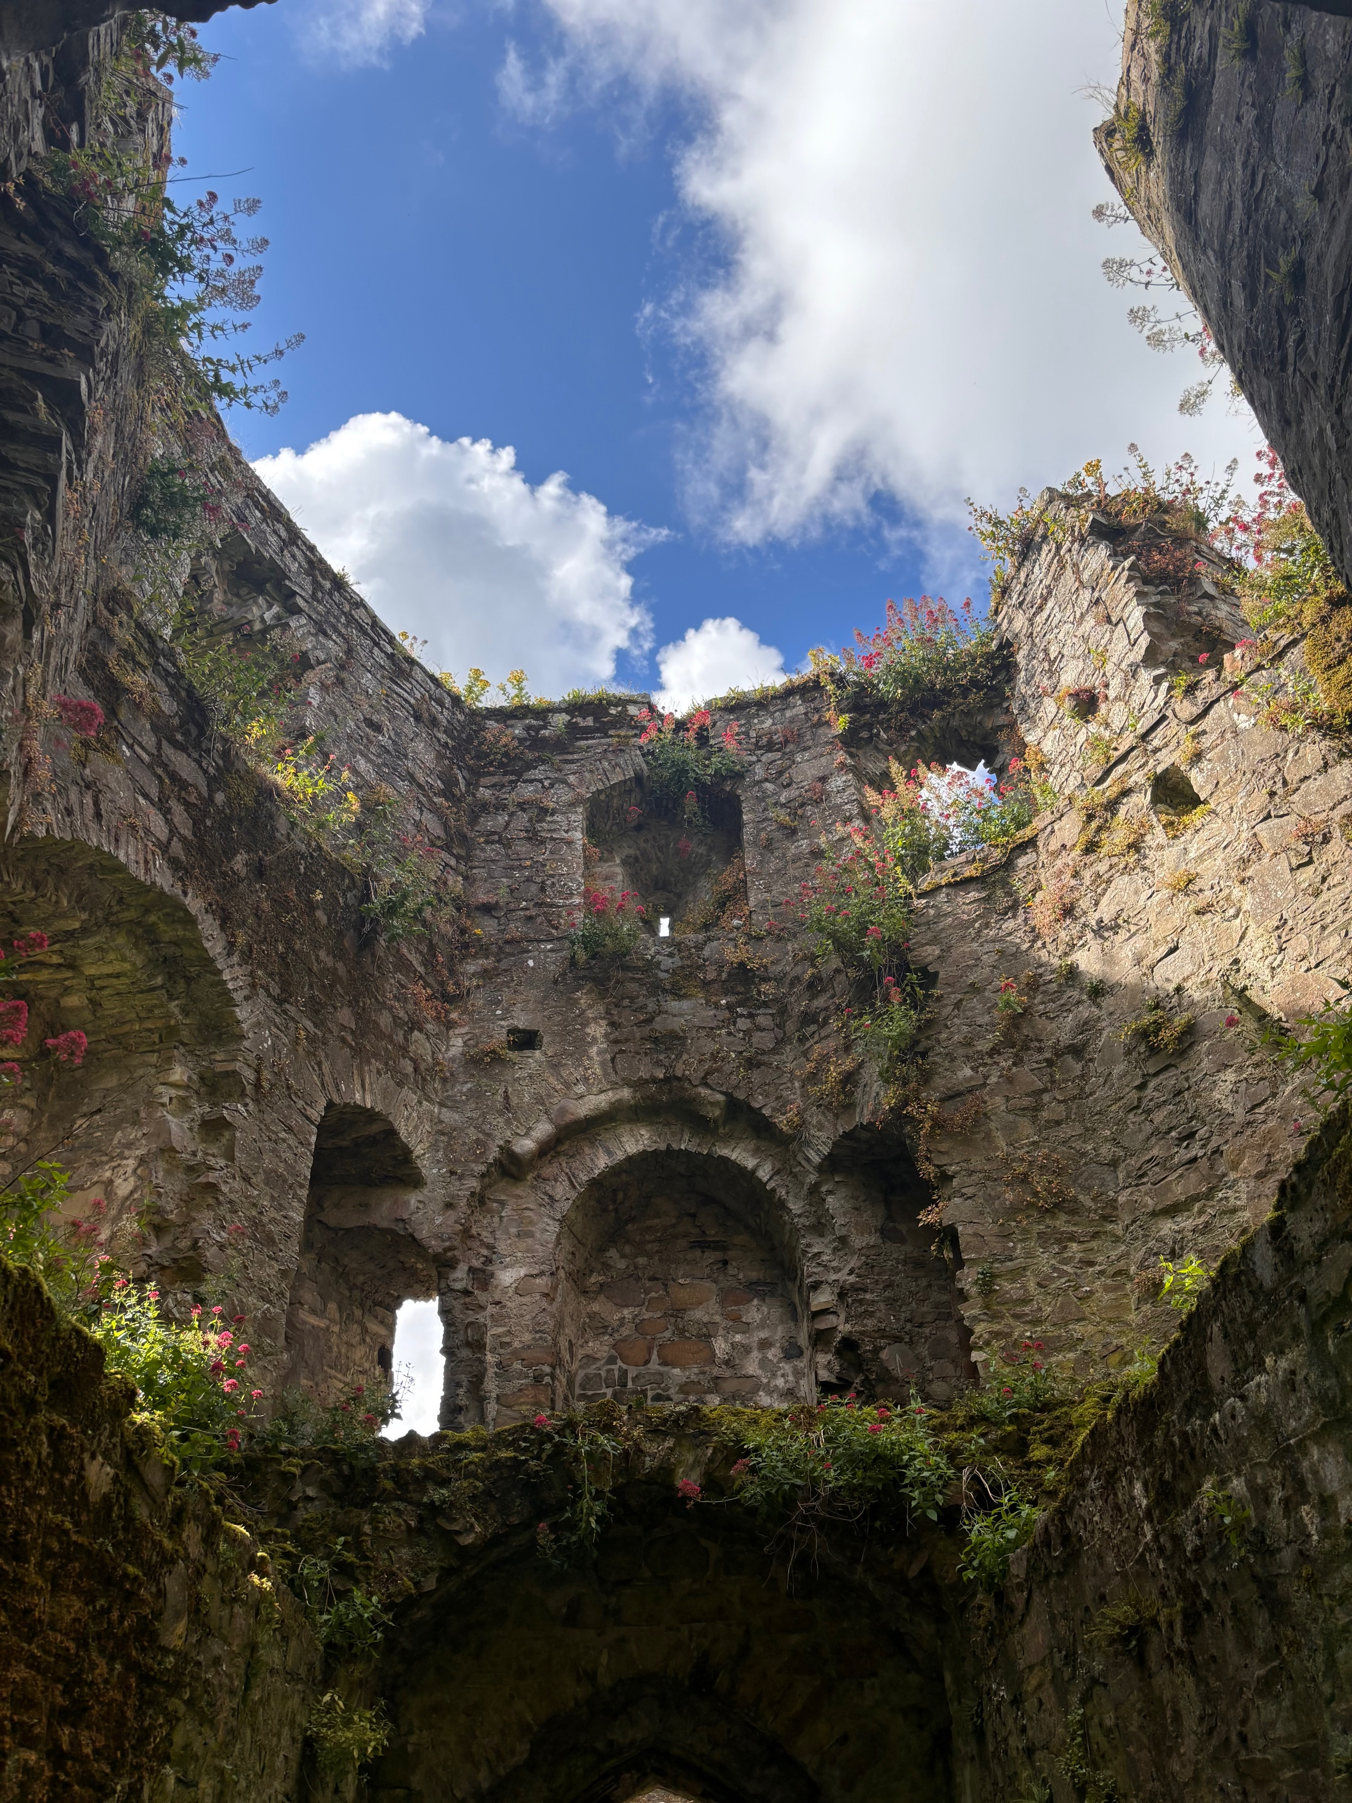
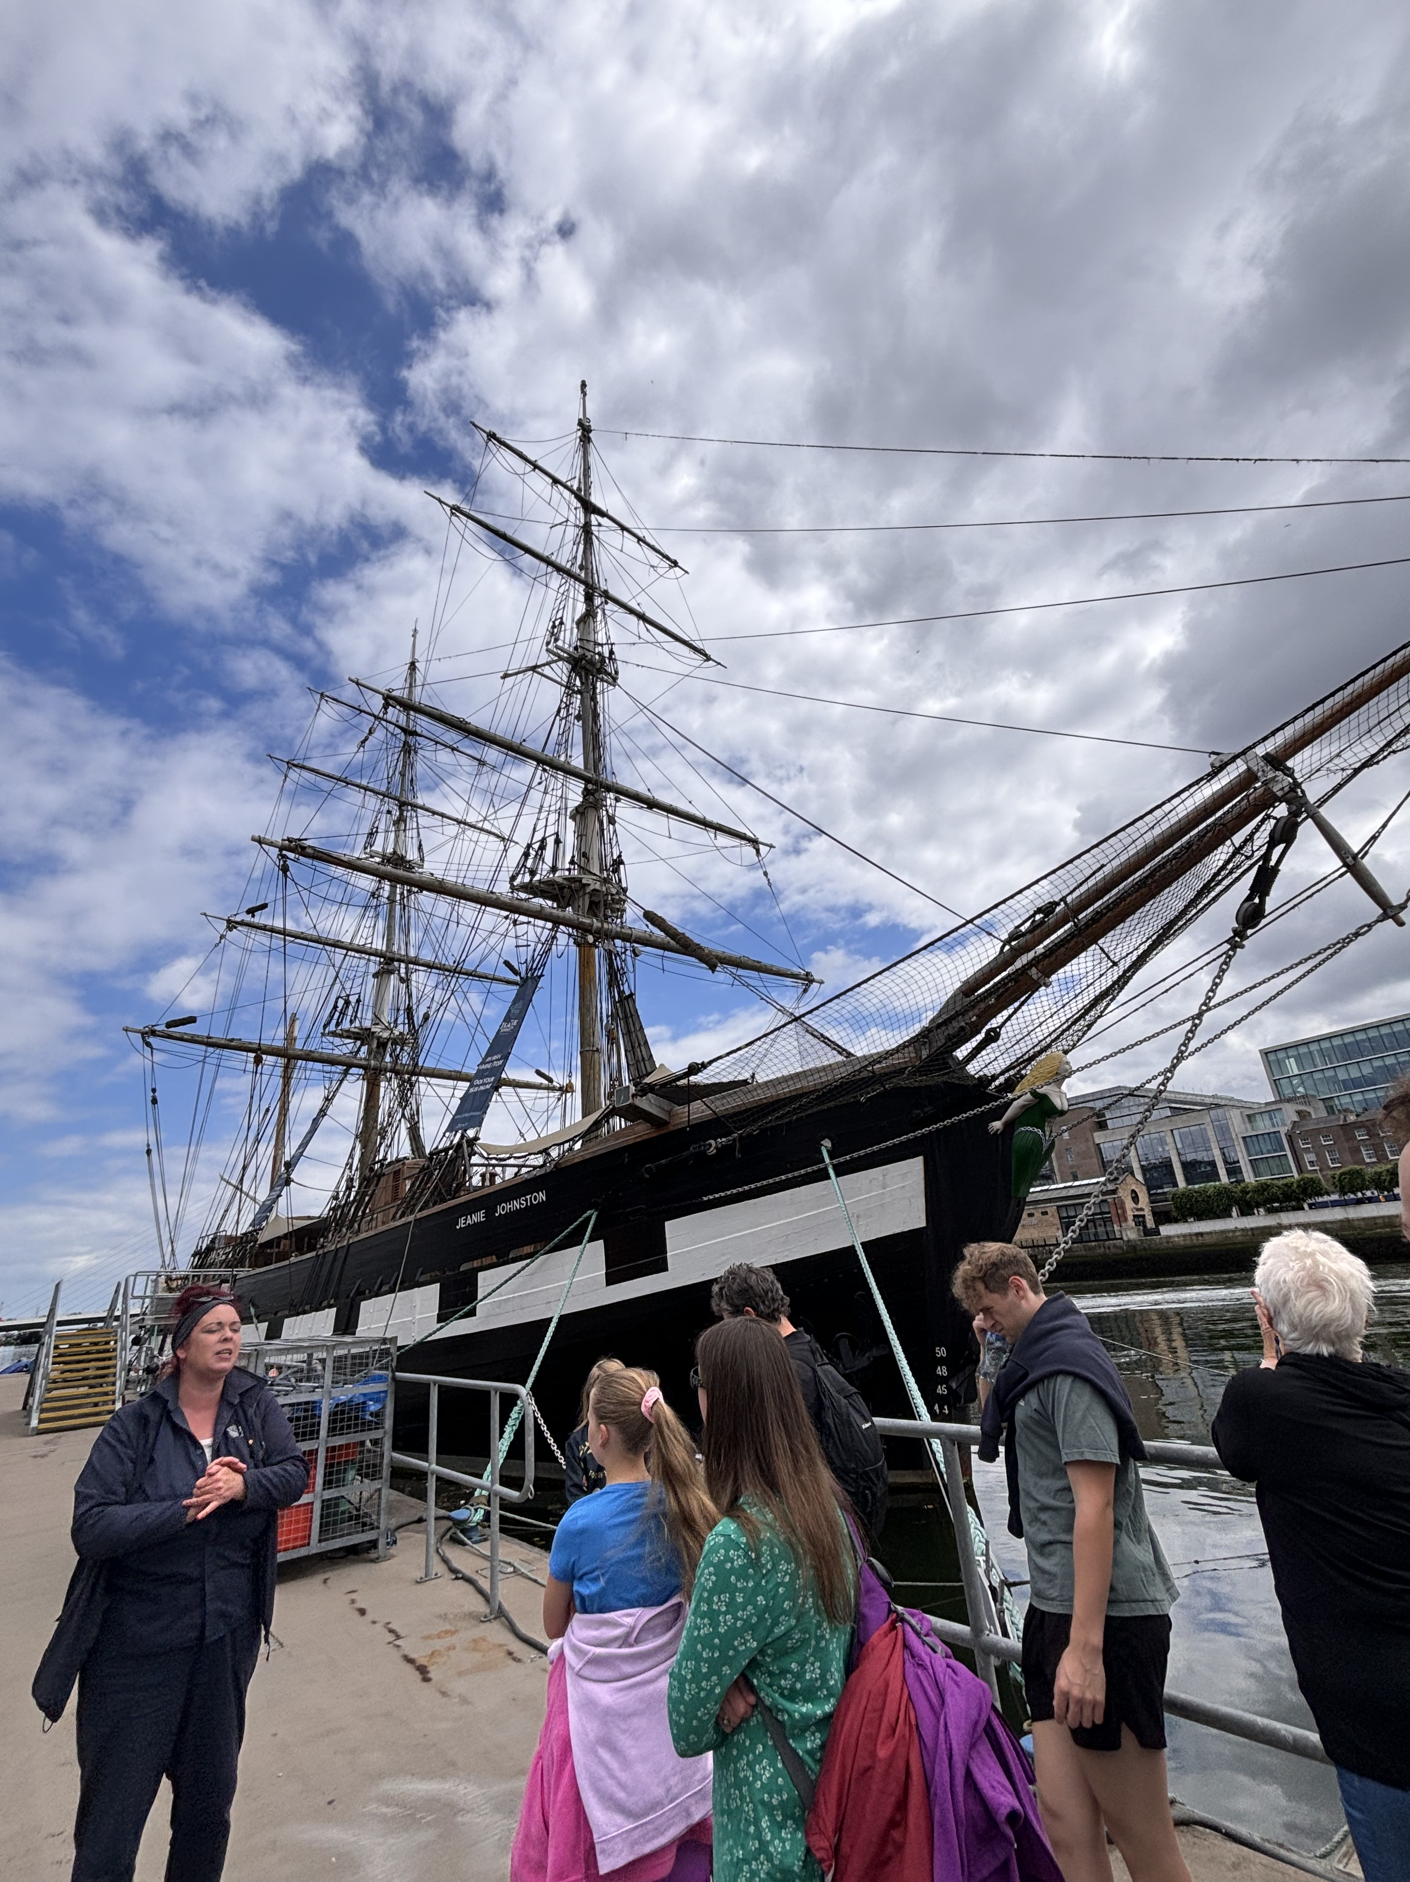
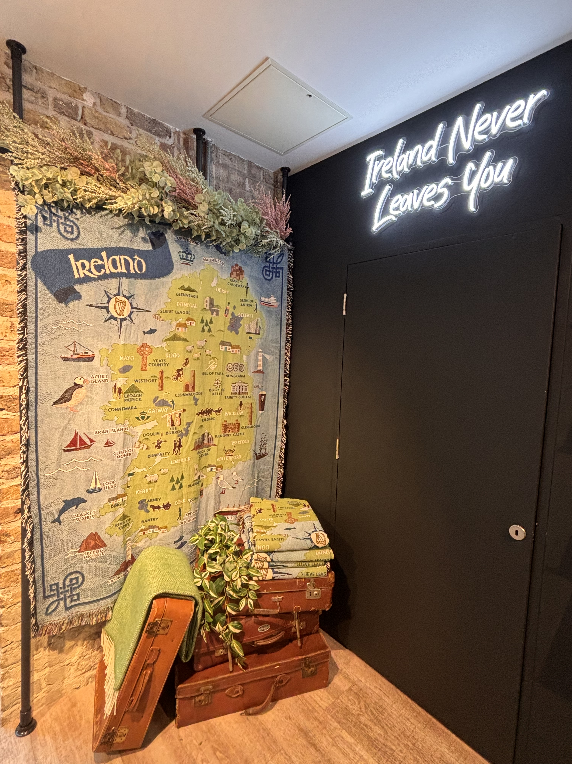
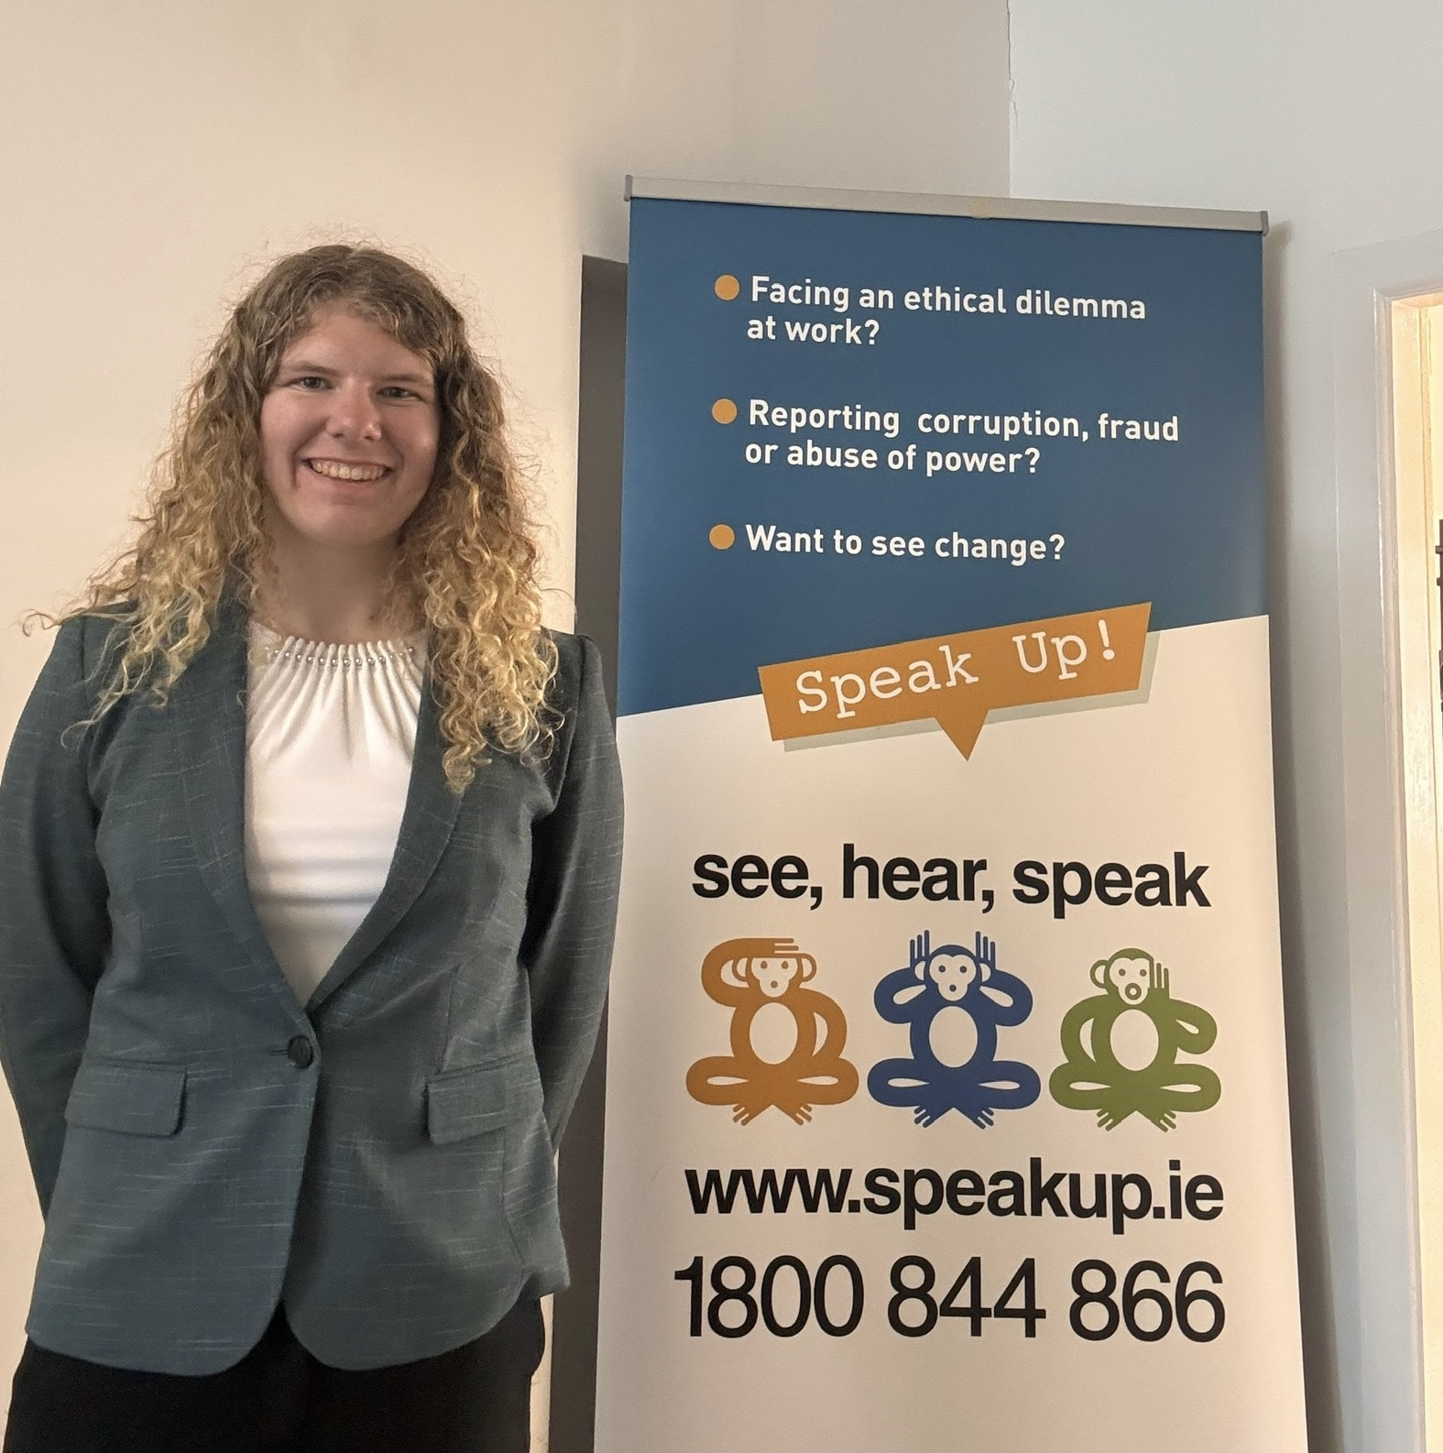
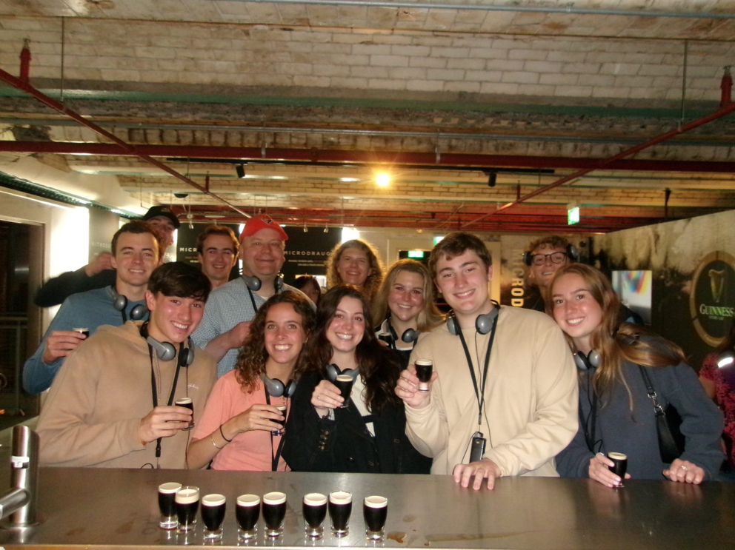
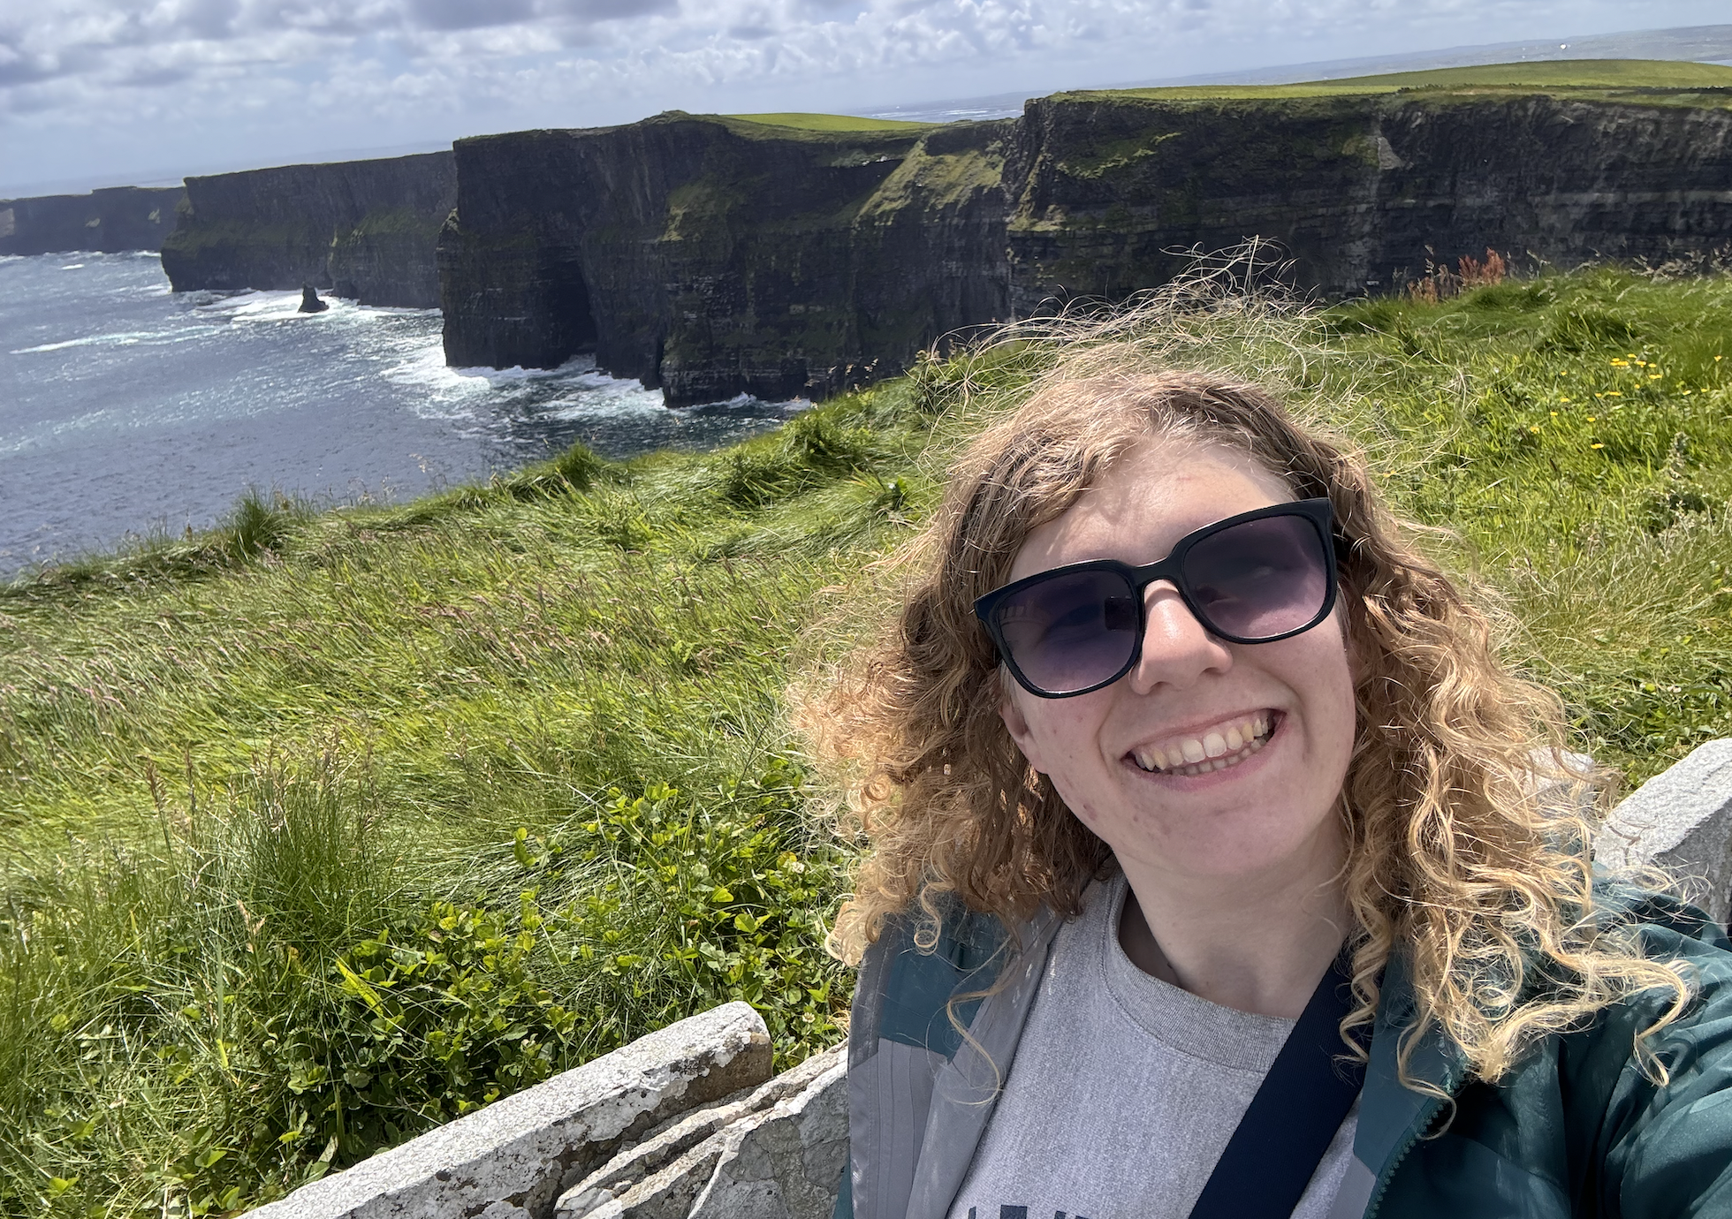
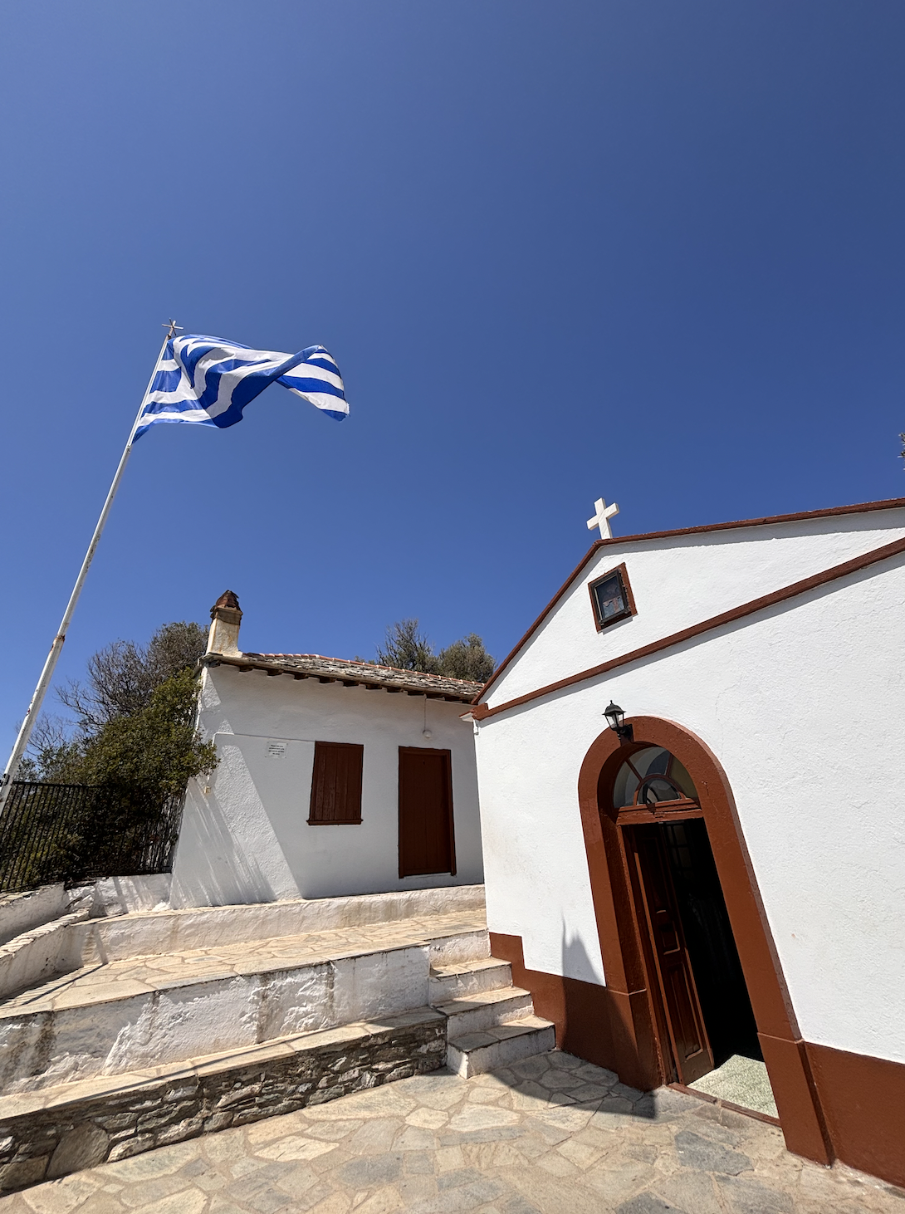
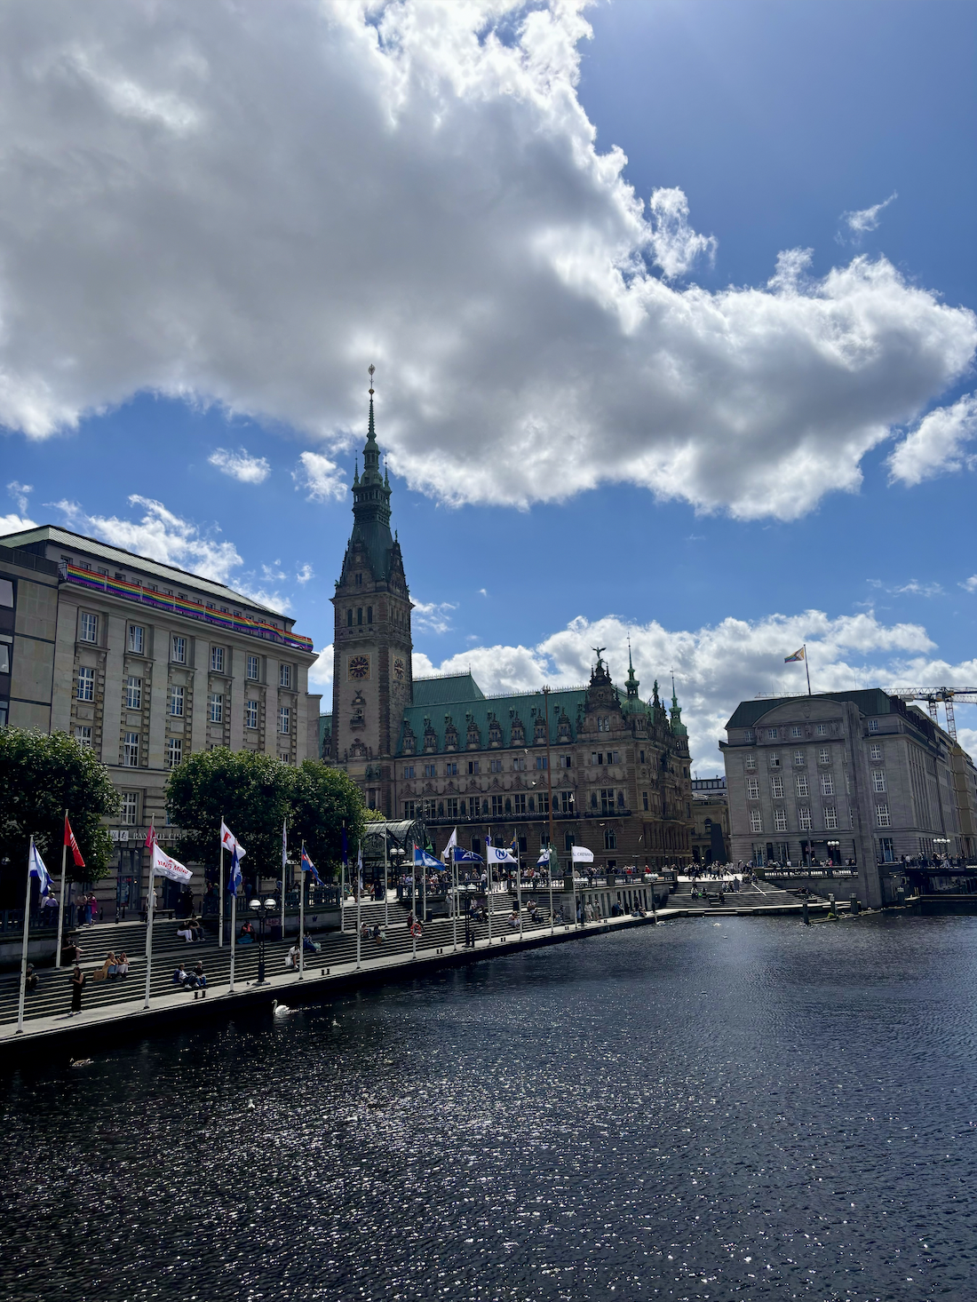
Kayla Howie – Bucknell in Dublin
Summer 2024
Abstract
Spending June and July of 2024 working with Transparency International Ireland and traveling throughout the country of Ireland has been beyond rewarding and has aided in the continual evolvement of my perspective on the world and what I want for the future. The course work brought a fresh perspective to concepts I had already learned and has expanded my worldview. The Bucknell in Dublin program took us to every corner of the country, and we were able to explore so much of Ireland and ourselves with the constant support of Bucknell. I cannot overstate how grateful I am for this program.
Course Work
Internship
Cultural Events
Personal Travels
Helpful Credits:
2 full Bucknell credits
300-level ANOP and 200-level MGMT
W2 and Global Connections requirements
Logistics:
Once a week for 3 hours
Global perspective on operations
Case studies
Reflective writings
Experiential Learning:
Internship
Museums
Trips throughout Ireland
Transparency International Ireland
Speak Up Helpline Adviser & Legal Executive
Responsibilities:
Respond to national helpline for reporting workplace corruption
Research and connect potential whistleblowers to necessary legal resources
Logistics:
Commute from University College Dublin campus Tuesday–Friday
Work 10-6 (chosen over 9-5 option)
Given stipend for lunch
In Dublin:
8 tours (emigration, history, culture)
4 dinner events
Around Ireland:
22 unique locations
2 overnight trips (Galway and Belfast)
Highlights:
Holding a sheep at a sheep farm
Cliffs of Moher
6 castles (Including kissing the stone at Blarney Castle)
Greece:
Friday–Sunday
Two islands - Beaches, Mama Mia! set, food
Scotland:
Day trip to Glasgow
Loch Lomond, Sterling Castle, Highland Cows
Germany:
Saturday–Wednesday (free weekend for everyone on the trip)
Hamburg - Visiting family friends

