Slide 1
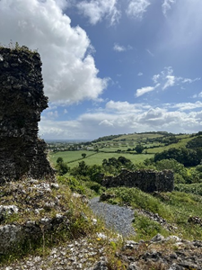
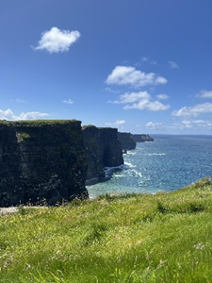
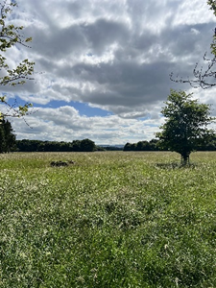
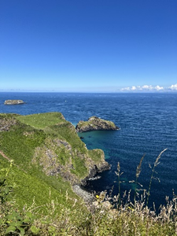

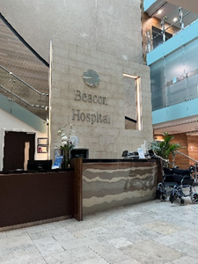
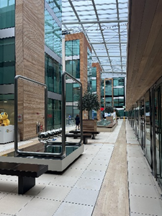
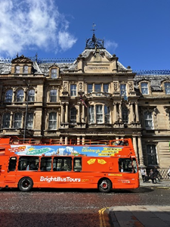
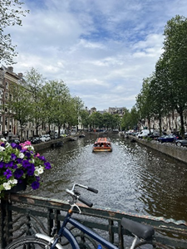
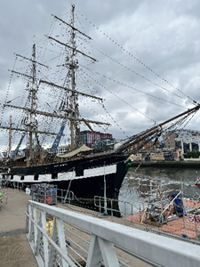
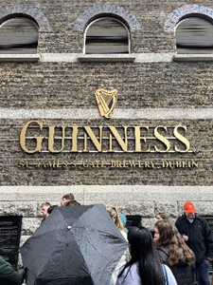
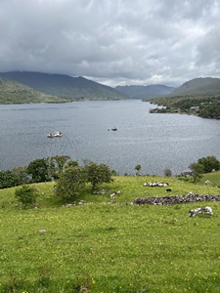
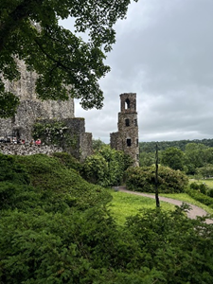
Madelyn Gerst: Bucknell in Dublin
Bucknell University, Lewisburg PA
Abstract
Last fall, I decided to apply to the Bucknell in Dublin study abroad program, and I haven’t looked back since. I had the experience of a lifetime in Ireland and am grateful to have been able to grow as a person and a professional. While in Ireland, I took two courses through Bucknell taught by Bucknell professors. I was able to learn in a classroom setting but also used Ireland as my classroom. I spent Tuesday through Friday in my internship at Beacon Hospital. There I worked with many professionals to audit patient handover and process flow within the theatre (surgery) department. Outside of class and my internship, I was fortunate enough to explore a large bit of Ireland. We went just about everywhere, taking in the beautiful sites and appreciating the culture. I loved my time in Ireland and would urge anyone to apply!
Course Work
Cultural Events
While studying abroad in Dublin, I was enrolled in two Bucknell classes. We met every Monday from nine to twelve and went on half-day trips in the afternoon. This mix of in-person and experiential learning boded well for my personal and professional growth. ANOP315: Guinness to Globalization dove into the history of Ireland from an operations perspective. Our assignments consisted of weekly writings that built up to our final paper due at the end of the program. MGMT290: Management in a Global, Societal, and Cultural Context used Ireland as its classroom. We got to explore many historical sights, museums, and tourist attractions to shape a better understanding of the culture and traditions of Ireland. My favorite trips were those to the Jeanie Johnston replica on the River Liffey and the Guinness Storehouse. Our assignments included weekly blogs, a reflection paper, and two projects. Overall, I feel as though these classes allowed me to become a better learner and writer while also educating me on the rich history of Ireland.
Maybe my favorite part about visiting Ireland was the opportunity I got to explore the country and the culture that makes it unique. One of our first weekend trips was to the west coast of Ireland in Galway. We only spent a night there, but I got to see so much. I really liked visiting the Killary Sheep Farm in Connemara. There, we watched a sheepdog herd a flock of sheep from three pastures over. We got to watch a sheering demonstration and even got to feed the lambs their milk. At Killary, I was able to learn about and appreciate the tradition of raising and selling sheep. It is and has always been a huge part of Irish culture. Another trip that sticks out to me was our visit to Blarney Castle near Cork. I had been anticipating this trip because I wanted to kiss the Blarney stone and receive the “gift of gab.” It was neat to see a castle hundreds of years old still prove to be beneficial to the people of Ireland. Tourism is a major industry in Ireland, and Blarney Castle helps keep this sector thriving. Both the Killary Sheep Farm and Blarney Castle are big parts of Ireland’s history and culture even today.
Internship
Travel
During my time in Ireland, I was fortunate enough to intern at Beacon Hospital for the duration of the eight weeks abroad. The Beacon is Europe’s most technologically advanced private hospital. My project was focused on patient handover and process flow, so I was tasked with auditing these processes. I worked closely with the senior administrative assistant, the director of education, and the director of clinical services to take a deeper look into the theatre (surgery) department. There, I collected data and looked specifically for inefficiencies and any lack of consistency throughout the process. A typical day for me looked a little like this. I would arrive around eight and put my scrubs on. Then, I would stay in the holding bay to observe the completion of the pre-operative checklists. I would do this all morning until around twelve. Then, I would take lunch and use the afternoon to put my data into an excel spreadsheet and analyze it. At the end of my eight weeks, I was able to present my findings to a group of my supervisors. This gave them a basis for any future audits they may plan to do.
While I did enjoy exploring Ireland and all it had to offer, I did find myself wanting to see and do as much as possible outside of Ireland as well. My first trip out of the country was to Edinburgh, Scotland. There, I got to visit Old Town, New Town, Swanston Farm, and so much more. I loved seeing Edinburgh Castle, the Royal Mile, and the highland cows. I liked the old feel of the streets there. On our free weekend, I went to Amsterdam, Netherlands for four days. We went on a canal tour, saw the Heineken Museum, walked through the red-light district, and visited a few museums. The city was beautiful and so welcoming to tourists. During this weekend, I also went on a day trip to Brussels, Belgium. We happened to be there on their Independence Day, so we celebrated by attending the festival and visiting the parliament building. I got to eat a proper Belgian waffle and see the museums there. Overall, I think I spent my free time very wisely being sure to see and do as much as possible both inside and outside of Ireland.

