Slide 1

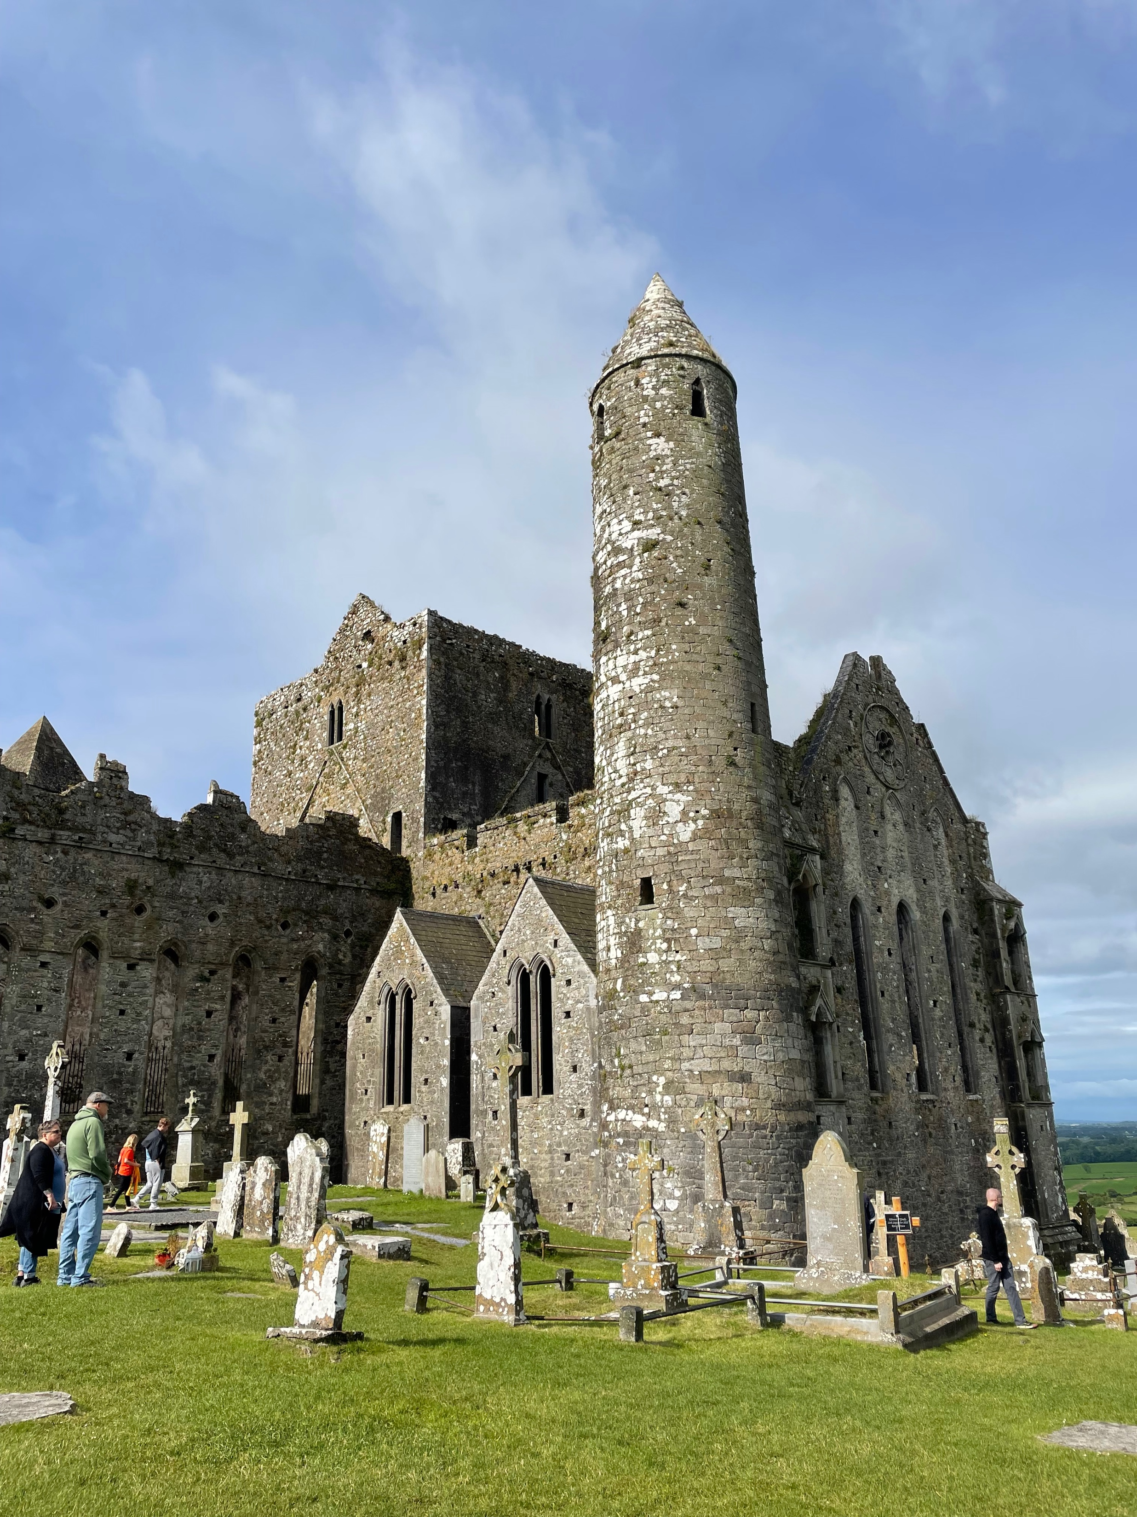
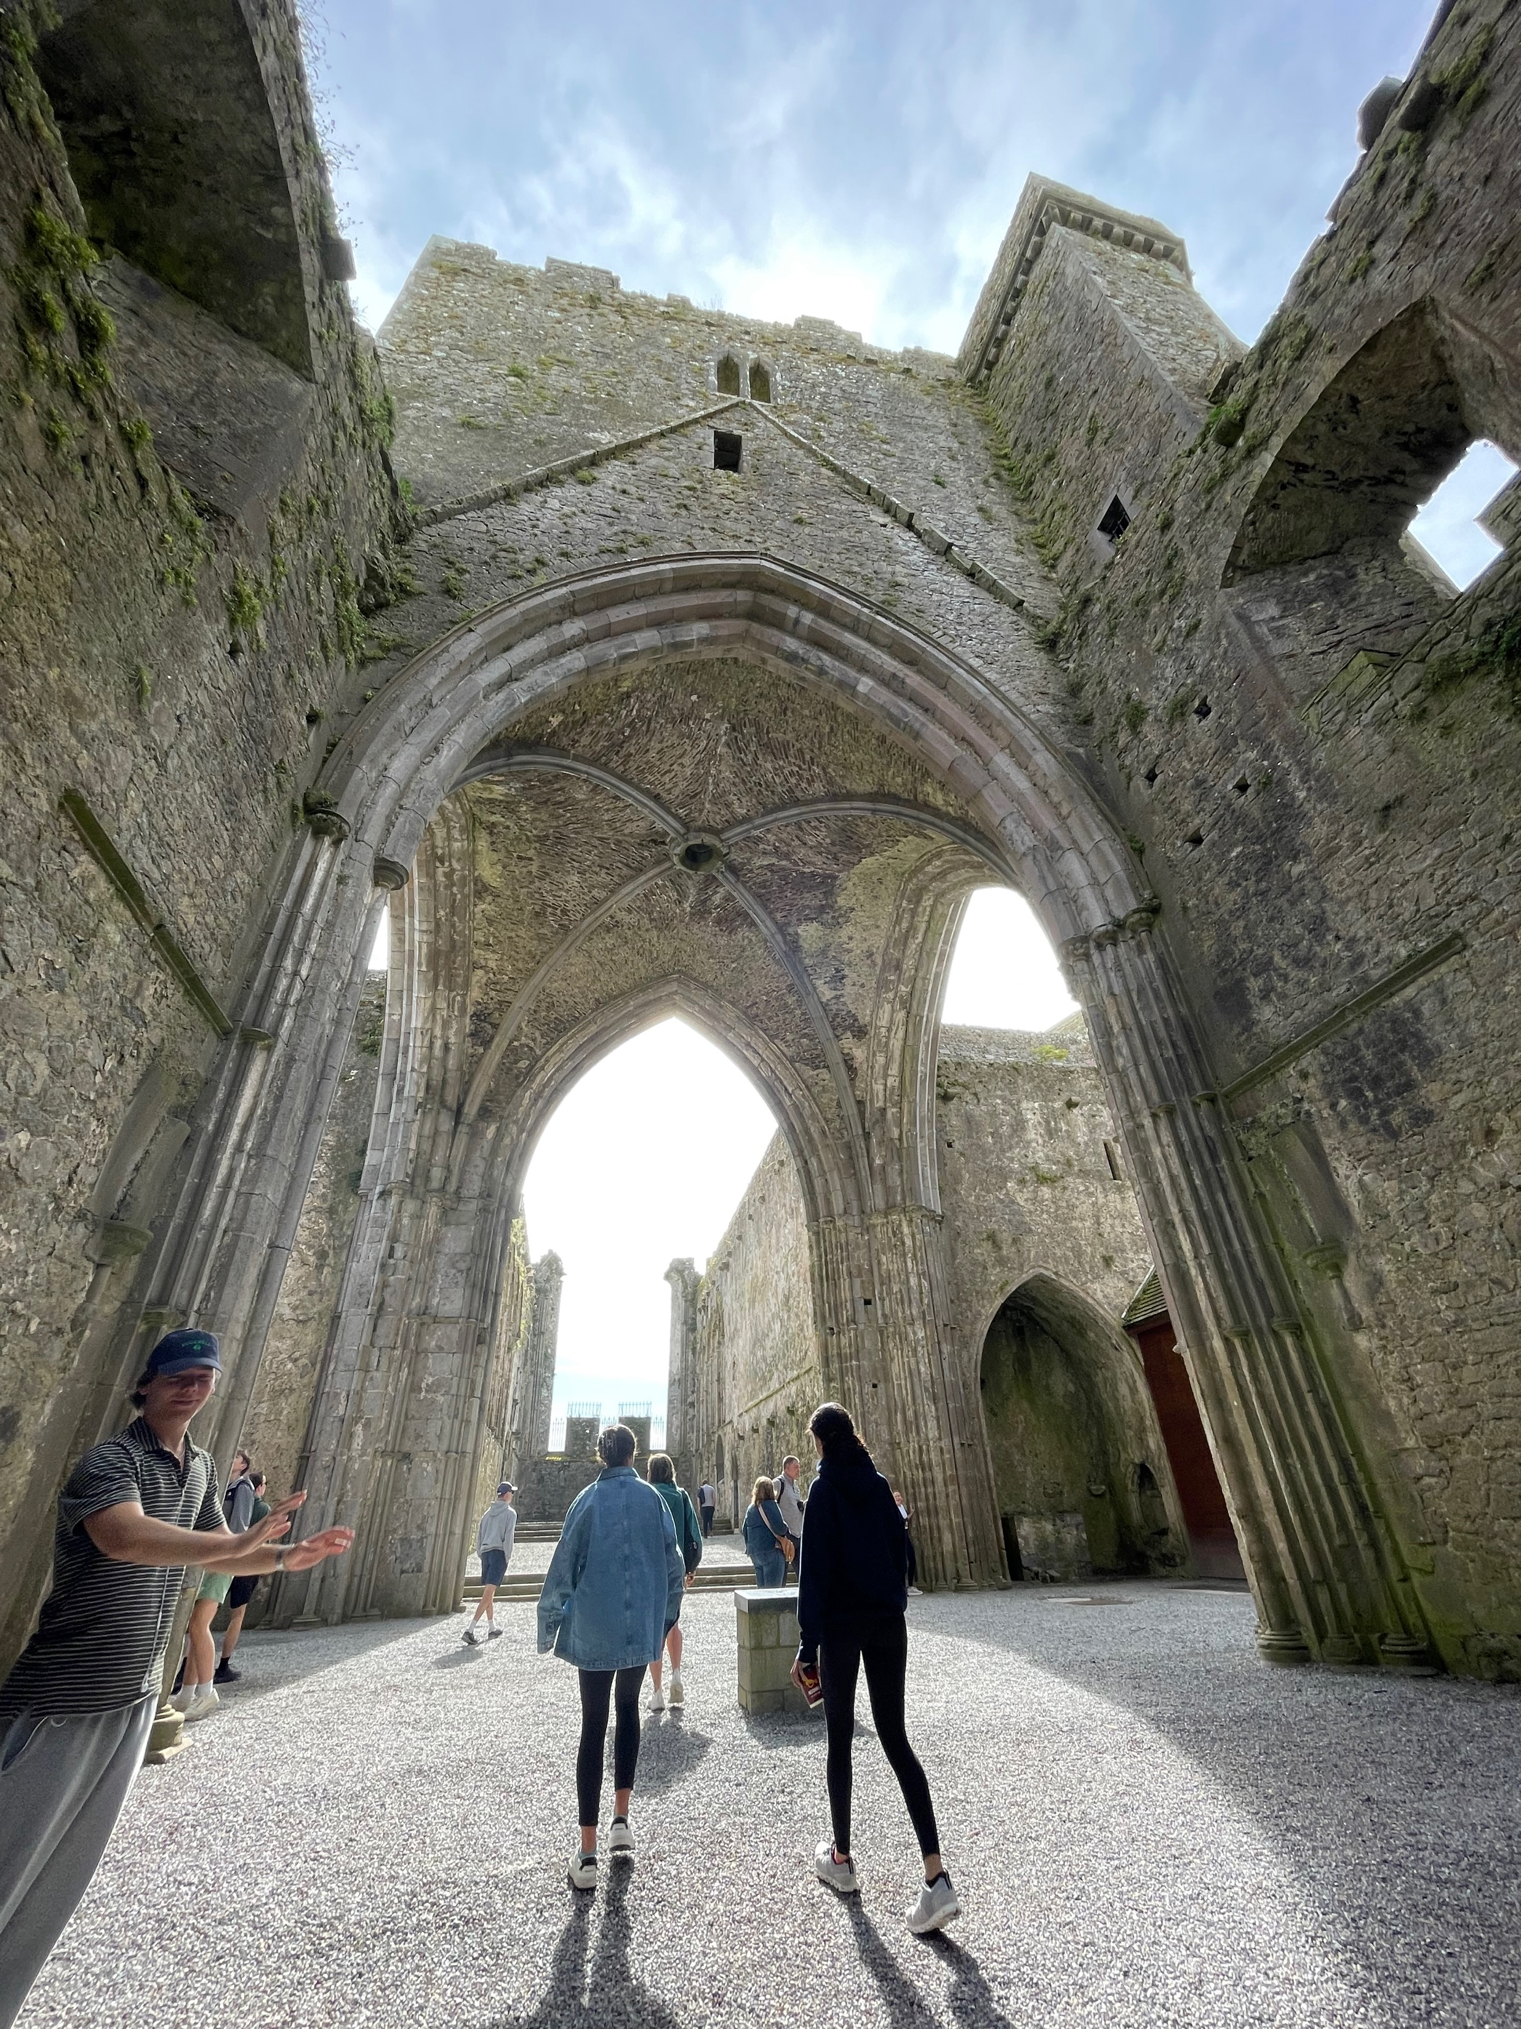
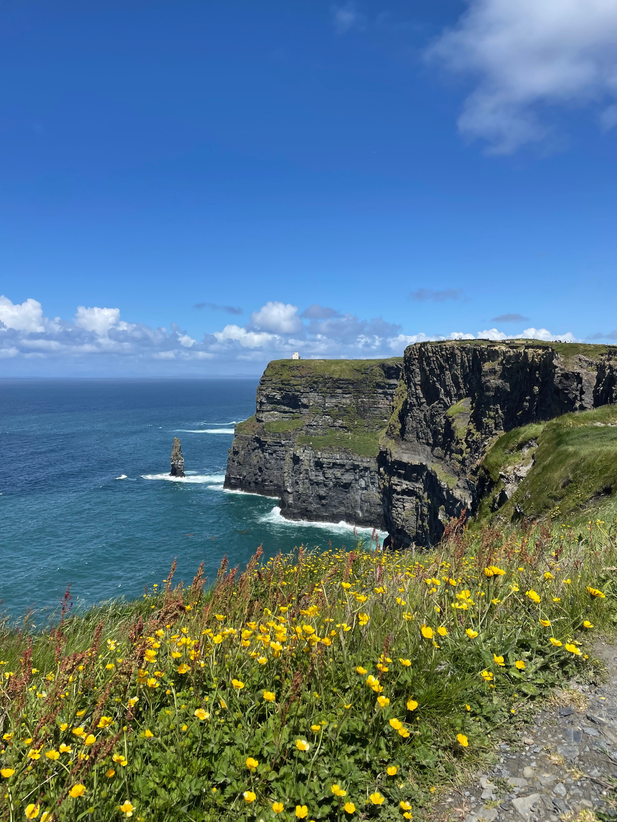
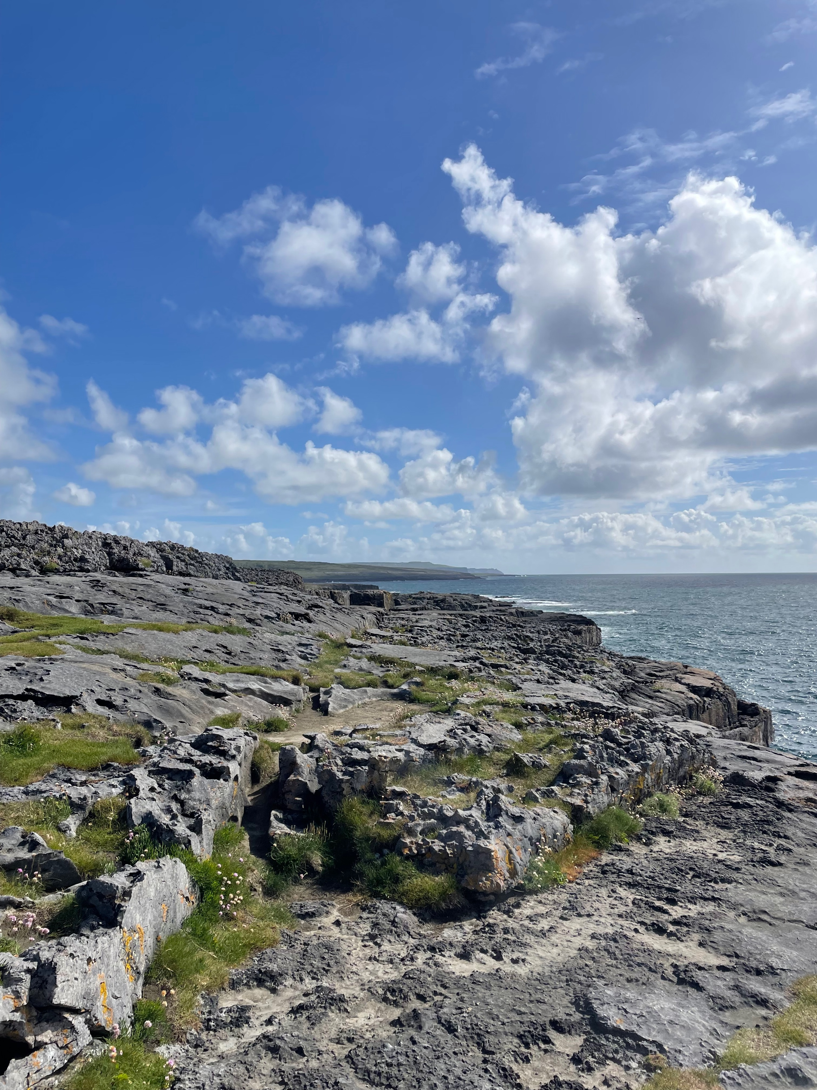

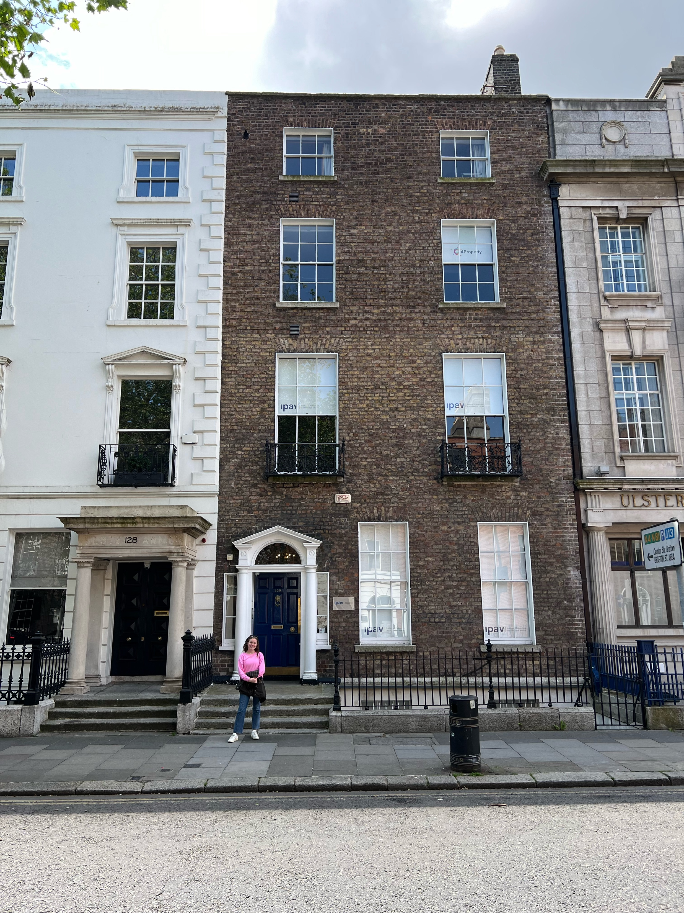
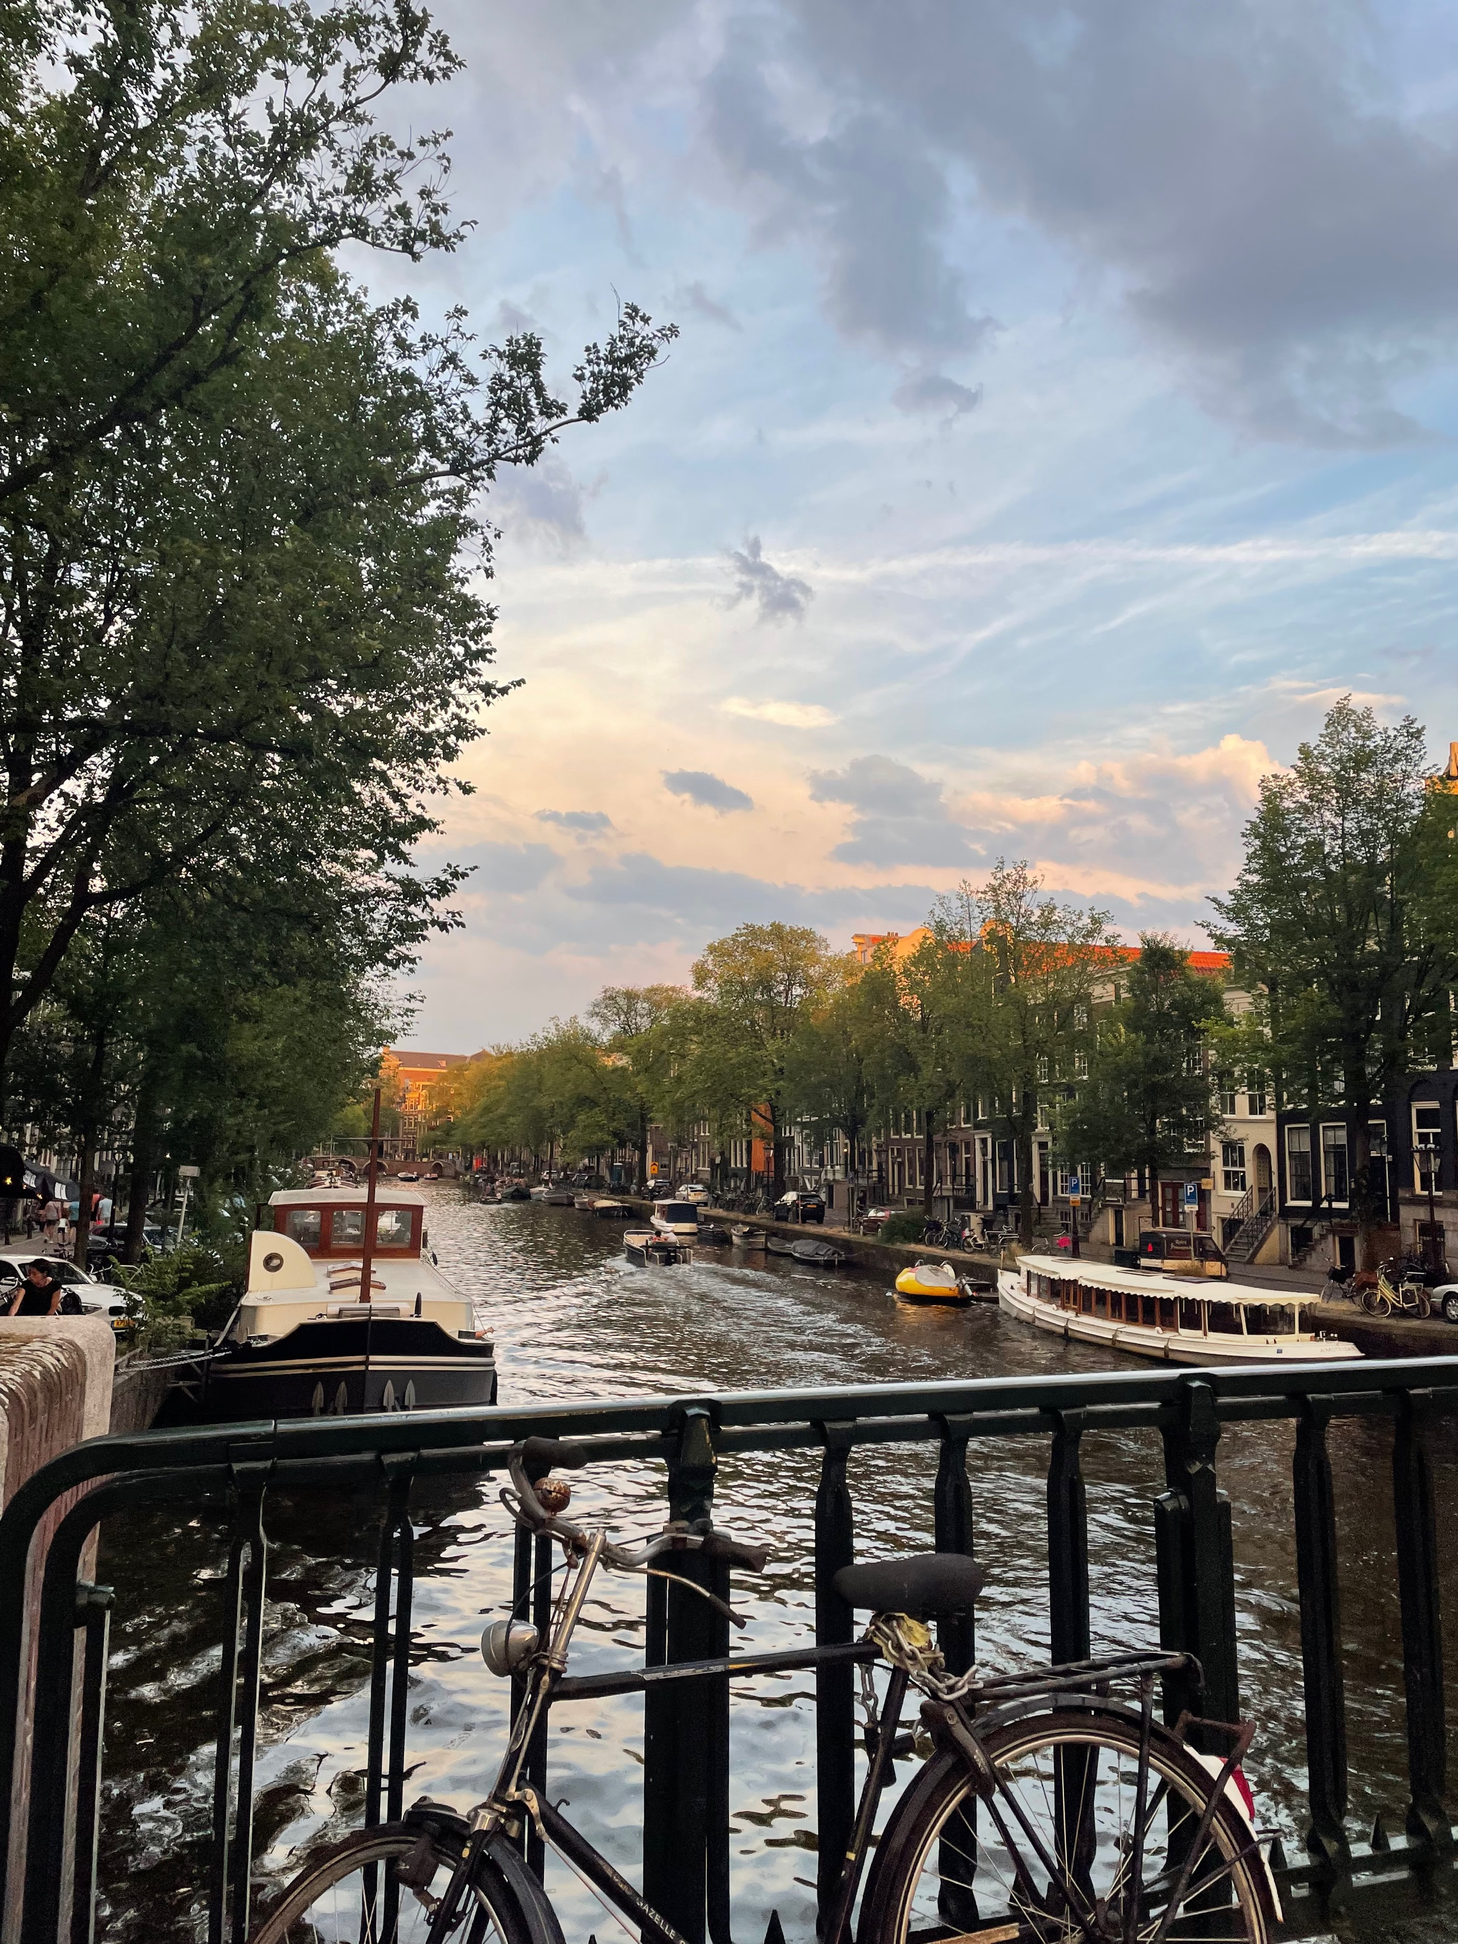
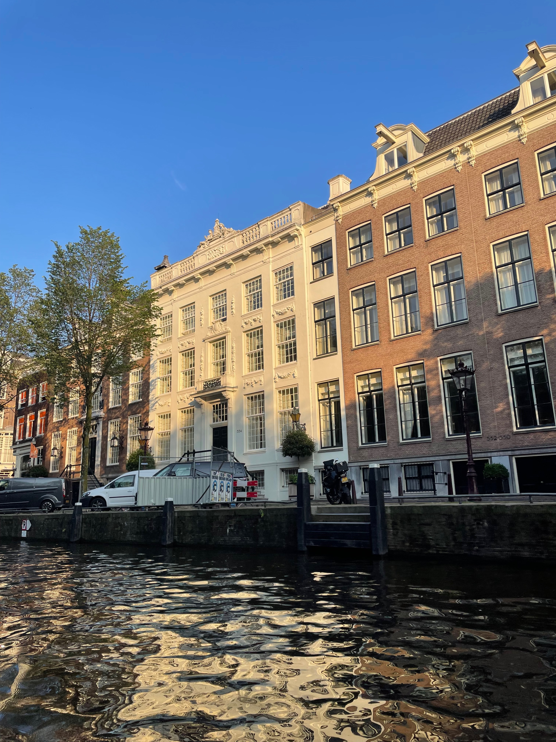
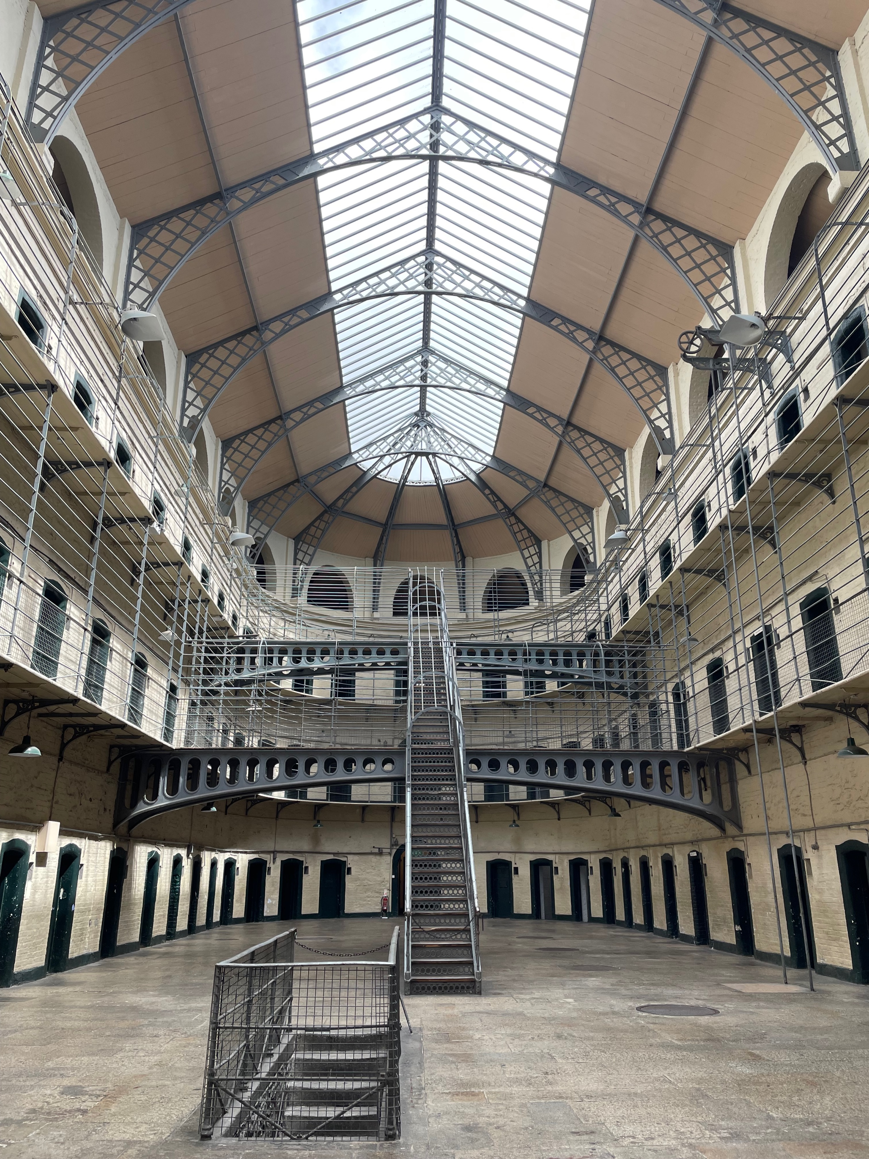
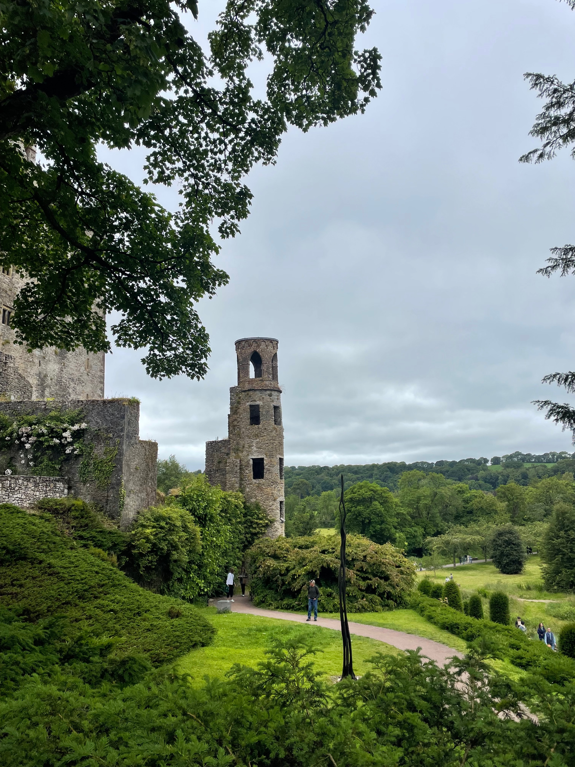
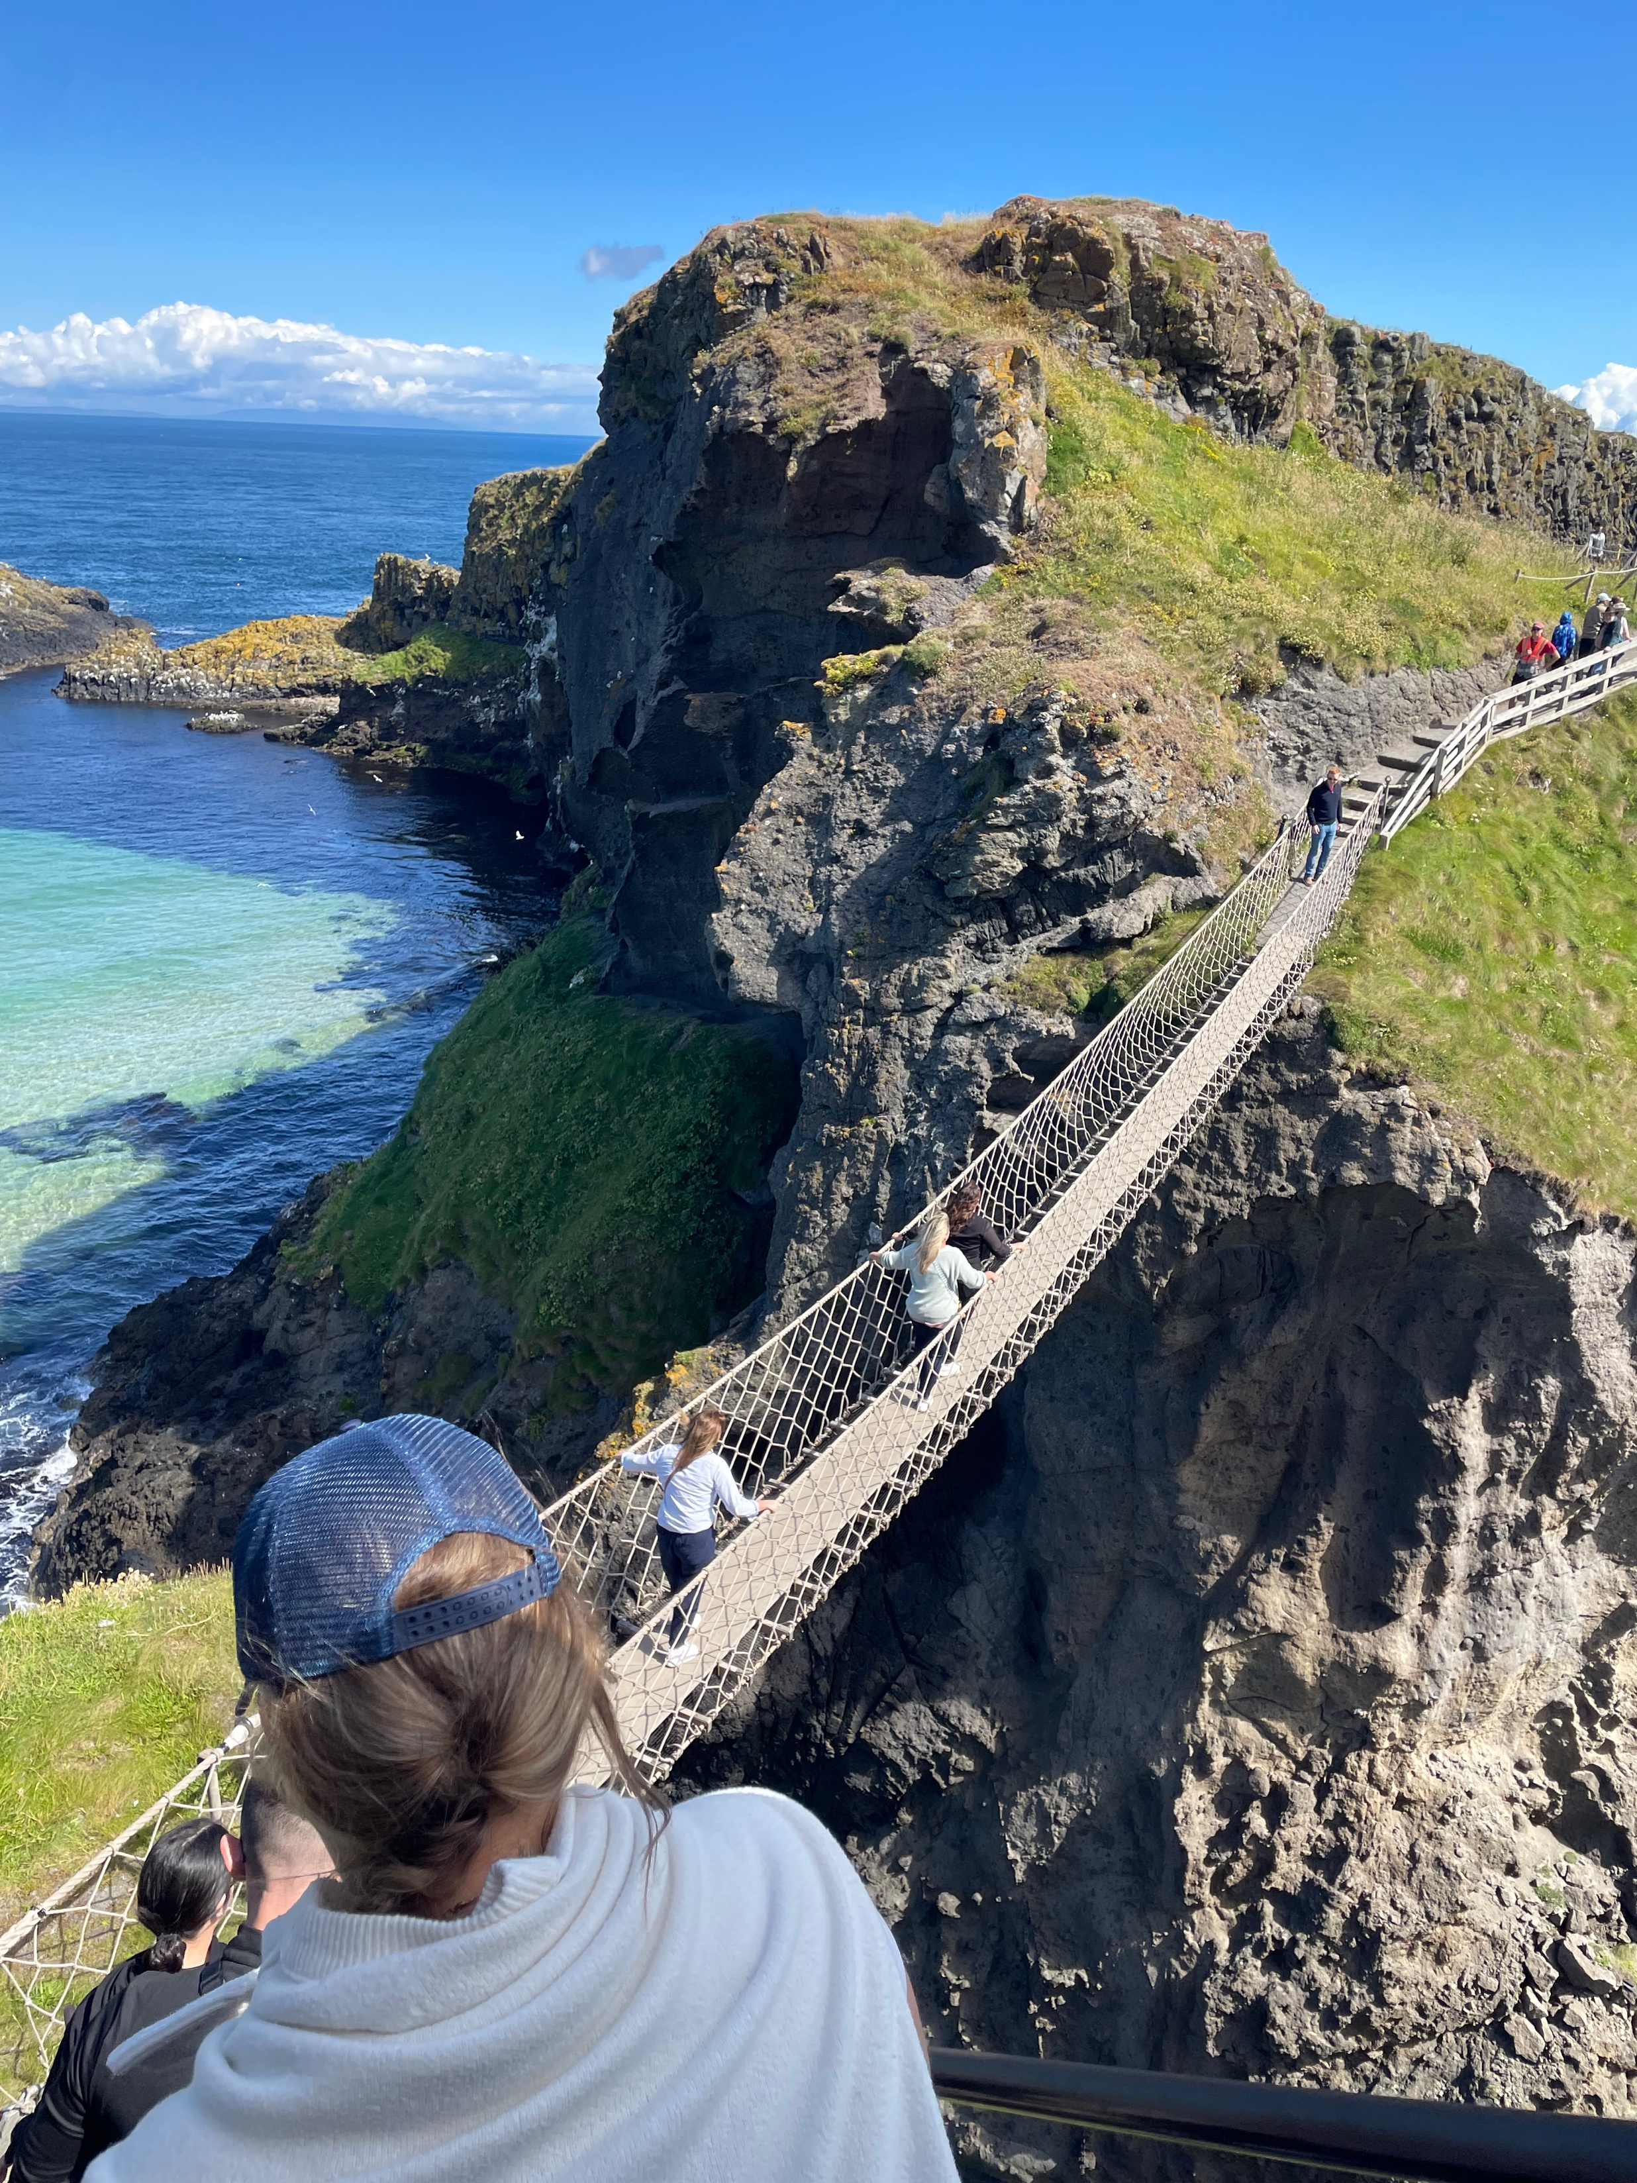
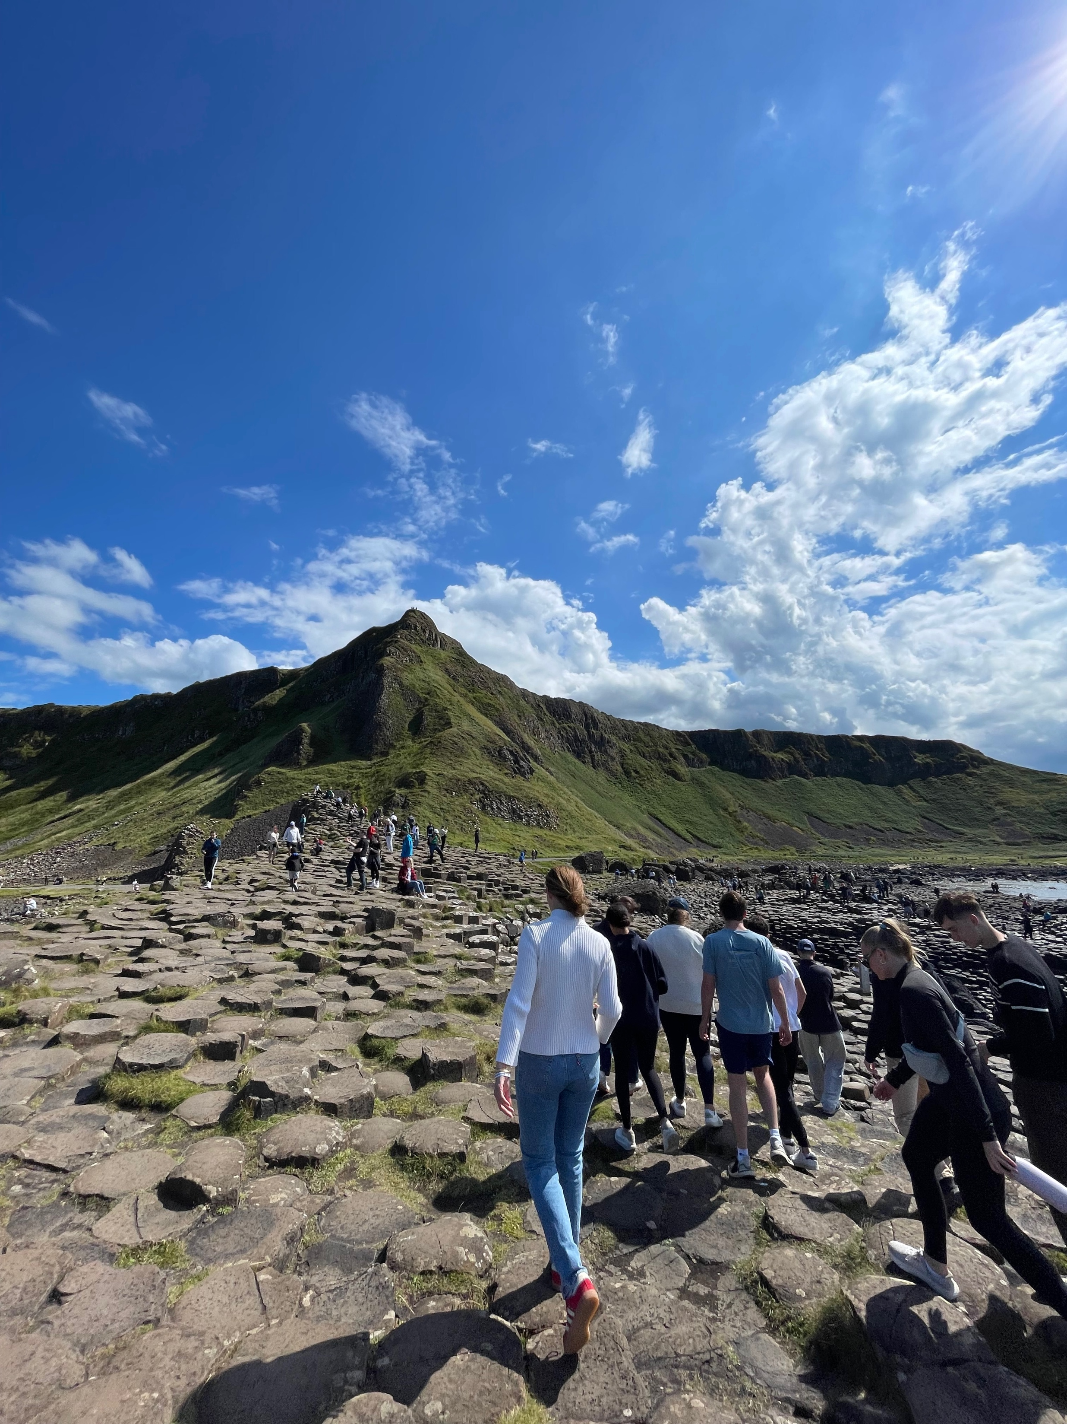
Bucknell in Dublin, Summer 2024
Margaret Williams
Bucknell University, Class of 2026
Abstract
The Bucknell in Dublin program offered a unique blend of classroom and experiential learning, covering topics from history and culture to religion and management. Through writings and classroom discussions as well as museum visits and weekend trips, we became intimately familiar with Ireland’s history and its systems and operations today. Led by Associate Dean Ivy Kepner of the Freeman College of Management and Professor Joe Wilck of the Analytics & Operations Management department, and with tremendous assistance from the team at Connect-123, the eight weeks spent in Ireland were some of the most rewarding of my life; I grew personally and professionally while immersing myself in a new culture alongside 28 other Bucknellians who are now some of my closest friends.
Course Work
Internship
Cultural Events
Exploration
ANOP 315: Guinness to Globalization
ANOP 315 discussed the history of Ireland with a concentration on operations and supply chain management. Our studies focused on eight monumental eras spanning from the Pre-Industrial Period to Brexit and the 21st Century. Outside of the classroom, the course was supplemented with experiential learning with weekly museum visits to the Jeanie Johnston Famine Memorial, The National Museum of Ireland, the Guinness Storehouse, and many others.
Each week, we were required to produce 1–2 page reports on certain time periods, connecting them to our internship and the field trip that week. We also did several case studies to better understand supply chain management in the 21st century. At the end of the trip, we completed a 10 page paper culminating the history of Ireland and our experience as a whole.
MGMT 290: Global/Society/Culture
MGMT 290 explored management in Ireland through individual eight-week internships. As students, we pursued internships across many fields and in various parts of Dublin. The course was enhanced with weekend trips throughout Ireland, including to the Cliffs of Moher, the Aran Islands, Blarney Castle, and Northern Ireland to name a few.
For this class, we were asked to write weekly blogs summarizing our internships, field trips, and weekend explorations. We also acquired several LinkedIn learning certificates to enhance our global leadership and management skills.
I interned at a company called 4Property, a real estate-focused holding company that specializes in all elements of the Irish real estate market, from marketing and property valuation to data collection and trend analysis.
My day-to-day responsibilities varied, but often involved research, website design, and customer support for each of the holding company’s business units. I worked directly with the CEO and alongside several other interns, two of whom also stayed at UCD.
Of note, 4Property is located on Baggot Street Lower in Dublin 2. This meant I was about a 25 minute bus ride from UCD’s campus and just a short walk from landmarks like St. Stephen’s Green and Grafton Street, putting me in a prime location for lunch hour explorations. I was also fortunate to work near fellow students, so we often commuted together and met up for lunch.
To better understand Irish culture, we supplemented our classroom learning with weekend trips around Ireland and visits to various museums each Monday. In total, we toured six museums, attended four program-wide dinners, played two famous Gaelic sports, explored countless castles, and visited 22 locations.
One of my favorite weekends revolved around our trip to the West Coast. In just three days we went to Galway, the Cliffs of Moher, the Burren, the Aran Islands, Connemara National Park, Kylemore Abbey, and Killary Sheep Farm. The small size of the island made it easy to travel from coast to coast and allowed us to see most of the country in just two months.
Our visit to Northern Ireland was particularly educational. We did a Black Taxi Tour through Belfast, which took us to some of the most important historical sites from a period that’s now known as “The Troubles.” Most notably, we saw (and signed!) the peace walls that still separate the Catholic population from the Protestant population.
We also crossed the Carrick-a-Rede Bridge and toured Giant’s Causeway, both of which were favorites from the entire trip.
During our free weekend, a group of us booked a trip to Amsterdam. The convenience of travel between countries in the European Union made the trip pretty seamless and allowed us to spend as much time in the Netherlands as possible. Some favorites from the weekend include a visit to the Anne Frank Museum, a canal tour, and the Heineken Experience.

