Slide 1

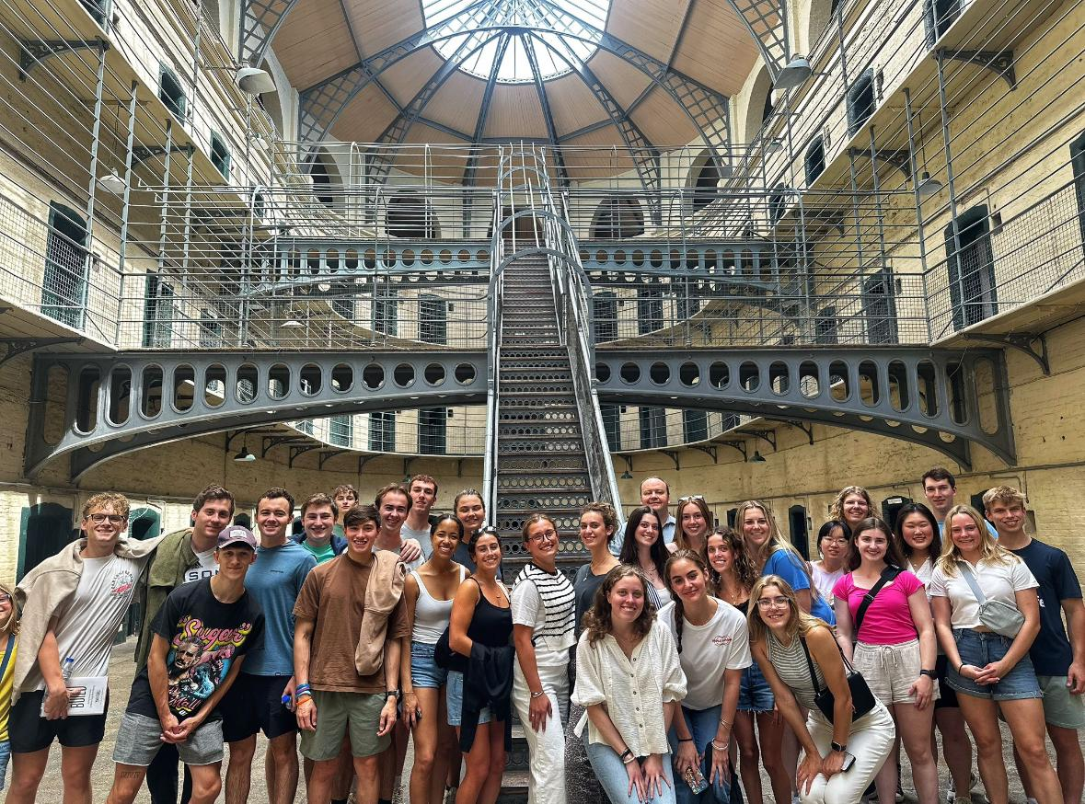

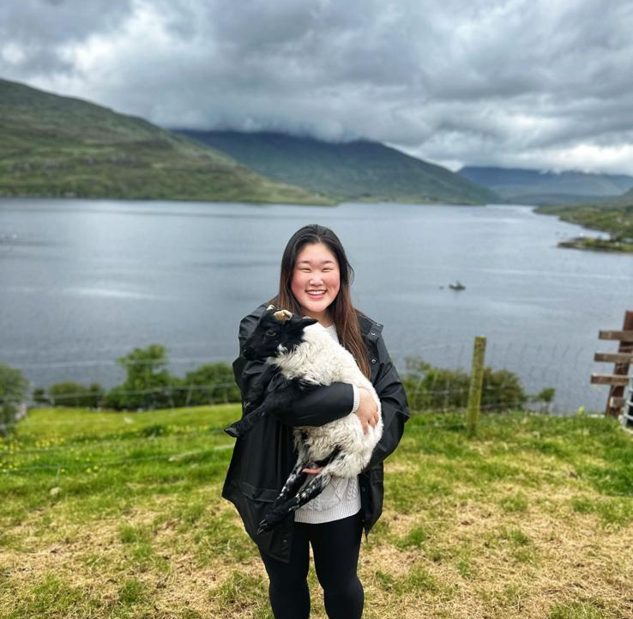
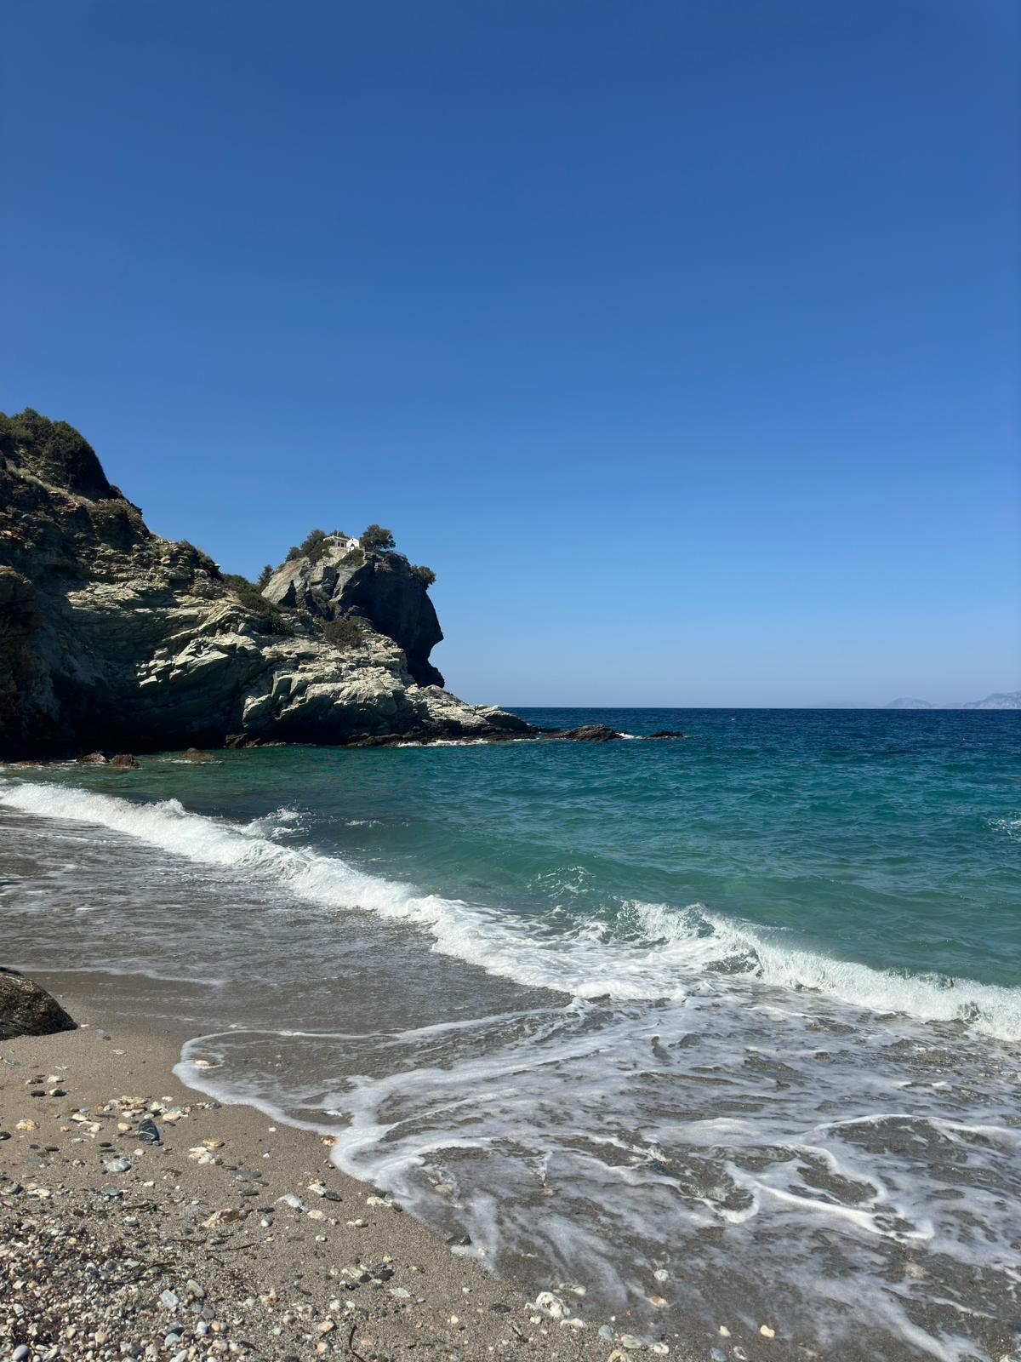
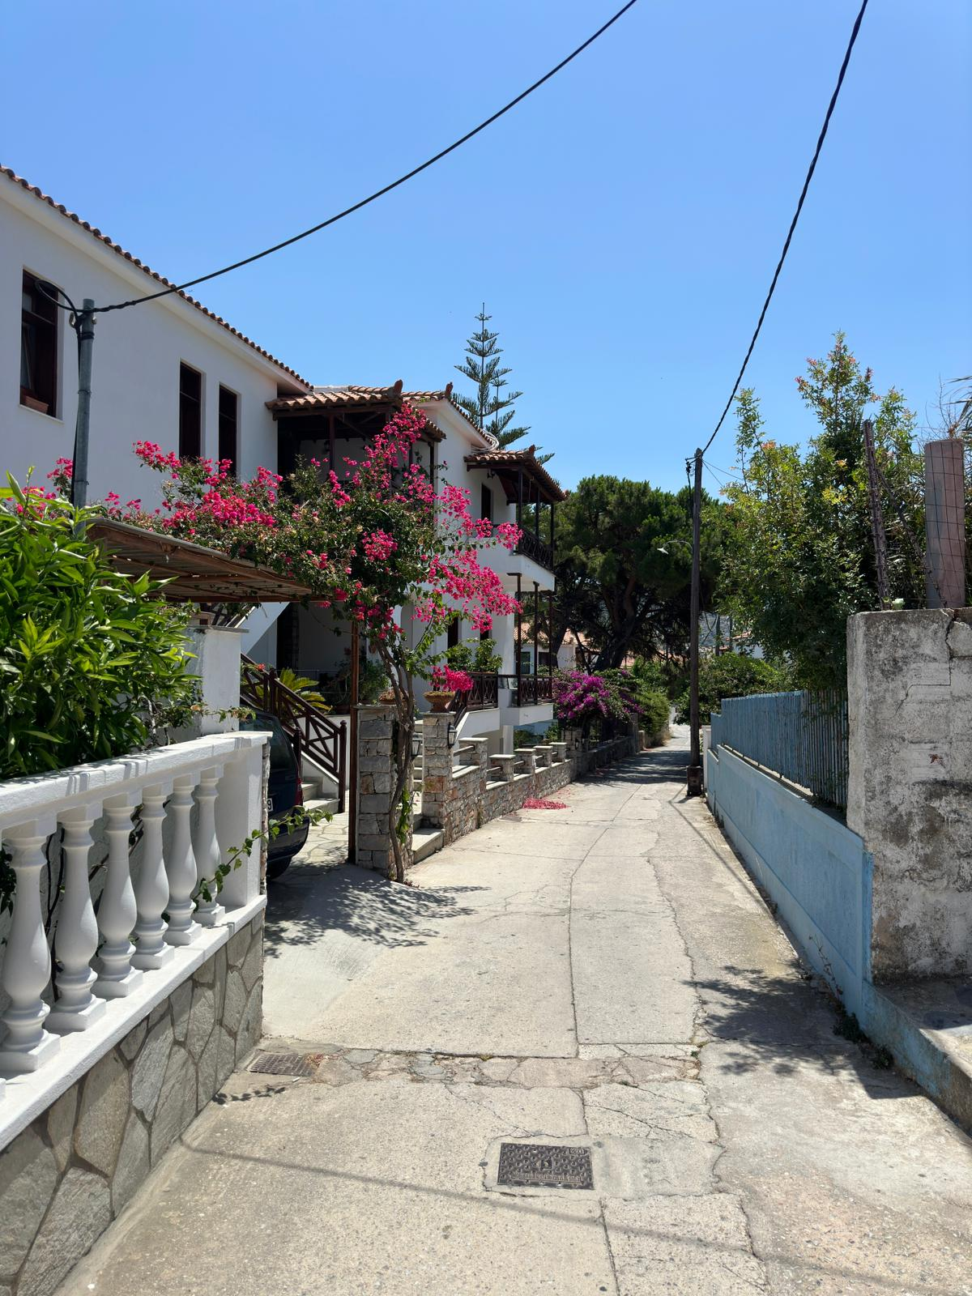
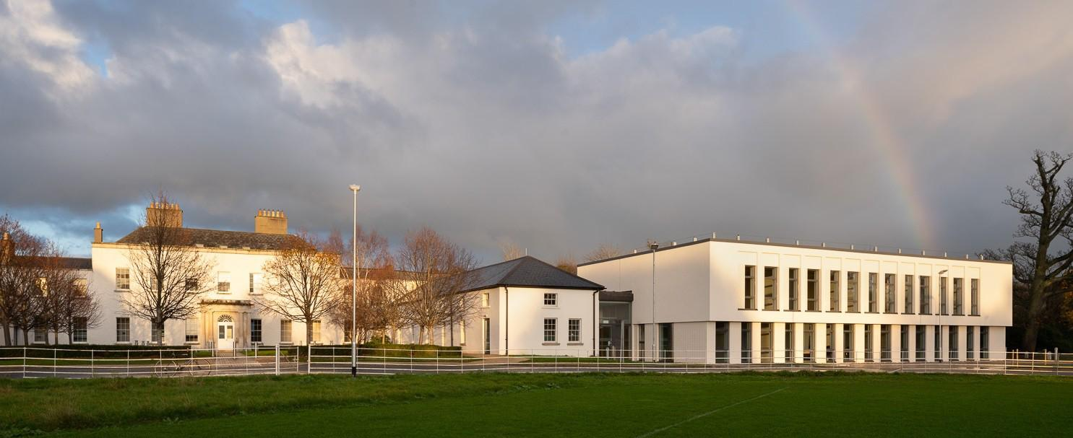
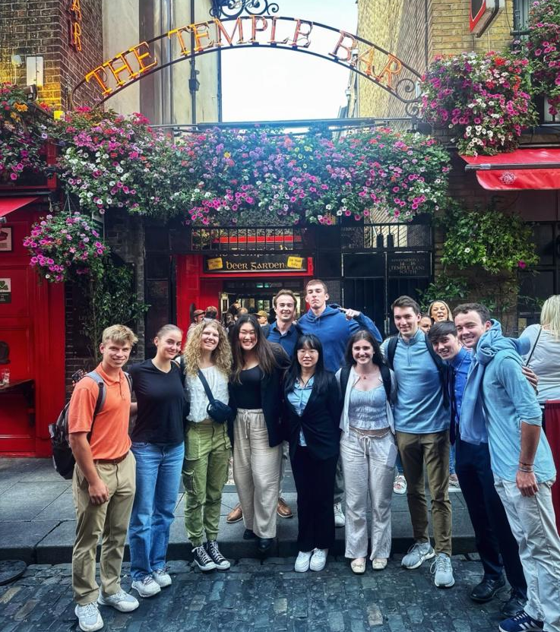
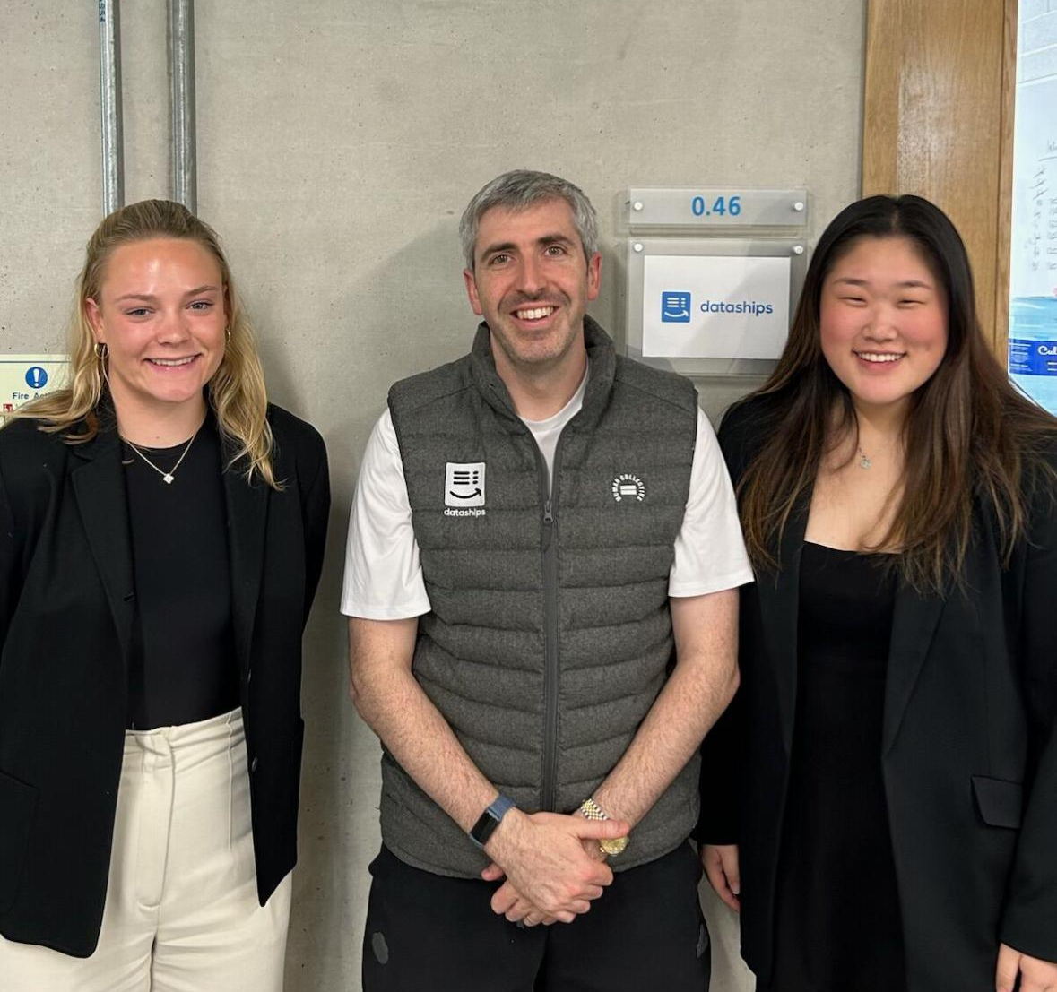
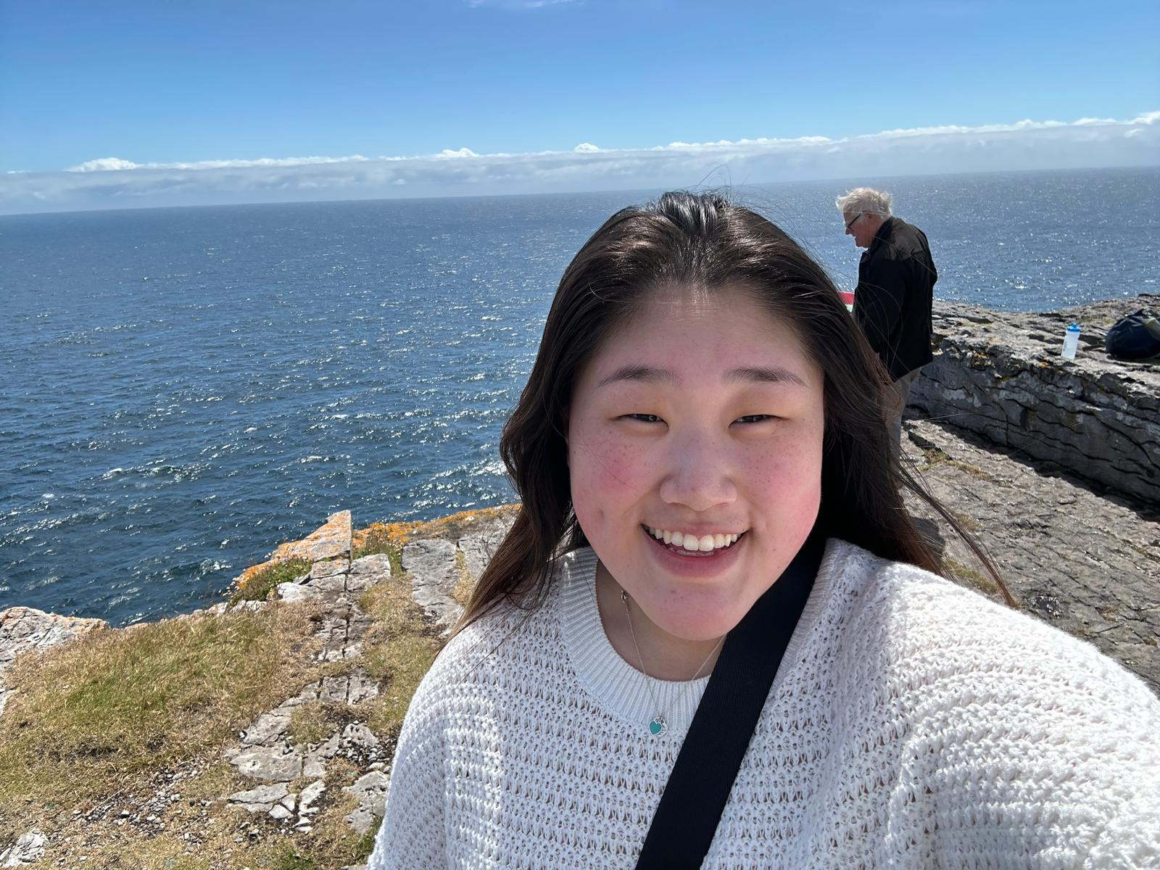
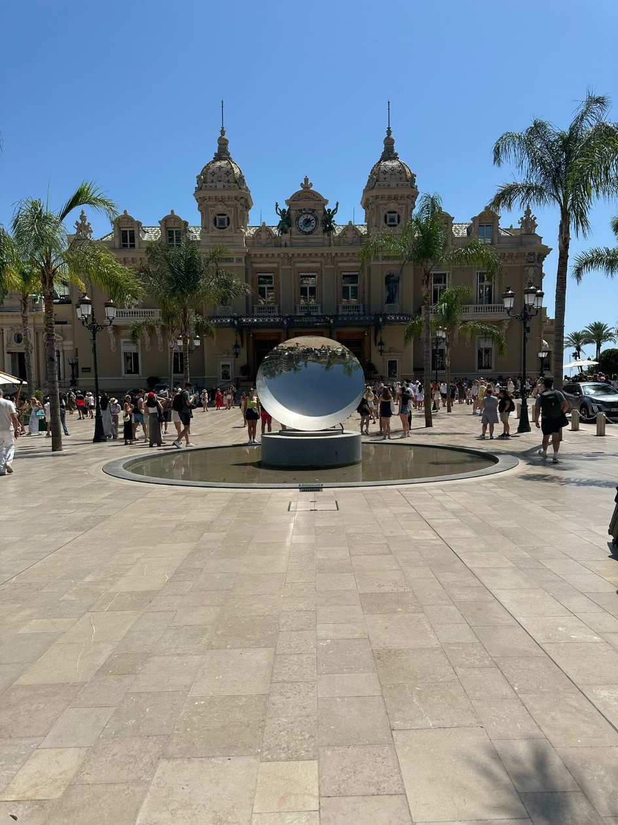
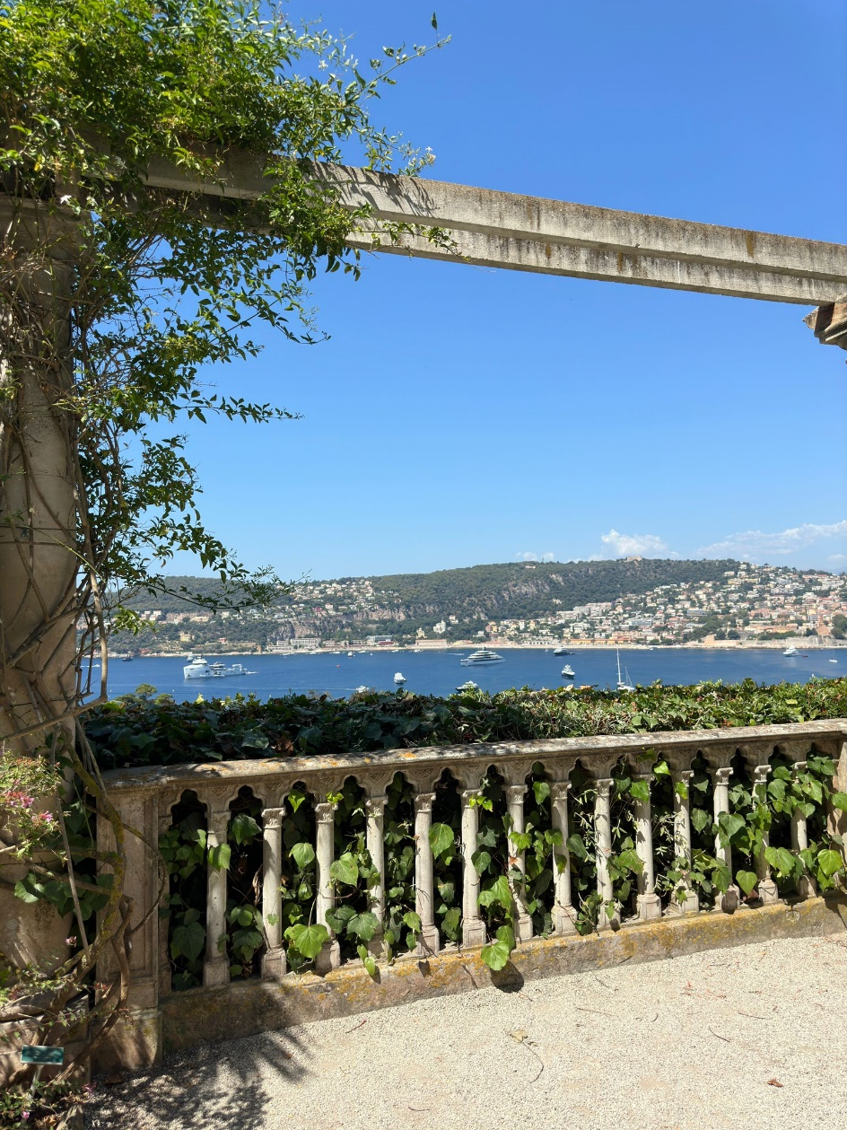
Bucknell in Dublin Summer 2024
Stella Chang
sic003bucknell.edu
Abstract
The Bucknell in Dublin program cemented the idea that coming to Bucknell was the right decision for me. I have made lasting friendships, traveled the world, and put my coursework to use in an international internship. My work at Dataships has shown me the importance of communication, teamwork, and taking initiative, while my courses helped me gain a deeper understanding of Ireland’s rich and complex history. I am so grateful to Bucknell for offering this program to first-year students and for Professor Joe Wilck and Dean Ivy Kepner, as I truly believe my experience would not have been this enriching and enjoyable without them. My time in Dublin was truly one of the best summers I have ever had, and I look forward to taking advantage of more opportunities within Bucknell and the Freeman College of Management.
Course Work
Internship
Cultural Events
Euro Summer!
Overview:
2 full credit Bucknell courses: ANOP 315-Guinness to Globalization and MGMT 290-Management in a Global, Societal, and Cultural Context
Specifications:
ANOP 315: Combination of in-class discussion/lecture, field trips, case studies, weekly writing assignments, and a final paper
MGMT 290-Management in a Global, Societal, and Cultural Context: Consisted of an internship, weekly blog posts, a paper, and cultural experiences
Dataships- Financial Accounting and Business Support Intern
Responsibilities:
Utilized data enrichment tools such as Apollo and Lusha to gather contact information for our sales team
Conducted research on industry standards and compared it to internal data to find weaknesses and strengths in the performance of our clients
Created pitch decks for potential clients showing the value proposition and product offerings of Dataships
Highlights:
Dataships achieved a revenue of 1 million dollars on June 12! We all went out to have celebratory pints and a big company dinner
The Republic of Ireland:
Dublin experiences such as the Jeanie Johnston Museum, EPIC Museum, the Guinness Storehouse, and the Kilmainham Gaol Prison
Excursions to the Wicklow Mountains, Blarney Castle, Celtic Boyne Valley, Howth, and the Cliffs of Moher
Overnight trip to Galway
Northern Ireland:
Day 1-Belfast
  Titanic Museum
  Political taxi tour
Day 2
  Carrick-a-Rede rope bridge
  Giant’s Causeway
Greece:
3-day trip to Skopelos and Skiathos
Went to the Mammia Mia church, saw gorgeous beaches, and had the most amazing food!
Scotland:
Day trip to Glasglow
Saw Loch Lomond, Trossachs, Stirling Castle, and highland cows!
France:
Spent time in Grasse, Cannes, Antibes, Saint Jean Cap Ferrat, Èze, and Beaulieu!
Monaco:
Spent time in Monte Carlo and got to see the Prince’s Place, the Casino, and the F1 track
Italy
Went to Ventimiglia where I spent the afternoon at the most beautiful beach

