Slide 1

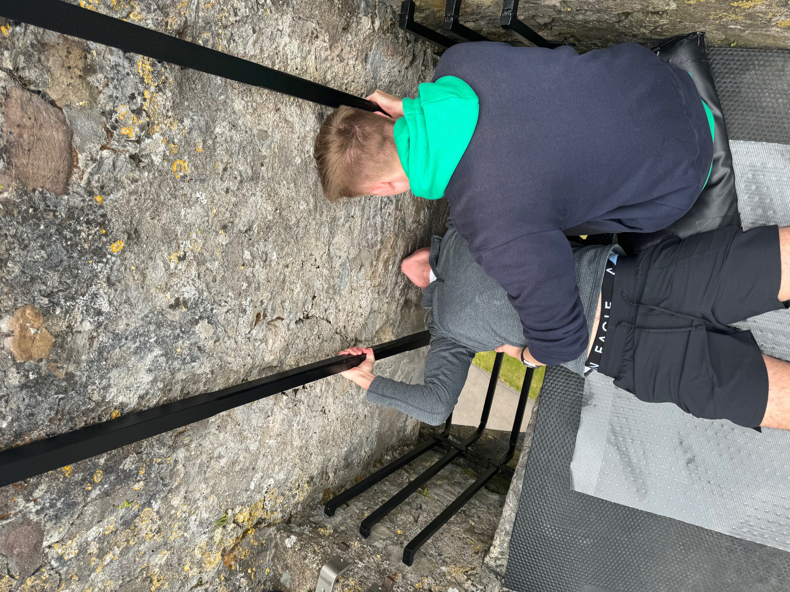
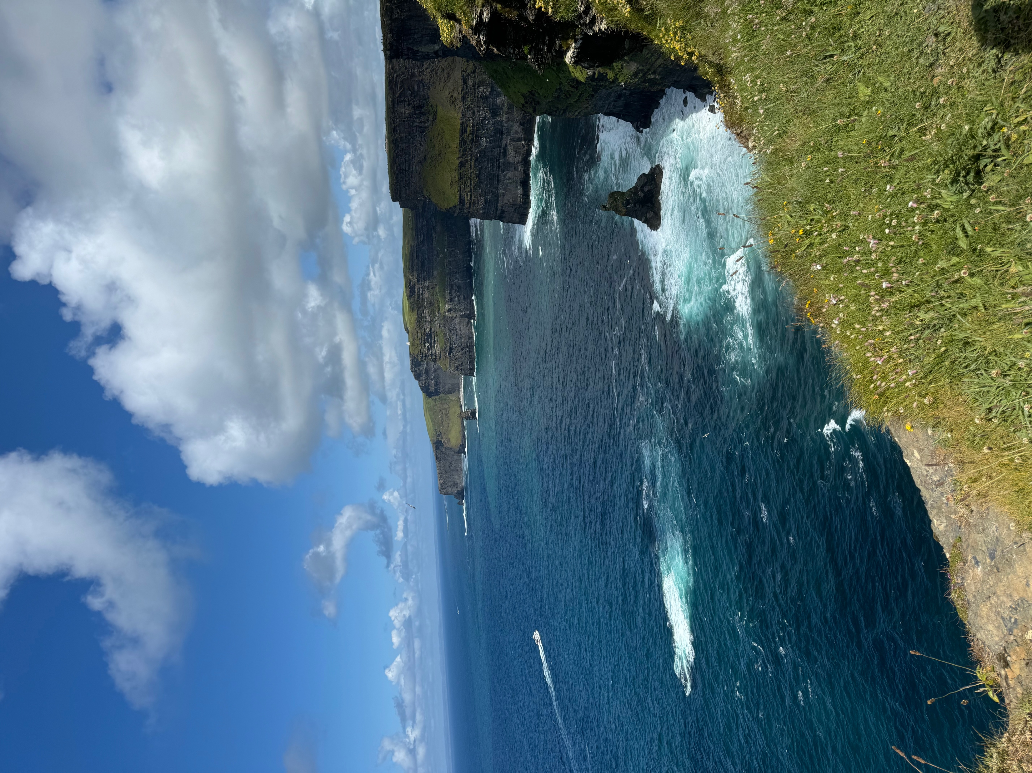
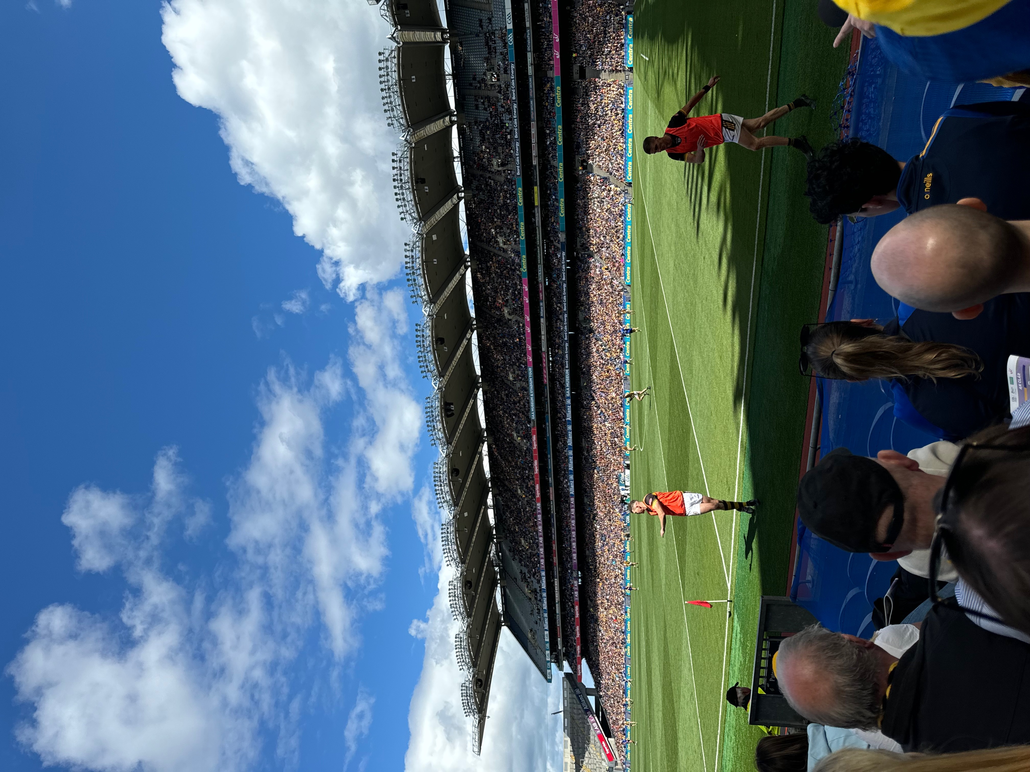
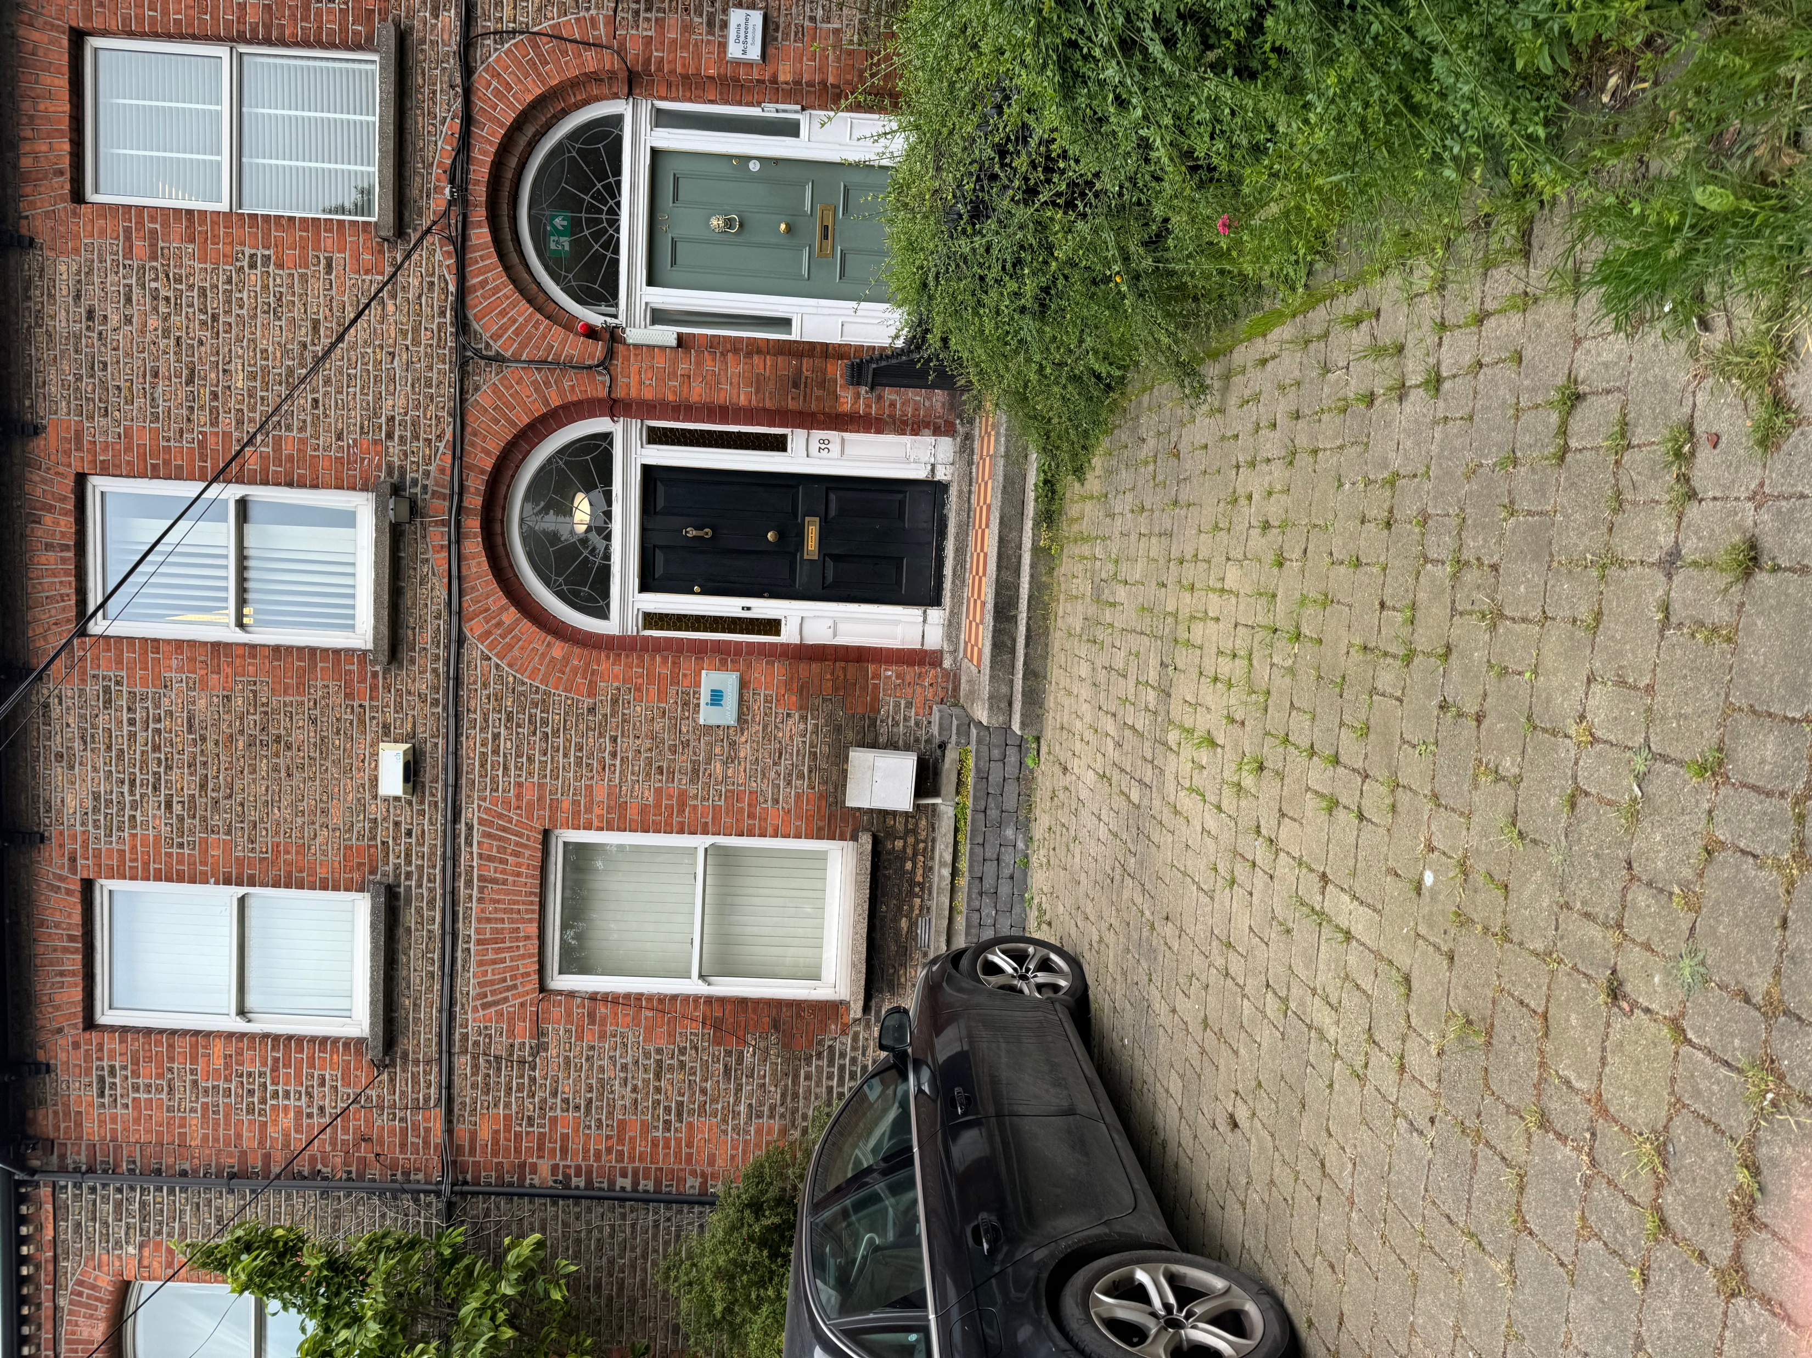
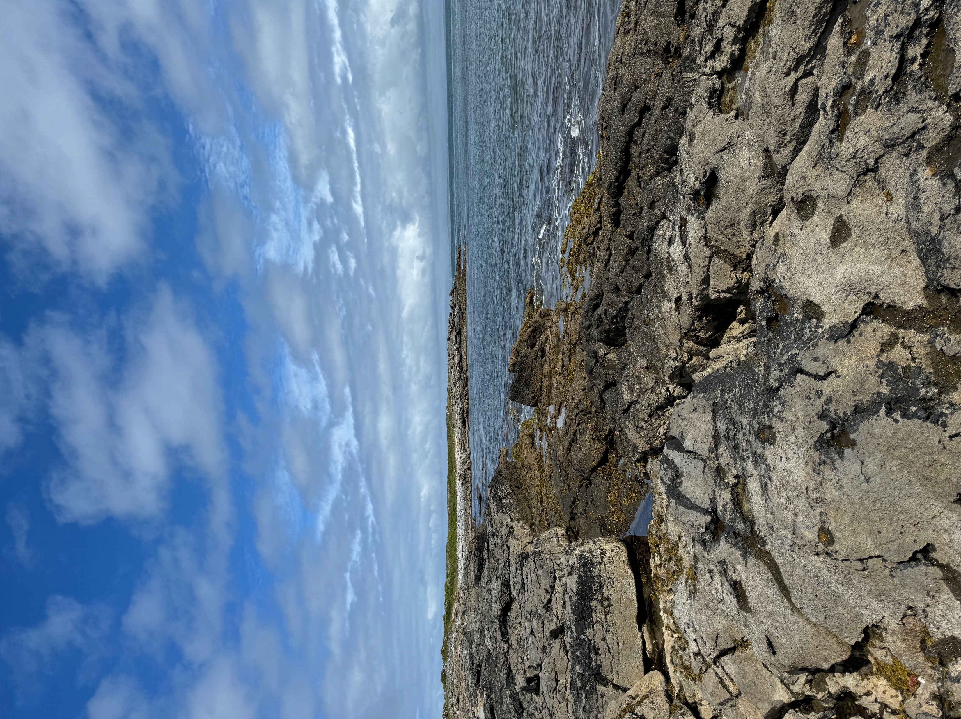
Bucknell in Dublin
By: William Shoemaker
Department of Economics, Class of 2026
Abstract
My time here in Dublin was 8 weeks, starting January 1 and leaving at the end of July. We stayed at the University of College of Dublin, situated just south of the city. We stayed in Apartments on campus, with 5 other people. During this program, we earned 2 credits, while also completing an internship. Each week, we had class on Monday and worked at your internship for the rest of the week. We did nearby field trips throughout the week, and traveled around the country on the Weekend. Some of the major places that we visited outside of Dublin included Galway, Belfast(UK), Wicklow Mountains and Kilkenny. We experienced everything that Ireland has to offer, and enjoyed every single minute of it.
Course Work
Internship
Cultural Events
Favorite Spots
Guinness to Globalization- ANOP 315
Overview:
This course talked about the historical management of operations and services in Ireland. We talked about the basic supply chain management, like agriculture and manufacturing.
Time periods:
We talked about different time periods in Ireland and they shaped the current state of the country today. Some examples of a couple of periods were the ”Troubles”, and Brexit. We connected these time periods with the field trips we had throughout the week.
Weekly Writing Assignments:
Each week, we had to write a one page paper on a given time period, and connect with the field trip and your internship during that given week. This would then later help us shape our final paper, covering all of the time periods.
Case Studies:
Each week we did a case study, going over different supply chain and operations management within a company. We did case studies on 7-11, 1-800 flowers, and Comcast. We would do these in groups, and discuss them in detail during class
Final Paper:
This paper was 10 pages long, highlighting each time period, and relating it to everything we saw in Ireland. We also talked about our own experiences, and how we progressed throughout the trip,
Company: JW Accountants
38 Grand Canal Street Upper
Finance and Funding Intern
Work Week: Tuesday to Friday 9-5
JW Accountants specializes in corporate finance, examinership, and liquidation, helping companies sell their assets and bonds to help them make a financial recovery.
As an intern:
Prepare documents for liquidation cases
Collate information for preparation of financial statements
Creditor reconciliation and data processing
Cliffs of Moher
One of my favorite spots that we went to was the Cliffs of Moher, situated on the west coast of Ireland. The cliffs stretch out to 9 miles, looking out to the Atlantic Ocean and the Aran Islands. You can see waves crashing on the rocks, and birds diving in the ocean
t
Kissing the Blarney Stone was definitely something
I wanted to do coming to Ireland. Kissing this stone
gives you the gift of Gab (Great Eloquence or skill
of flattery).
The Aran islands
The Aran Islands are situated on the West coast of Ireland, near Galway. Here, we rented bikes, exploring the entire island. The Aran Islands are known for their beautiful landscapes and wildlife.
.
The Semifinal Hurling match between
Kilkenny and Clare will be something I will
not forget. Watching a whole new sport, and
Learning while the game was going on was
awesome.

